Slide 1
Tau Beta Pi
The Engineering Honor Society
Integrity & Excellence in Engineering

Slide 2
What is Tau Beta Pi?
1885 - founded at Lehigh University
2014 - 242 chapters & 554,000 members
UMBC = MD-D chapter
Recognizes exceptional engineers and students with exemplary character!

Slide 3
Perks
Scholarships
Fellowships
Career Assistance
Leadership Opportunities
Leadership Training
Service Opportunities
Networking
Newsletter & Magazine
Stole at Graduation
AND WE HAVE FUN!!
Notes:
Visit tbp.org for more information

Slide 4
TBP Social Activities
UMBC Movies
The Hobbit: Battle of the Five Armies 3/26 - 3/28
Into the Woods 4/9 - 4/11
American Sniper 4/16 - 4/18
Game Day - March 13 @ 1-3 PM in ENGR 112
There’s gonna be pie & pizza!
Laser Tag (TBD)
Orioles Game - April 24 @ 7:05 PM
(Student Night!!)

Slide 5
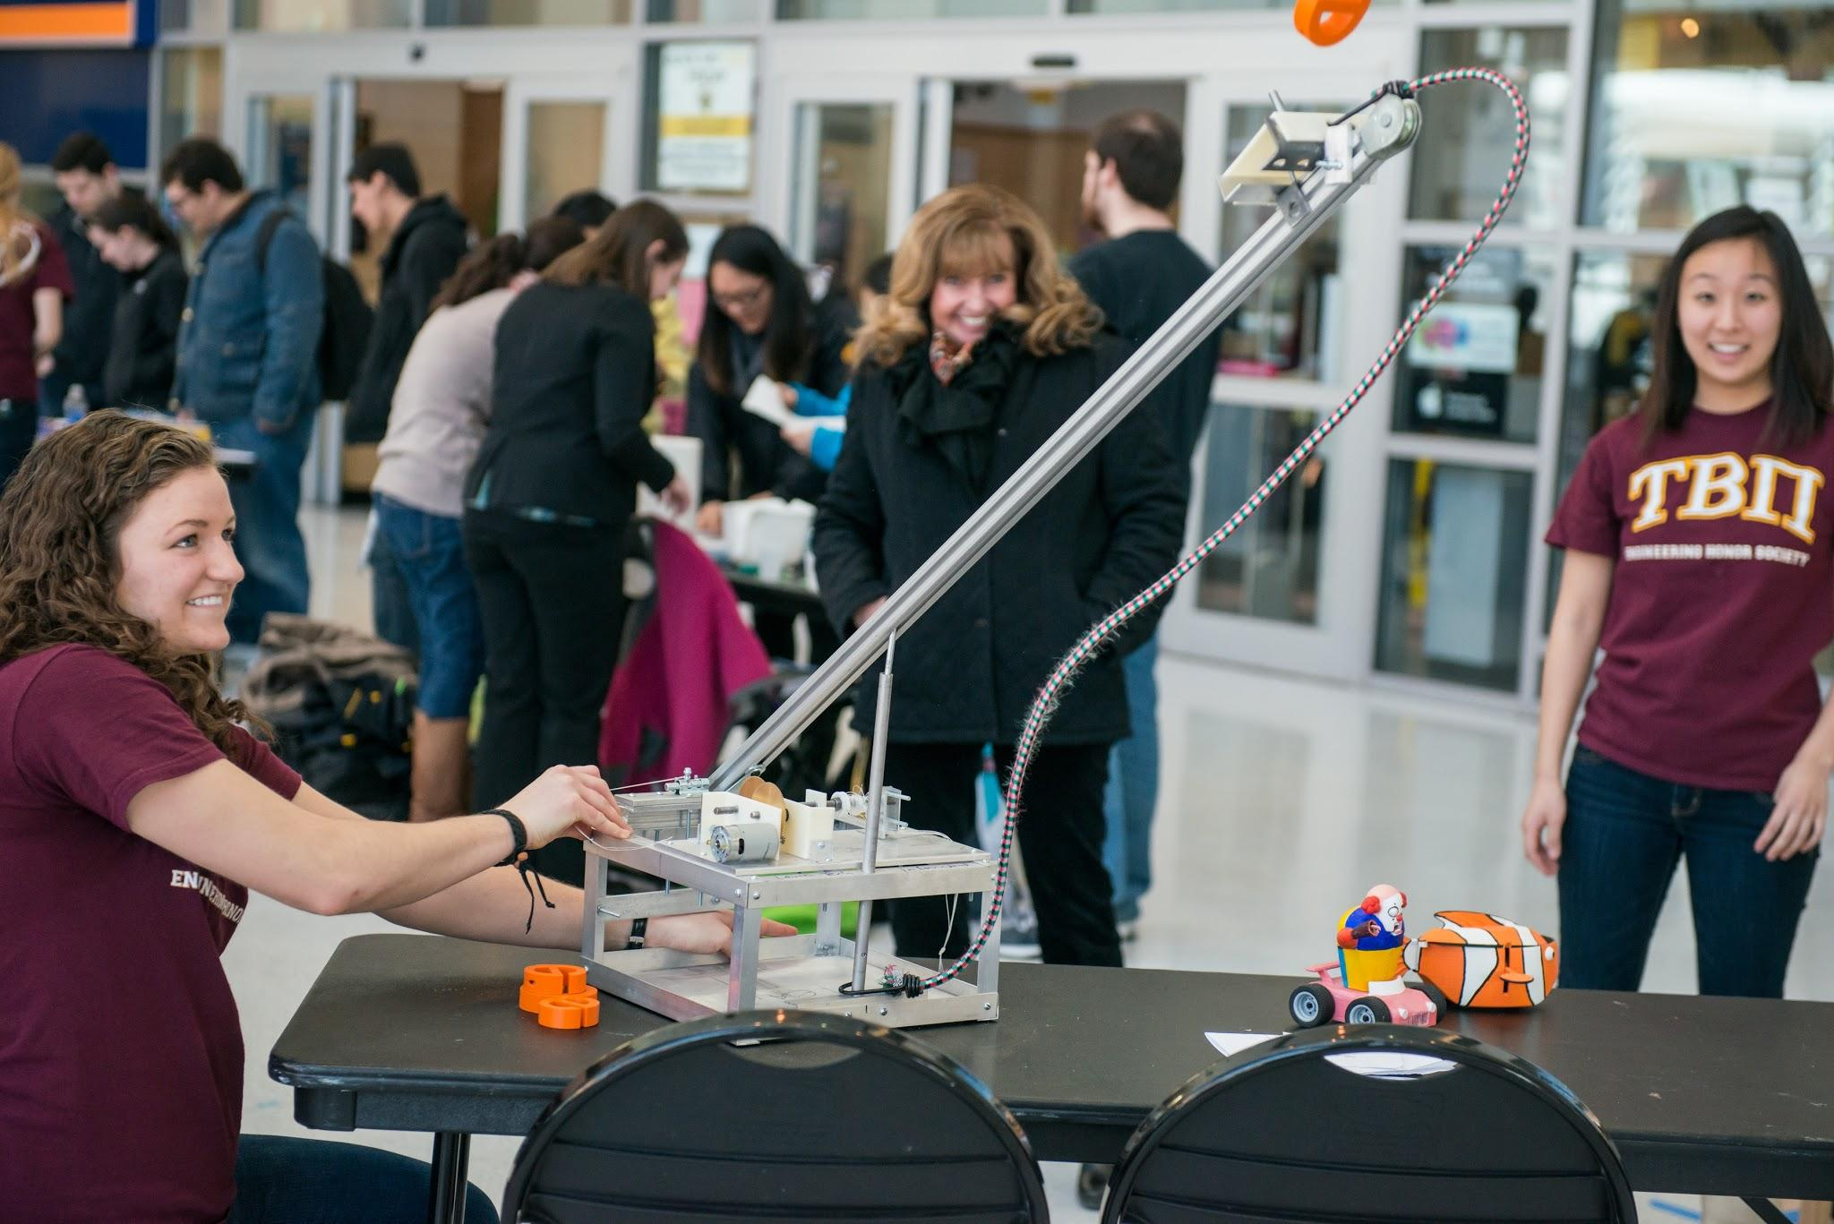
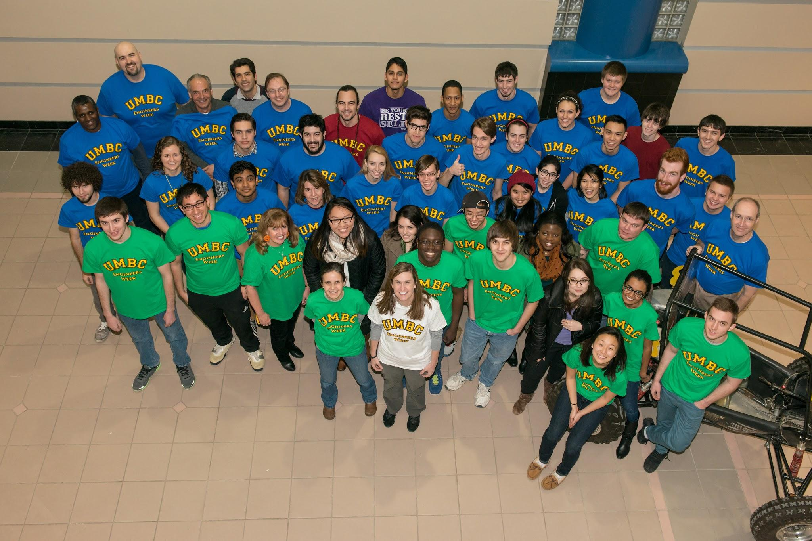
Engineers Week!
Tau Beta Pi hosted Engineers Week this year at UMBC!
T-shirts are still for sale - $5
photo by Marlayna Demond for UMBC
photo by Marlayna Demond for UMBC

Slide 6
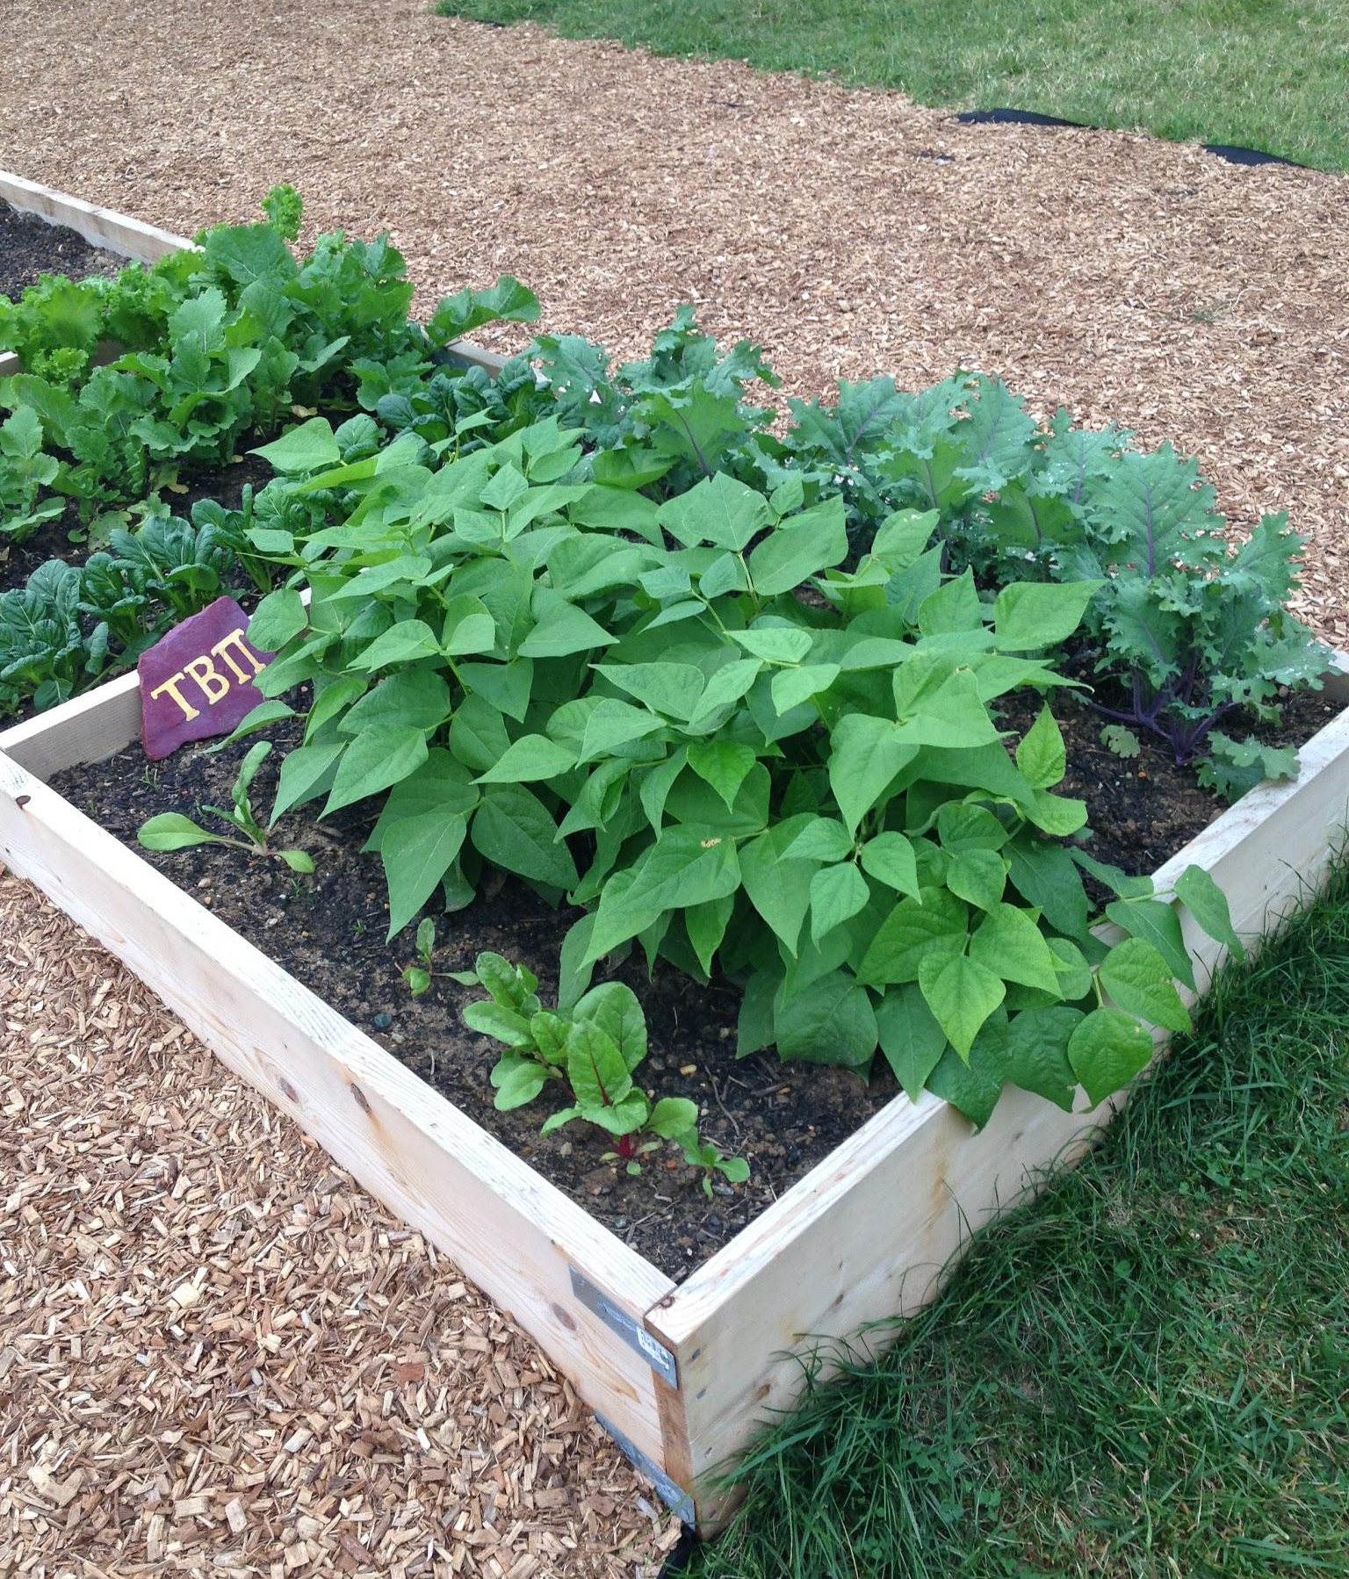
TBP Sponsored Events/Activities
The TBP Garden Plot
Tutoring/Mentoring opportunities
Service opportunities

Slide 7
Requirements for Initiation
5 hours of social activities
5 hours of service activities
Polish ‘The Bent’ (in front of ITE) ~Early April
Polish your personal bent
Member Signatures: get signatures from 3 TBP professors and 5 current TBP members
One time admission fee

Slide 8
Requirements for ‘Active’ Membership
5 hours of social activities
5 hours of service activities
Attend initiation each semester
Attend all GBMs

Slide 9
What To Do Now
Come to GBMs (every 3 weeks)
April 1 - 12pm - ITE 102
Service & social events, bent polishing and TBP Signatures
Catalog Cards
Pay attention to your emails!!

Slide 10
Questions??

