Slide 1
GBM #4
Tau Beta Pi - 4/1/2015

Slide 2
TBP - Active Status
5 Social hours
5 Service hours
Attend Initiation

Slide 3
Initiation
April 25th @ 11am!
Location: TBD
Business Casual

Slide 4
Officer Elections @ Initiation
President
Vice President
Treasurer(s)
Corresponding Secretary
Recording Secretary
Events Coordinator
Service Coordinator
Initiation Coordinator
Tutoring Coordinator

Slide 5
Tutoring Coordinator - Ken Foo
Coordinate tutoring for underclassmen
Raise awareness for TBP in engineering classes
Poll which classes we can tutor
Arrange tutors to tutees on an individual basis
Show up to events
Assist with any other duties necessary
Printing out documents, smuggling eating utensils, bent polishing, and etc

Slide 6
Initiation Coordinator - Anthony Nguyen
Plan Initiation
Reserve rooms
Contact the catering company
Hold interest meetings
Bent Polishing
Required reports
Eligibility report
Catalog cards
Communicate with the initiates

Slide 7
Service Coordinator - Jeremy Fedors
Plan TBP Service Activities
Attend and supervise TBP service activities
Make sure the events are carried out as planned
Record attendance
Make non-TBP service activities known
Fill out project reports

Slide 8
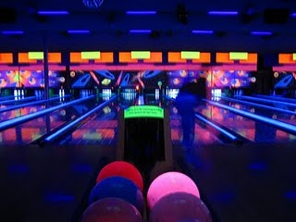
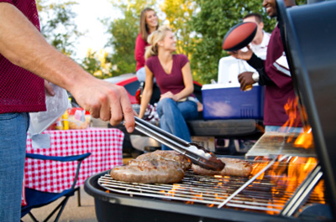
Events Coordinator - Kevin Johnson
Organize social events and advertise them in various ways
Keep track of who attends which events and for how long
Work with other officers to organize fundraising events
Assist with any other tasks the officers need assistance with

Slide 9
Recording Secretary - Vanessa Mackley
Main Roles
Keep track of attendance and requirements
Take meeting minutes
Bulletin board upkeep

Slide 10
Corresponding Secretary - Stephanie Bonadies
Required Reports
Submit to HQ for a grade!
Eligibility, election, final action, ratification ballot, project reports, etc.
Communicate with:
Other chapters
District directors
TBP HQ
Corporations, etc.

Slide 11
Treasurers - Jacob Alvarez & Victoria Yun
Senior Treasurer
Bookkeeping
Manage payments to TBP national
Financial Report
IRS 990-N Form
SBS Account
Junior Treasurer
Assist & receive training from Senior Treasurer
T-shirts
E-Week advertising
Fundraising

Slide 12
Vice President - Stephen Vicchio
Work closely with the President
Mentor and support the new officers
Communicate with the TBP advisors

Slide 13
President - Sarah Hemler
Oversee all of chapter operations
GBMs, Officer Meetings, Initiation, Engineers Week, etc.
Coordinate with Corresponding Secretary for communication with HQ
Communicate with advisors

Slide 14
Updated: Social Events!
UMBC Movies
Into the Woods 4/9 - 4/11
American Sniper 4/16 - 4/18
Laser Tag (TBD)
Orioles Game - April 24 @ 7:05 PM (Student Night!!) Chipotle Fundraiser? (TBD)
Kesha Concert- April 26 at 7pm!

Slide 15
Tutoring
Are you interested in tutoring some budding engineers? Or in helping with a tutoring session?
If you are interested in tutoring, please fill the form or speak to Ken Foo at the end of the meeting.

Slide 16
Service Opportunities
April 2nd (tomorrow)- Let’s Get Techy
April 20-23, URCAD
The Samaritan Women, date TBD
April 29th- Blood drive, 8AM-9PM
April 30th(?)- Lakeland Elementary/Middle Stem Day

Slide 17
The Garden!
If you are interested in helping this semester, please see Stephanie or Sarah after the meeting.

Slide 18
Bent Polishing
April 13 (12-1 pm) and 17 (12-1:30 pm) @ ITE Building

Slide 19
TBP - Scholarship Opportunity
http://www.tbp.org/scholarships.cfm
Deadline: May 1st

Slide 20
TBP T-Shirts
Available for $10 cash please
Just restocked on all sizes!
Contact Victoria Yun at vyun1@umbc.edu if you would like a shirt
Wear it to GBMs!

Slide 21
Eligible Initiates
5 Service & 5 Social Hours
Bent Polishing
Catalog Cards by 4/8
Must attend initiation

Slide 22
Next GBM = April 22nd
ITE 102 - 12:00pm
*Don’t forget to join the TBP my UMBC page!

