Slide 1
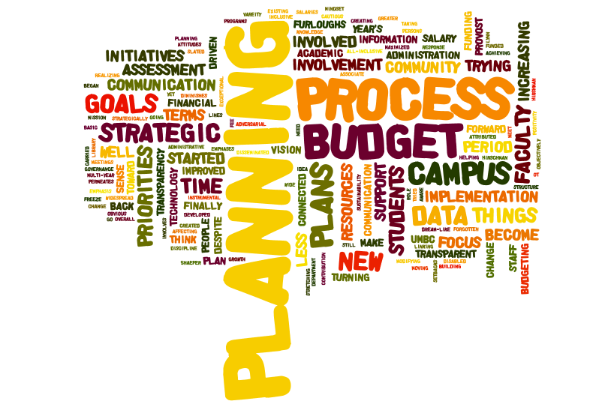
http://alumni.umbc.edu/retreat Tweet the Retreat at #UMBCretreat

Slide 2
What was the campus planning process like 1998-2002?
Top-down
Identity: “Institution was trying to come to grips in terms of an identity.”
Fragmentation
“silos”
“task-forces”
“little integration”
http://alumni.umbc.edu/retreat Tweet the Retreat at #UMBCretreat

Slide 3
What was the campus planning process like 1998-2002?
“A time of continuous financial growth and funding” vs. “The campus was very budget-focused. It was a big priority.”
Entrepreneurial
Planning not linked to budget
http://alumni.umbc.edu/retreat Tweet the Retreat at #UMBCretreat

Slide 4
1998 – 2002: Drivers THEMES
Political support and climate
Support of Gov. Glendening was a supportive driver
Campus itself: Ability to build new buildings (e.g. Public Policy, ITE, etc.)
Resources were the same as had been in previous decades
Advances in technology, communication & infrastructure
Enhanced IT infrastructure
Broader sweep of communication and tools
Effort to get research better supported – infrastructure
Expansion of dorms
“Attempting to procure more resources such as graduate assistants, better lab space, etc.”
Access to data improving
http://alumni.umbc.edu/retreat Tweet the Retreat at #UMBCretreat

Slide 5
1998 – 2002: Drivers THEMES
Collaboration & encouraging change and innovation
Faculty working together across disciplines
“Continual input of young faculty and staff acts as a driver to at least start the discussion & take risks of trying new techniques”
Junior faculty and staff are encouraged to innovate and participate
Shared governance
Pioneering
Honors University task force made recommendations, which was a positive force
Identity and becoming an Honors University
Defining what “honors university” means: “The excellent guidance of our esteemed President was an instrumental driver in reaching this vision.”
Establishing idea that all students would be assisted
Retention was starting to become a primary focus
Focus on student learning
Ambitious and “leap before we look”
http://alumni.umbc.edu/retreat Tweet the Retreat at #UMBCretreat

Slide 6
1998 – 2002: Barriers THEMES
Top-down leadership structure with poor communication and low
levels of faculty/staff engagement
“Distance between faculty/staff and the planning administrators.”
Lack of coherent vision for UMBC’s identity, including our role in
USM
“…there were multiple opinions and directions and people could listen to what they wanted to.”
Insufficient resources and lack of framework for effectively
deploying available resources during rapid growth
“leap before we look”
http://alumni.umbc.edu/retreat Tweet the Retreat at #UMBCretreat

Slide 7
What was the campus planning process like 2003-2007?
CONTINUED: focus on task-forces
NEW:
Process became “inclusive of various campus populations (students, faculty, staff, alumni)”
“Shared governance has become stronger.”
“More integration across campus, departments, Deans valuing, looking to departments for ideas”
“Air of excitement because UMBC finally seemed to be coming into its own.”
http://alumni.umbc.edu/retreat Tweet the Retreat at #UMBCretreat

Slide 8
What was the campus planning process like 2003-2007?
“More intentional and purposeful”
Focus on master plan, 2016
Assessment, data-oriented, comparison to peer institutions
Transparency
http://alumni.umbc.edu/retreat Tweet the Retreat at #UMBCretreat

Slide 9
2003 – 2007: Drivers THEMES
Infrastructure, Fundraising & Technology
Campus infrastructure (e.g. residential facilities, academic buildings, parking, etc.)
Fundraising increased
“Linking fundraising with student dorms with student success.”
Increased parking and 4 acres of court house property
“Driver - PS implementation (2005-2007) facilitated electronic transmission of student, financial, personnel and demographic data to internal and external constituents (MHEC, USM) and improved campus reporting.”
New buildings shift away from commuter campus
Facilities master plan
Increased Research Profile
Research infrastructure and Chem and Bio renovations
Promise NSF grant for grad students and diversity
University research centers grow
New grants in JCET and GEST
http://alumni.umbc.edu/retreat Tweet the Retreat at #UMBCretreat

Slide 10
2003 – 2007: Drivers THEMES
Leadership & Planning
Embarked on our current 2016 Strategic Framework
New VP for Finance and Admin and Dean of Grad School
Plan for hiring faculty and staff
Attention to evaluation and data and accountability: Middle States
“Evolving leadership”
Planning and budget: regular processes, new program approval tied to planning and budget, Renegade Chairs group focused on planning & budget
“Putting IT and Engineering together and building the ITE building accommodated growth of STEM research and teaching.”
Technology and data management and reporting
http://alumni.umbc.edu/retreat Tweet the Retreat at #UMBCretreat

Slide 11
2003 – 2007: Drivers THEMES
Collaboration
“Because it was so confusing at the top people just found their own ways to get things done by going around formal structure...things happened through relationships.”
Departments engaging with Shriver Center and each other
“Don’t have entrenchment - young institution.”
Identity and Reputation
Reputation growing
“Late in this period students became drivers, our students seemed better, we recruited strong students and we saw them as dependable.”
Student retention important
“The growth left people feeling hopeful and allowed room to breathe. We started to get recognition.”
Chess team
“Basketball invitations to NCAA tournaments”
http://alumni.umbc.edu/retreat Tweet the Retreat at #UMBCretreat

Slide 12
2003 – 2007: Barriers THEMES
Lack of resources and conflict over resources, including a more difficult state political climate
Growing pains: Changes in university structure and tensions relating to UMBC’s role in the system, plus issues with implementing PeopleSoft
“Implementation of PeopleSoft, enormous impact on expenses, productivity, morale.”
Continued leadership issues resulting in infighting
“Mismatch between the implementers and the ‘people in the trenches.’”
http://alumni.umbc.edu/retreat Tweet the Retreat at #UMBCretreat

Slide 13
What was the campus planning process like 2008-2012?
CONTINUED: linking of planning and budgeting; transparency
NEW: “UMBC mindset that economic stagnation would not keep us from making progress.”
Four campus priorities
“Change in attitude toward data - more available, widespread, in demand by all segments of campus.”
High degree of communication
http://alumni.umbc.edu/retreat Tweet the Retreat at #UMBCretreat

Slide 14
2008 – 2012: Drivers THEMES
Economic context forces focus and attention
Lack of budget forced UMBC to focus more intensely upon where resources should be utilized. Budget and planning focused on priorities
Performing Arts building especially visible
More lecturers hired
National context important
Diversity initiatives important with planning, campus awareness enhanced and encouraged
Election of first African American President changed focus of what could be accomplished by a person of color; increased focus upon understanding multi-cultural relations
http://alumni.umbc.edu/retreat Tweet the Retreat at #UMBCretreat

Slide 15
2008 – 2012: Drivers THEMES
Infrastructure, Research & Technology
Better food venues
Planning for the new Performing Arts and Humanities Building drives expanded visibility and understanding of these disciplines both internally and externally.
Tech improvements make OIR data available for planning and decision-making
Advance grant, JCET
Tech for creating community
Leadership and Planning
Provost Hirschman’s energy and vision – good timing
Campus engaged in planning
VPs working well together
Speaker of the House Pro Temp (a UMBC alumna) influential in getting legislation passed.
http://alumni.umbc.edu/retreat Tweet the Retreat at #UMBCretreat

Slide 16
2008 – 2012: Drivers THEMES
Collaboration and Student Involvement
New PAHB causes disciplinary connections and visibility for disciplines
Wider student involvement and student engagement
http://alumni.umbc.edu/retreat Tweet the Retreat at #UMBCretreat

Slide 17
2008 – 2012: Barriers THEMES
Economic challenges continue, but their impacts and our
responses have changed
Student population growth without faculty growth, furloughs, hiring freeze, reliance on PT faculty, tuition affordability (students’ financial challenges), fewer external funding opportunities → Effects on campus morale
“UMBC ‘burst’ on the national scene just as recession hits the country”
Change: leadership was previously listed as a barrier to our
work, but in 2008-12 became a driver
http://alumni.umbc.edu/retreat Tweet the Retreat at #UMBCretreat

Slide 18
And don’t forget…
http://alumni.umbc.edu/retreat Tweet the Retreat at #UMBCretreat

