Slide 1
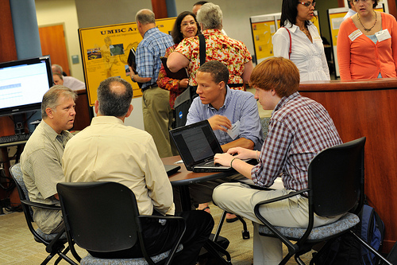
UMBC Data Gallery Tour
http://alumni.umbc.edu/retreat Tweet the Retreat at #UMBCretreat

Slide 2
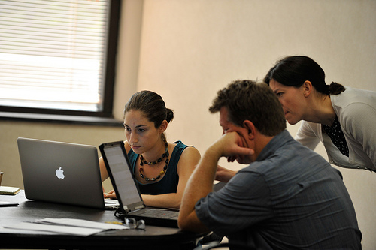
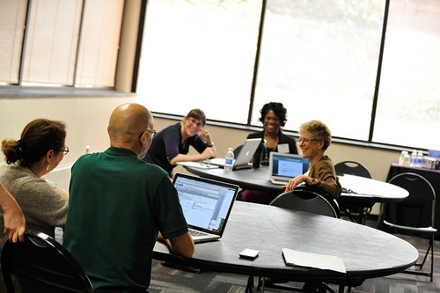
Your Theme Team
http://alumni.umbc.edu/retreat Tweet the Retreat at #UMBCretreat

Slide 3
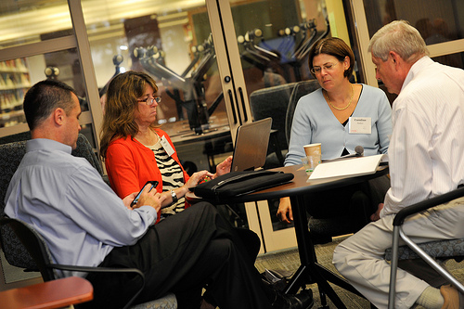
What data should we be highlighting EXTERNALLY?
Civic engagement: “The ways we are preparing students to lead in our state, nation and world.”
Diversity: "There is a wider and more diverse background of students, from all demographic factors.”
http://alumni.umbc.edu/retreat Tweet the Retreat at #UMBCretreat

Slide 4
What data should we be highlighting EXTERNALLY?
The number and quality of our academic offerings.
"The successes and impact of quality student experiences (study abroad, Shriver Center, first-year experiences, leadership, student life).”
Strong innovation in undergraduate learning/teaching:
"Improved student performance through academic transformation.”
Share sets of data that illustrate culture of innovation.
URCAD, CASTLE, Internships.
http://alumni.umbc.edu/retreat Tweet the Retreat at #UMBCretreat

Slide 5
What data should we be highlighting EXTERNALLY?
“The success of our graduates. This is a great stepping stone.”
Graduation rate of athletes.
"Overall growth during the past decades.”
Alumni relationships (career-long mentoring, etc.)
Interdisciplinarity.
http://alumni.umbc.edu/retreat Tweet the Retreat at #UMBCretreat

Slide 6
What data should we be highlighting EXTERNALLY?
"Capital budget data with USM BOR and legis. More information about where we are relative to peers and what we have done with it.”
“Highlight places where we don’t compare favorably or have high needs (the higher percentage of students who report suicidal thoughts or high levels of stress could get us money from the DHMH”)
http://alumni.umbc.edu/retreat Tweet the Retreat at #UMBCretreat

Slide 7
What data should we be giving more attention INTERNALLY?
Diversity as a shared value and a high expectation that needs review and attention
Student, faculty and staff composition
Faculty reflecting student diversity?
Diversity broadly understood
http://alumni.umbc.edu/retreat Tweet the Retreat at #UMBCretreat

Slide 8
What data should we be giving more attention INTERNALLY?
Sustainability of campus environment
Space and facilities utilization research and decision-making
Environmental issues: alternative work and transit arrangements, carbon
Footprint
Green space
http://alumni.umbc.edu/retreat Tweet the Retreat at #UMBCretreat

Slide 9
What data should we be giving more attention INTERNALLY?
How we research ourselves and communicate to the campus throughout the year and across the campus
Planning and budget: students want more involvement
Negative stories, challenges
Opportunities & successes: student engagement, faculty research funding
Student athletes
Sharing data throughout year and across departments
Research funding data and meanings before going external
Mechanisms of transparencies
Need more qualitative measures and stories
Look at peer institutions and other regional institutions
Survey students about their experience
http://alumni.umbc.edu/retreat Tweet the Retreat at #UMBCretreat

Slide 10
What data should we be giving more attention INTERNALLY?
Developing and supporting faculty and staff
“Track compression at Associate Prof level. Faculty salary compression overall”
Compensation levels are low
Training of PIs and other professional development
Expanding the size of faculty and staff with attention to composition and diversity
Cross-disciplinary connections: “instead of just talking about
Interdisciplinarity -- make it easier to actually honor it.”
http://alumni.umbc.edu/retreat Tweet the Retreat at #UMBCretreat

Slide 11
What data should we be giving more attention INTERNALLY?
Mentoring and supporting students broadly and deeply throughout their time with us and beyond
Admissions, retention, graduation, career placements
Mentoring
Engagement
Sharing successes
Mental health
Advising
Attention to low enrollment programs
Attention to special populations: study abroad, professional students, international students, transfer students
Grad Assistantships, internships
Support beyond the scholarship programs
http://alumni.umbc.edu/retreat Tweet the Retreat at #UMBCretreat

Slide 12
What else should we be measuring?
Student success
More granular analysis of outcomes by group (e.g., commuters, transfers, students by discipline, grad students by support level, athletes, students in different campus programs, employed students)
“What kind of student will do well at UMBC?”
Long-term post-graduation outcomes (undergrad and grad)
Engagement, satisfaction and overall happiness
Learning – measures beyond retention rates
“Assessment of how students are learning what they’re learning…Not just the numbers, but qualitative stories.”
Job satisfaction of faculty and staff
More detailed internal analysis
Mentorship, professional development and leadership opportunities
Transit: accessibility and sustainability
Campus and regional engagement of students, faculty and staff
http://alumni.umbc.edu/retreat Tweet the Retreat at #UMBCretreat

Slide 13
What else should we be measuring?
Additional Insights
Measure impact of institutional reputation
“UMBC’s reputation as a factor in students’, scholars’ and, staff candidates’ choices to come to UMBC.”
Explore how to most effectively prioritize use of university resources
Share information about UMBC more effectively across campus stakeholders
http://alumni.umbc.edu/retreat Tweet the Retreat at #UMBCretreat

