Slide 1
Society of Physics Students
Meeting: 12 October 2012

Slide 2
Book Discussion
The Elegant Universe – Brian Greene
Parallel Worlds – Michio Kaku
Physics of the Impossible – Michio Kaku
23 November 2012, Friday, 3:00 – 4:00 pm

Slide 3
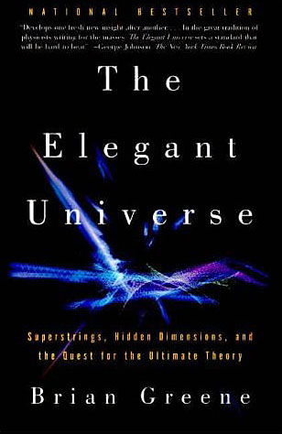
The Elegant Universe

Slide 4
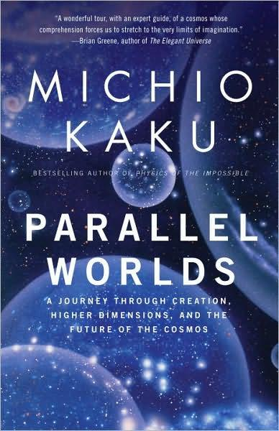
Parallel Worlds

Slide 5

Physics of the Impossible

Slide 6
Book Discussion
Brian Greene
Michio Kaku
“peels away the layers of mystery surrounding string theory to reveal a universe that consists of 11 dimensions where the fabric of space tears and repairs itself, and all matter-from the smallest quarks to the most gargantuan supernovas-is generated by the vibrations of microscopically tiny loops of energy”
“The Elegant Universe is a tour de force of science writing-a delightful, lucid voyage through modern physics that brings us closer than ever to understanding how the universe works.”
Parallel Words “In this thrilling journey into the mysteries of our cosmos, bestselling author Michio Kaku takes us on a dizzying ride to explore black holes and time machines, multidimensional space and, most tantalizing of all, the possibility that parallel universes may lay alongside our own.”
“Inspired by the fantastic worlds of Star Trek, Star Wars, and Back to the Future, renowned theoretical physicist and bestselling author Michio Kaku takes an informed, serious, and often surprising look at what our current understanding of the universe's physical laws may permit in the near and distant future.”

Slide 7
Punkin Chunkin
Sunday, 4 November 2012
Royal Farms
18657 Sussex Highway
Bridgeville, DE 19933
$10 per person
Car pooling
    86.6 miles (Approx: 2 hours from UMBC)

Slide 8
Physics Competition
UPhysicsC.com
Advisor: Dr. Takacs
takacs@umbc.edu
Begins Friday, 16 November
Please set up times with your group in order to prepare for the competition.
SPS will provide the registration fee.

