Slide 1
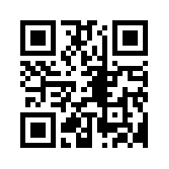
Fall 2015 Events
Social Events
*Bring 2 Forms of PHOTO ID*
Welcome Back Picnic
Thursday, September 3rd, 2015
4pm-7pm (Flat Tuesdays)
First Social Hour
Thursday, September 17th, 2015
6pm-8pm (Flat Tuesdays)
Halloween Social Hour
Thursday, October 15th, 2015
6pm-8pm (Flat Tuesdays)
Thanksgiving Social Hour
Thursday, November 19th , 2015
6pm-8pm (Flat Tuesdays)
Senate Meetings
Monday, September 14th, 2015
5pm-7pm (UC 312)
Monday, October 5th, 2015
5pm-7pm (UC 312)
Monday, November 2nd , 2015
5pm-7pm (UC 312)
Monday, December 7th, 2015
5pm-7pm (UC 312)
gsa.umbc.edu
UMBC_GSA
@ UMBCGSA
The Commons 308
Monday-Thursday, 9AM-4PM
(410) 455-2773
gsa@umbc.edu
Fall 2013
www.facebook.com/UMBCGSA

