Slide 1
Opportunities in Conservation Biology & Ecology

Slide 2
Internships, Research and Careers

Slide 3
Collaborate to equip students with the skills and resources necessary to translate their academic interests into graduate and professional study, entry into the workforce, and community service and leadership.
UMBC students are prepared to make a difference.

Slide 4
TRANSITION
One-stop shop for career related services
Integrate services of two departments to best serve students, employers, faculty, and staff
Career Planning and Job Search housed in The Career Services Center (M/P 212)
Internship, Co-op, and Research housed in Shriver Center
Shriver Center continues to provide service-related programming and opportunities

Slide 5
SERVICES AND SKILL DEVELOPMENT
Resume, cover letter, personal statement critique and career counseling
Mock interviews
Job & Internship Search Strategy
Workshops and Seminars:
Dining Etiquette
Dependable Strengths
Salary Negotiation
Walk-ins hours available Mon.- Fri. 2pm- 4pm (M/P 212)
Evening walk-ins in Kuhn Library
Tues & Wed 6-8pm
Notes:
Intern 101 includes a variety of topics particularly relevant to the experience of an intern (e.g., time management, professional communication, developing mentors, etc.); explain that the mock interviews are videotaped and students receive one-on-one coaching on successful interview techniques.

Slide 6
SERVICES AND SKILL DEVELOPMENT
Employer Networking
On the Road
Lunch & Learn
Corporate Visibility Days
Career Fairs & Recruitment Events
On Campus Interviews
Information Sessions
Professional Development
Reflections
Intern 101 Sessions
Internship Success Conference

Slide 7
NEXT STEPS
Create a resume and upload it to UMBCworks to start fully utilizing UMBC recruiting services:
If you are seeking an INTERNSHIP, CO-OP, or RESEARCH POSITION:
Please call The Shriver Center at 410-455-2493 for an appointment with a Coordinator who will review your resume, go through potential credit options, and help you best maximize your search using UMBCworks and other tools.
Notes:
Can use this slide for Transfer Students as a way to engage in the hands on process of searching for Internships. Use a mock student to use show how the process works by looking at the popular majors in the course.

Slide 8
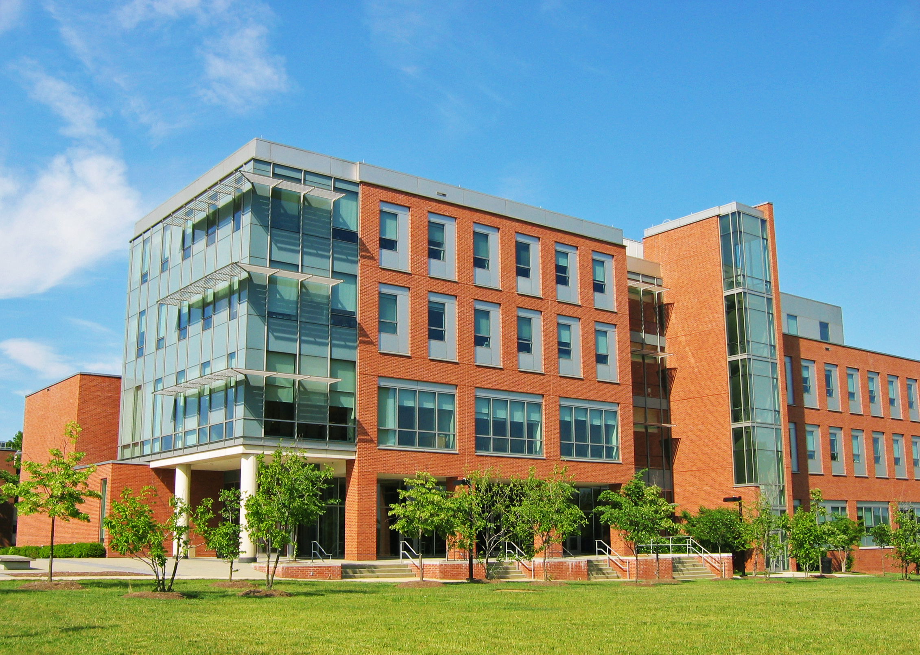
Where is the Shriver Center?
Ground Floor of the Public Policy Building
Email: shrivercenter@umbc.edu
Telephone: 410.455.2493
Notes:
Note location

Slide 9
NEXT STEPS
If you are seeking ON-CAMPUS, PART-TIME, or FULL-TIME EMPLOYMENT:
Please call or visit The Career Services Center for an appointment. Visit during walk-in hours (Monday-Friday, 2-4pm) for a resume review and to learn how to familiarize yourself with UMBCworks and the Career Services Center’s other services during your job search.
If 2-4pm is not convenient, contact the Center at 410-455-2216 to make alternate arrangements.

Slide 10
CAREER SERVICES CENTER
Math/Psych 212
410-455-2216
careers@umbc.edu
careers.umbc.edu
www.facebook.com/UMBCcareers
Walk-ins: Monday-Friday, 2:00pm-4:00pm
Notes:
Mention what the walk-in hours are about. Daily, students are able to stop in for a quick resume review or if they have questions. These are 15-minute sessions on a first-come, first-serve basis.

Slide 11
What about study abroad?

Slide 12
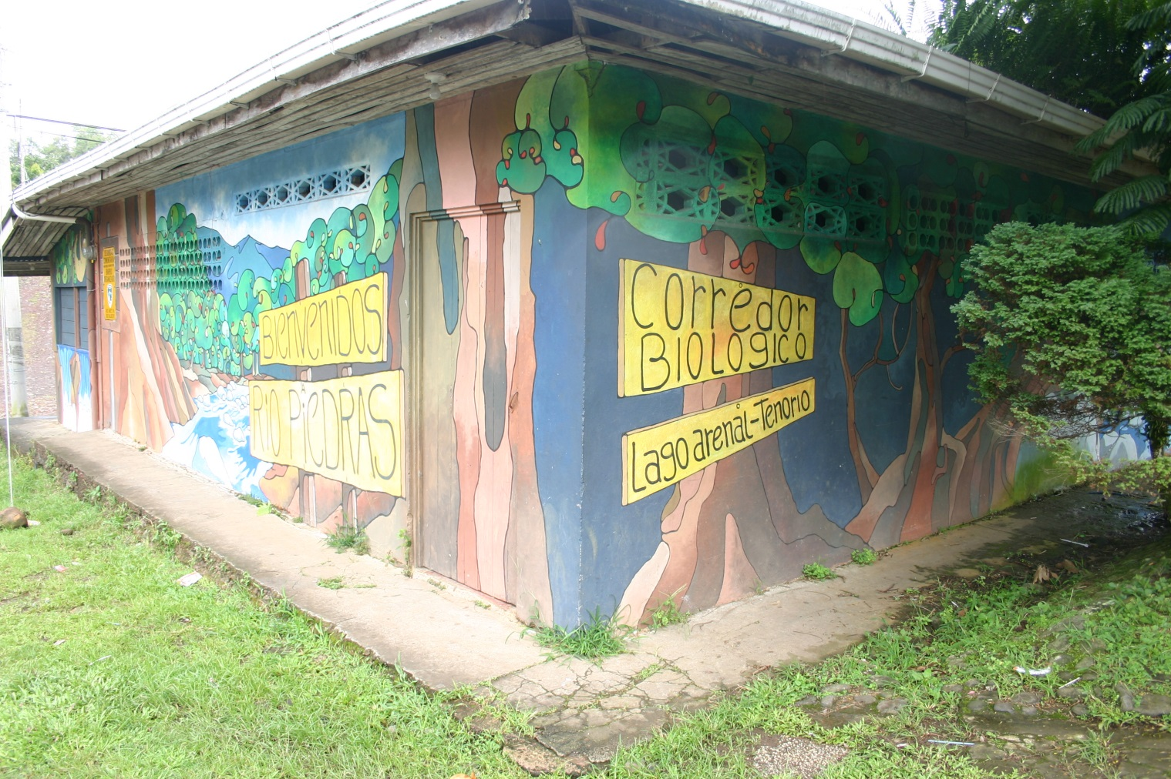
Sustainable development & conservation in Costa Rica
Summer Session I – June 1-15, 2014
Dept. of Geography & Environmental Systems
Lead Instructor: Dr. Maggie Holland
Co-Instructor: Carlos Muñoz, MSc (PhD program at U. Idaho)

Slide 13
What we hope to offer UMBC students:
A unique travel abroad experience with an emphasis on applied research
Direct interaction with rural communities engaging in sustainable development projects
Opportunity to gain experience with specific research methods
The chance to gain first-hand understanding of tropical biodiversity
Gain a more nuanced appreciation for balancing the needs of development and conservation in a tropical rural setting
(much more)

Slide 14
Mix of field research & service-learning
Course intro workshop in San José
6-day visits to each of 2 conservation corridors in north-central Costa Rica
Lago Arenal & Monteverde regions
Meet with community groups
Gain experience in field research techniques:
Focus group discussions
Participatory mapping
Focus: local perceptions of conservation priorities, successes & challenges
Environmental service project in each corridor
Designed by local corridor councils
2 field trip visits to Volcán Tenorio & Monteverde reserves
Wrap-up workshop

Slide 15
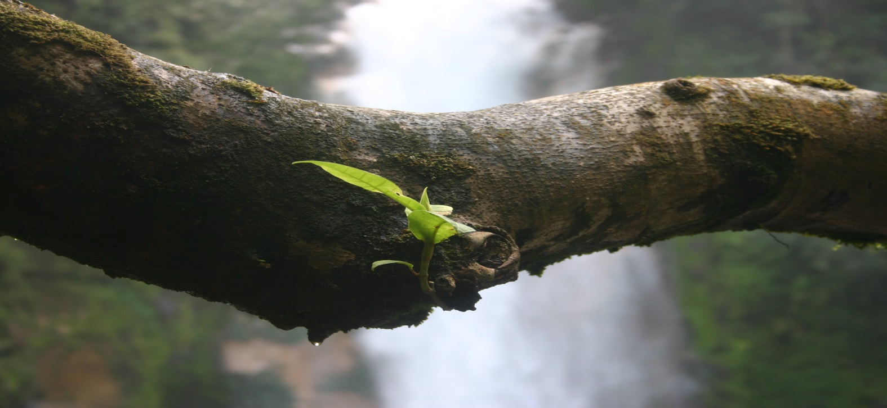
Course details
GES 400/600 Special Topics (3 credits)
Upper-level undergraduate & graduate
Open to non-GES majors
Spanish language skills highly desired (not required)
Class size: 10-16 students
Trip cost: ~$2,269
+ roundtrip airfare ($500-600)

Slide 16
What we’re hoping students will bring to this experience:
Energy & enthusiasm
Able to embrace adventure
Interest in field research related to practical approaches to conservation
Specific skills: GIS, previous qualitative or quantitative analysis experience, skills in digital storytelling
Any questions?
Dr. Maggie Holland (GES) – mholland@umbc.edu
Katie Heird (IES) – kheird1@umbc.edu
Stay tuned for informational session in February!

