Slide 1
Internships & Careers: Ecology, Evolution, Behavior, Conservation Biology etc. OUTLINE
I. UMBC Researchers – esp Biology and Geography
II. Summer Internships – Local
III. Summer Internships – National esp. NSF REUs
IV. Summer Courses – UMBC, Costa Rica, Field Stations
VI. Specific Projects – Dr. Lohr, Dr. Studds, Dr. Omland
V. Study Abroad – Katherine Heird (Costa Rica 2014 ?2015)
Office of International Programs

Slide 2
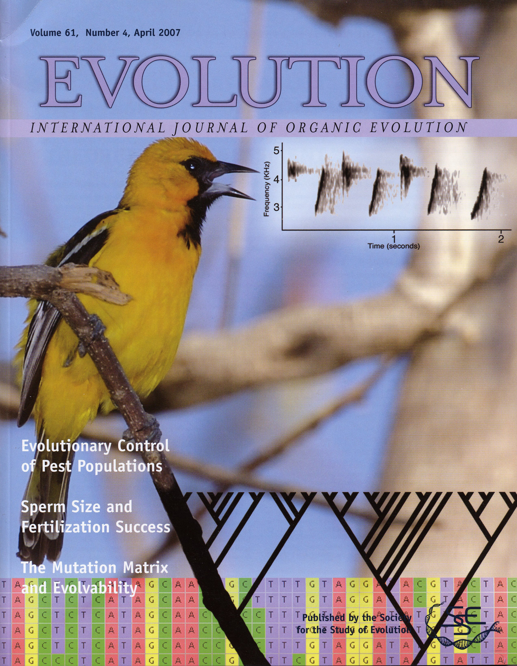
Dr. Kevin Omland
- BA, Dartmouth College, NH
- PhD 1995 Univ. Albany, New York
- PostDocs Duke Univ; Smithsonian
UMBC
Assistant Professor 2000-2006
Associate Professor 2007-2011
Professor 2012-present
First Internship: US Forest Service, then research with undergrad professor on songbird ecology.
Current interests: DNA phylogenies of orioles; color and song evolution; speciation in reverse in ravens.

Slide 3
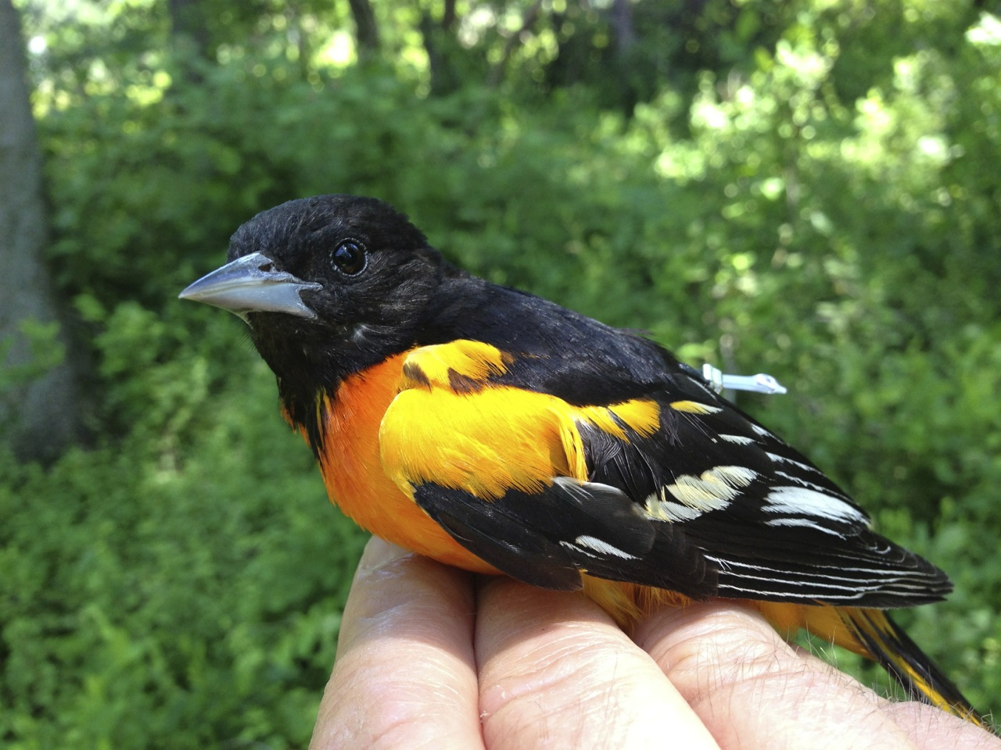
Internships & Careers: Ecology, Evolution, Behavior, Conservation Biology etc. I. UMBC Researchers: Biology
Mendelson - sexual selection in fishes
Lohr - bird song and conservation biology
Omland - female bird song & phylogeny (esp. orioles)
Leips - fruit fly evolution & ecology
Cronin - color & vision in marine invertebrates
etc.

Slide 4
UMBC Researchers: Geography (GES)
Studds - migratory bird ecology & behavior
Baker - forest ecology
Swann - stream ecology
Ellis - human dominated landscape ecology
Holland - environmental policy (e.g. Costa Rica)
etc. etc.

Slide 5
II. LOCAL INTERNSHIPS (MD & DC)
SMITHSONIAN
- Smithsonian Environmental Research Center
(“SERC” just south of Annapolis)
- Nation Museum of Natural History
(systematics of birds, insects, fish, dinosaurs, etc.)
- National Zoo
(including Migratory Bird Center & Genetics Lab)
- Conservation Research Center
(Front Royal, VA)
(also conservation organizations etc. DC: National Wildlife Federation, Conservation International, EPA, Congress…)

Slide 6
II. LOCAL INTERNSHIPS (MD & DC)
US Department of Agriculture (Beltsville “BARC)
Patuxent Wildlife Research Refuge (Laurel)
Maryland Zoo (Baltimore)
National Aquarium (Inner Harbor)
Institute Marine & Environmental Technology
(IMET, Inner Harbor, aquaculture, marine microbiology)
Local Nature Centers (every county)
Howard: Robinson Nature Ctr, Howard Co. Conservancy
Baltimore: Marshy Point Nature Center
Annapolis: Chesapeake Bay Foundation

Slide 7
III. NATIONAL INTERNSHIPS
REU SITES (Research Experience for Undergraduates)
http://www.nsf.gov/crssprgm/reu/list_result.jsp?unitid=5047
E.G. RAPTOR RESEARCH CENTER, Boise, Idaho
Research Topics: Raptor Biology, Ecology, Behavior, Conservation Biology, Wildlife Management, Ornithology, Sensory Ecology, Population Biology, Demography, Molecular Ecology
(REU SITES ARE PROBABLY QUITE COMPETITIVE, BUT IF YOU HAVE DECENT GRADES, HAVE CLEAR INTERESTS IN THAT AREA, IT IS EASY TO APPLY FOR 3-5)
http://www.nsf.gov/crssprgm/reu/reu_search.jsp

Slide 8
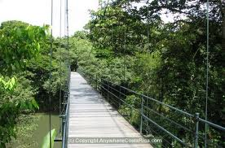
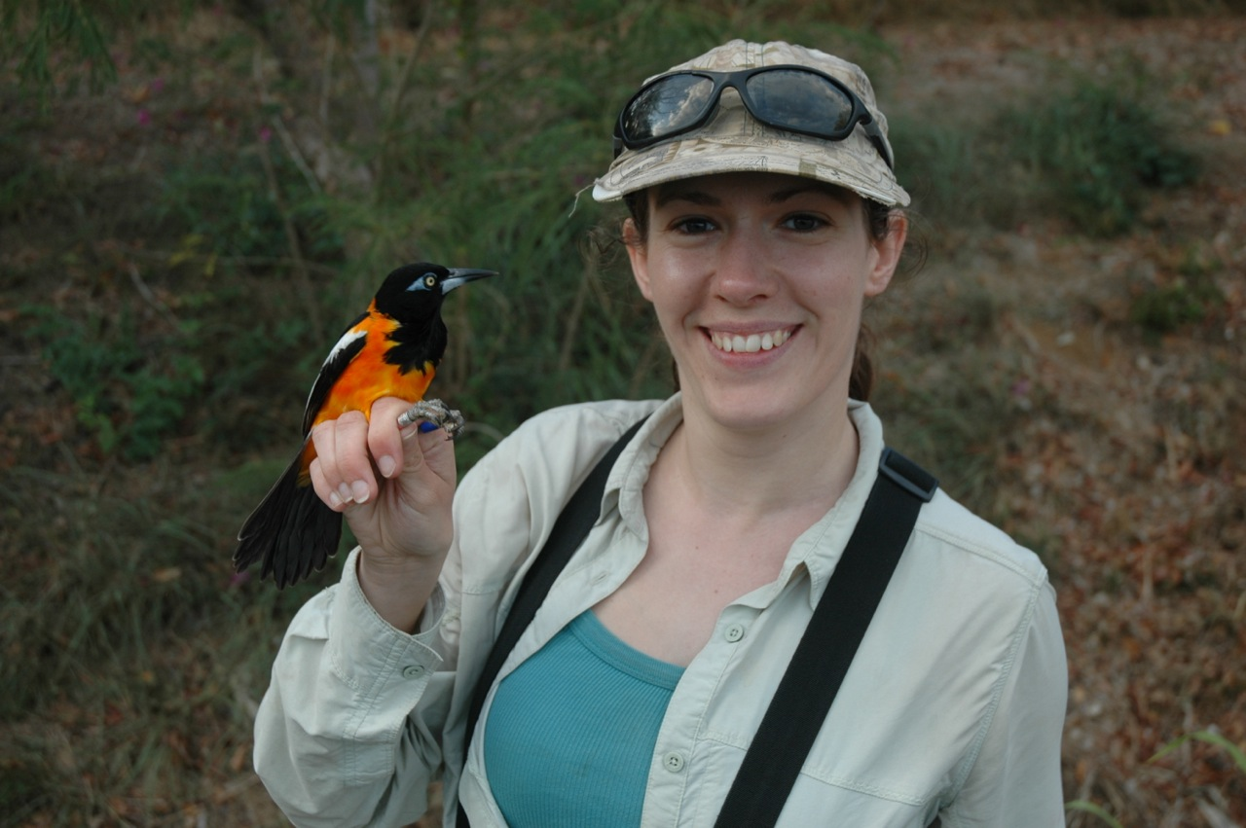
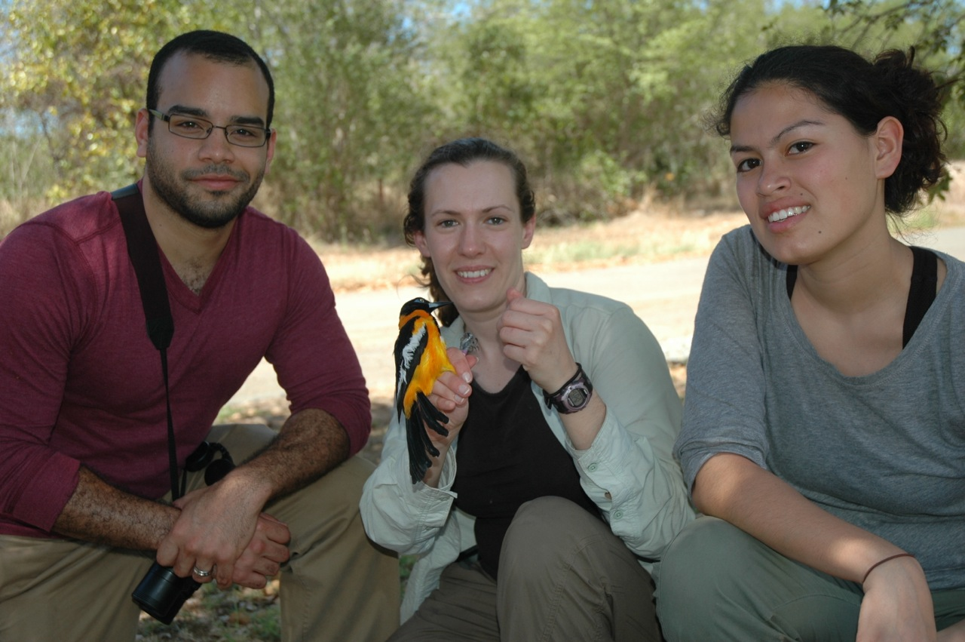
IV. Summer Courses – UMBC
BIOLOGY
Biology 142 – Intro Ecology & Evolution (Dr. Sturge)
Biology 461 – Population Genetics (Tracy Smith)
Biology 480 – Animal Behavior (Dr. Rachel Sturge)
GEOGRAPHY
Costa Rica, Study Abroad (Dr. Maggie Holland)
NEXT YEAR BIOLOGY – STUDY ABROAD – TROPICAL BIOLOGY
- course in planning stages, likely to do if enough interest.
- likely July 2015, 1 week UMBC, 2 weeks Costa Rica
- Dr. Kevin Omland, Biology, send me an email if interested

Slide 9
IV. Summer Courses – Field Stations
ORGANIZATION OF BIOLOGICAL FIELD STATIONS
http://www.obfs.org for example:
Virginia: Mountain Lake Biological Station
http://mlbs.org/summercourses
University of New Hampshire, Shoals Marine Laboratory
http://www.sml.cornell.edu/sml_students_creditcourses.html
Colorado: Rocky Mountain Biological Laboratory (combo course/research)
http://www.rmbl.org/file_uploads/Students/2014.pdf
Costa Rica: Organization for Tropical Studies, e.g., La Selva Rainforest Station
http://www.ots.ac.cr/index.php?option=com_content&task=view&id=162&Itemid=348
Specific Intern Opportunity: Upstate New York. Huyck Preserve
(beautiful field site, did my PhD there, UMBC intern 2010)
http://www.huyckpreserve.org/odum-internship.html

Slide 10
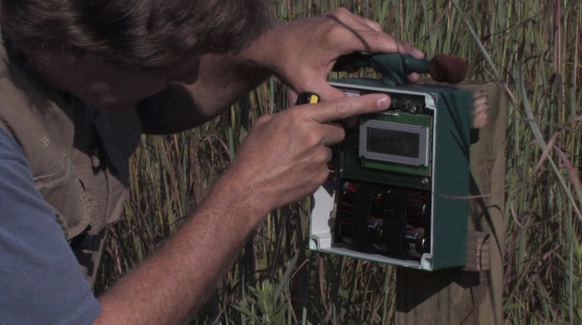
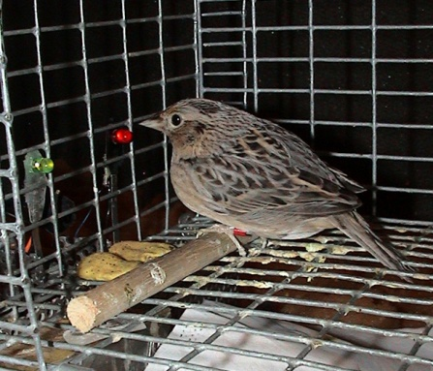
V. Specific Openings: A. Dr. Bernard Lohr (Biol)
ANIMAL BEHAVIOR / BIOACCOUSTICS
Seeking motivated UMBC undergraduates for summer research
1) a laboratory captive breeding study, and
2) bird song studies at a nearby field station.
B. Dr. Omland (Biol) – projects in evolution and animal behavior
- DNA sequencing of Common Ravens (speciation in reverse)
- fieldwork on Baltimore Oriole migration (Howard County, need car)
EMAIL ME WITH YOUR RESUME & TRANSCRIPT omland@umbc.edu
C. Dr. Collin Studds (GES) – migratory bird ecology fieldwork

