Slide 1
Hydraulic Fracturing a.k.a. “Fracking"
Let your voice be heard!
Presentation by Sean Mullin
Legislative Aide
Delegate Shane Robinson District 39

Slide 2
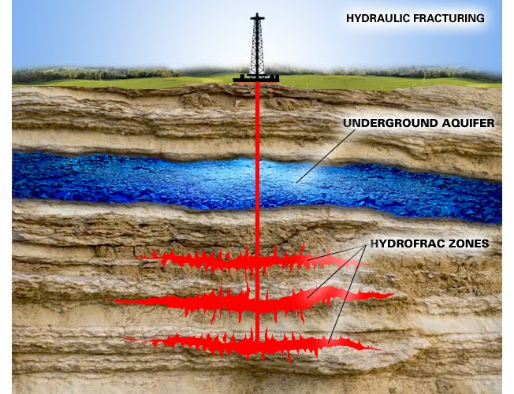
Hydraulic Fracturing…What is It?
Hydraulic fracturing, or “fracking”, is the well stimulation process of drilling and injecting fluid into the ground at a high pressure in order to fracture shale rocks to maximize the extraction of underground resources – oil, natural gas, and geothermal energy.

Slide 3
What is Involved?
Hydraulic fracturing involves the pressurized injection of fluids commonly made up of water and chemical additives into a geologic formation.
The pressure exceeds the rock strength and the fluid opens or enlarges fractures in the rock.
The fracturing fluids (water and chemical additives) are then returned back to the surface. Natural gas will flow from pores and fractures in the rock into the well for subsequent extraction.

Slide 4
Exploring “Fracking”
Natural gas is a finite resource.
Many claim that renewable energy sources are not yet ready for development and utilization.
Agencies, such as the Department of Natural Resources and Maryland Department of the Environment, are taking a lot of time studying “fracking” instead of investing in research to develop renewable sources of energy (solar and wind).

Slide 5
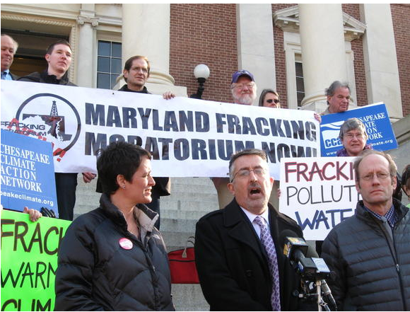
What this Means to You…
Currently, the state of Maryland has a “fracking” ban which prohibits “fracking” until a comprehensive scientific study is completed to investigate the effects.

Slide 6
Impact of “Fracking”
One of the natural gases being extracted through “fracking” is methane.
The Environmental Protection Agency (EPA) has stated that the environmental impact of methane over a 100 year period is about 20x worse for our atmosphere than carbon dioxide
Although many "fracking" sites have managed to reduce their emissions, there are still several that have not attempted to lower their methane output.

Slide 7
Impact of “Fracking”
During the “fracking” process, methane gas and toxic chemicals can leach out from the system and contaminate nearby groundwater.
Methane concentrations are 17x higher in drinking-water wells near fracturing sites than in normal wells.
There have been over 1,000 documented cases of water contamination next to areas of gas drilling as well as cases of sensory, respiratory, and neurological damage due to ingested contaminated water.

Slide 8
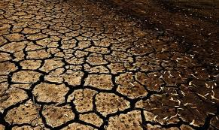
Impact of “Fracking”
Many experts expect that the world will be in the midst of a water crisis by the year 2030.
The demand for "fracking" would potentially divert or increase the price of water needed for agriculture which is an essential and permanent part of the state’s economy.

Slide 9
Impact of “Fracking”
It takes 1-8 million gallons of water to complete each fracturing job which, once used, is turned into waste water.
The water brought in is mixed with sand and chemicals to create “fracking” fluid.
Approximately 40,000 gallons of chemicals are used per fracturing.

Slide 10
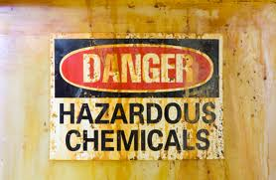
Impact of “Fracking”
Up to 600 chemicals are used in “fracking” fluid, including known carcinogens and toxins such as…
Hydrochloric acid
Formaldehyde
Lead
Uranium
Mercury
Radium
Methanol
Ethylene Glycol (primary ingredient in antifreeze and hydraulic brake fluid)

Slide 11
Impact of “Fracking”
Energy companies claim that the fluid used for “fracking” can be recycled.
After several uses, the “fracking” fluid collects sediment and becomes thicker and less useful.
The mixture then has to be disposed and becomes waste.

Slide 12
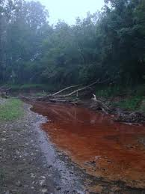
Impact of “Fracking”
Only 30-50% of the fracturing fluid is recovered, the rest of the toxic fluid is left in the ground and is not biodegradable.

Slide 13
Additional Environmental Repercussions
The pipelines used for extraction of natural gas could collapse underground, creating potential environmental mishaps.
The fluid injection involved in “fracking” practices have been linked to earthquakes.
It has confirmed that “fracking” practices have caused earthquakes in a town in Ohio that had no known previous earthquakes.

Slide 14
Economic Impact of “Fracking”
Energy companies that will dig wells for “fracking” will employ an out of state work force who are already skilled in “fracking”, which means that these high paying jobs will not go to Maryland residents seeking employment.
The jobs created are all temporary because the natural resources available for extraction are finite.
States that have allowed “fracking” have not experienced the alleged economic booms that were promised.

Slide 15
Economic Impact of “Fracking”
West Virginia allows “fracking” and still remains one of the poorest states in the nation.
Less than 10% of 9000 Texas shale wells had recouped their estimated production costs within the first seven years.
The “boom town effect” created by the out of state workers brought in to do the job often inflate prices and property values in areas where they are working.

Slide 16
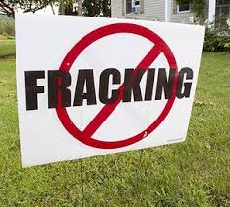
Does Maryland Need “Fracking?”
There is currently no energy crisis in Maryland.
There is no immediate need to begin “fracking” for energy resources in Maryland.

Slide 17
Looking Forward…
Developing a successful model for renewable energy is the future not just here in the United States but across the world.
In the past several years it has become a long term goal for many countries.
The state of Maryland needs to divert attention from “fracking” to research on renewable energy, taking a position of leadership in this emerging technology and create a model for other states to follow.

Slide 18
Resources
http://www.desmogblog.com/2012/09/06/deepening-doubts-about-fracked-wells-long-term-prospects
http://thinkprogress.org/climate/2013/09/19/2646881/study-fracked-wells-methane-emissions-super-emitters/
http://epa.gov/climatechange/ghgemissions/gases/ch4.html
http://www.midwestenergynews.com/2013/01/10/u-s-chambers-fracking-job-boom-behind-the-numbers/
http://www.desmogblog.com/2012/09/06/deepening-doubts-about-fracked-wells-long-term-prospects
http://www.nbcnews.com/science/fracking-practices-blame-ohio-earthquakes-8C11073601

