Slide 1
Fracking
What you need to know…

Slide 2
Promised Land Trailer

Slide 3
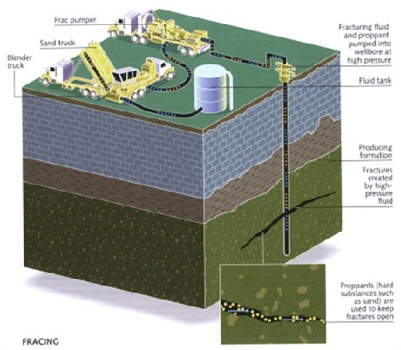
Fracking Basics
Explosive charges set off in oil and gas wells
Water and chemicals are pumped in
Largely increases productivity of natural gas wells
Cleanest burning fossil fuel
Huge potential economic benefits
http://www.msue.msu.edu/portal/default.cfm?pageset_id=580675&page_id=598850&msue_portal_id=25643

Slide 4
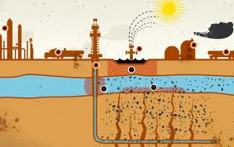
How is Fracking Different?
Wells are thousands of feet deeper
Wells go vertically down, then continue horizontally into the shale
Up to 100 times more water is used
A combination of undisclosed chemicals is used
This fluid has been found to contain…
Formaldehyde
Acetic acids
Citric acids
Boric acids
http://www.cleanwateraction.org/page/fracking-process

Slide 5
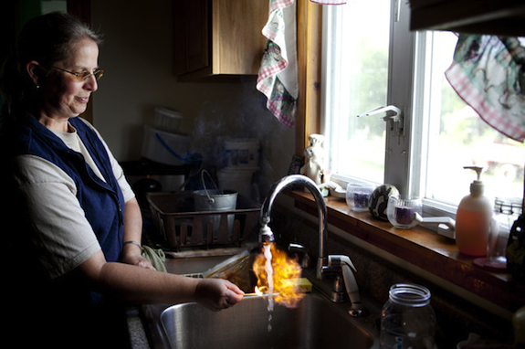
Dangers
Waste of water
Fracking fluid contains toxic chemicals
Water contamination, including drinking water
Pollution from trucks and machinery
Habitat fragmentation and disturbance
Methane leaks
Increased earthquake risk
http://www.cleanwateraction.org/page/fracking-dangers

Slide 6
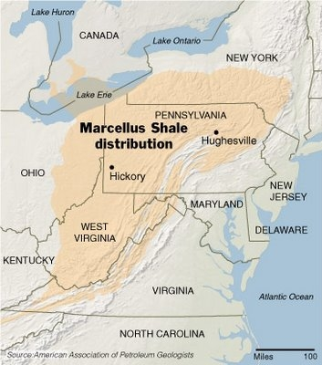
What Does This Mean for Maryland?
Marcellus Shale
Underneath Appalachians
Though to contain trillions of cubic feet of natural gas
In Chesapeake Bay Watershed
No studies have been done to determine its safety
http://www.bayactionplan.com/2011/04/fracking-in-maryland-proceed-with-caution/

Slide 7
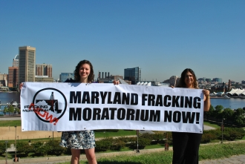
Moratorium
Delegate Heather Mizeur is introducing a bill that would prohibit fracking permits from being issued until Maryland completes scientific studies on the safety of fracking
http://www.chesapeakeclimate.org/campaigns/maryland/marcellus-shale-fracking

Slide 9
Questions?

