Slide 1
Firearm Safety
UMBC Rifle and Pistol Club

Slide 2
The Importance of Firearm Safety
Firearm Safety

Slide 3
4 Golden Rules of Firearm Safety
Always treat a firearm as if it is loaded.
Never point the muzzle at anything you are not willing to destroy.
Keep your finger off the trigger until you are ready to fire.
Be sure of your target and what’s beyond it.

Slide 4
Assume All Firearms are Always Loaded
No matter the circumstances always treat a firearm as if it is loaded.
Even if the safety is on, the action is open, and the firearm is unloaded.
Never rely on safety. They can and will fail.

Slide 5
Always Point the Muzzle in a Safe Direction
Be conscious of the direction your muzzle is pointed at all times.
This includes at yourself, any other person, animal, or property
Never handle a firearm behind other people or bend over with a gun in your hand on a shooting range

Slide 6
Keep Your Finger Off the Trigger Until You Are Ready to Fire
Make sure your sights are aligned with the target before you turn “off” the safety and place your finger on the trigger.
Pay attention to what you are doing while handling a firearm. Do not let your finger contact the trigger until the gun is on target.

Slide 7
Be Sure of Your Target and Its Surroundings
Pay attention to what is going on around your target.
Keep in mind that bullets can fragment or ricochet.
You are responsible for every shot you fire and anything the bullet hits, whether intentionally fired or not, no matter what.

Slide 8
12 Basic Rules for Safe Firearm Handling
1. Always treat the gun as loaded.
2. Always keep the gun pointed in a safe direction.
3. Always keep your finger straight and off the trigger until you are ready to shoot.
4. Always keep the gun unloaded until your are ready to shoot it.

Slide 9
12 Basic Rules for Safe Firearm Handling
5. Never point the gun at anything you don’t intend to destroy.
6. Be certain of your target and what is beyond it.
7. Learn the mechanical and handling characteristics of your gun before you use it.
8. Always use the proper ammunition.

Slide 10
12 Basic Rules for Safe Firearm Handling
9. Be sure the barrel is clear of obstructions before loading and shooting.
10. If your gun fails to fire when the trigger is pulled, hold your shooting position for a few seconds, then with your muzzle pointed in a safe direction, unload the gun.
11. Don’t rely on the gun’s safety to keep it from firing.
12. Be aware of your surroundings when handling guns so you don’t trip or lose your balance and accidentally point and/or fire the gun at anyone or anything.

Slide 11
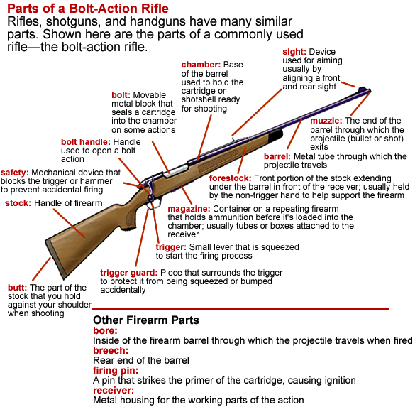

Slide 12
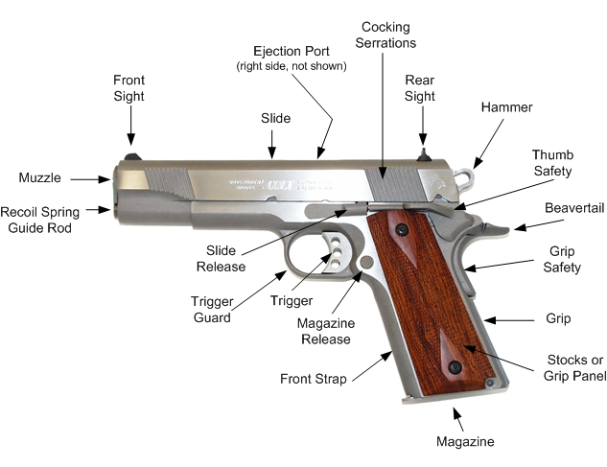

Slide 13
The Safety
There are many different types of safeties that vary from firearm to firearm. Make sure to familiarize yourself with the safety device(s) of any firearm you intend to operate.
Just because the safety is turned “on” does not mean you no longer have to follow the rules of firearm safety.
Safeties can and do fail

Slide 14
Other Firearm Parts
Action: The moving parts that load, fire, and eject shells or cartridges
Receiver: The metal housing for the parts of the action
Bore: The inside of the barrel through which the projectile travels
Firing Pin: Strikes the primer of the cartridge to cause ignition

Slide 15
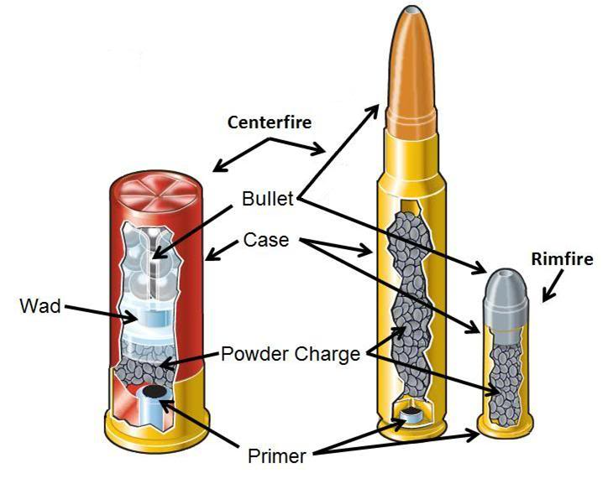
Ammunition
Ammunition
Projectile

Slide 16
Basic Components of Ammunition
Case: The container that holds all other ammunition components together. It’s usually made of brass, steel, or plastic.
Primer: An explosive chemical compound that ignites the gunpowder when struck by a firing pin. Primer can be placed in the rim of the case (rimfire) or in the center of the base of the case (centerfire).

Slide 17
Basic Components of Ammunition
Gunpowder: A chemical mixture that burns rapidly and converts to gas to propel the projectile.
Projectile: The object(s) expelled from the barrel.
Wad: A seal and/or shot container made of plastic that separates the powder from the slug or shot in a shotshell.

Slide 18
Projectiles
Bullet: A projectile, usually containing lead, that is fired from a rifle or pistol.
Slug: A solid projectile, usually made of lead, that is fired from a shotgun.
Shot: Numerous pellets, usually made of lead or steel, that are fired from a shotgun.

Slide 19
Using the Correct Ammunition
Always use the intended ammunition for a specific firearm. The caliber or gauge should be written on the on the barrel of the firearm.
Just because a cartridge fits in a magazine or in the chamber of the firearm does not mean it is safe to shoot.
Using improper ammunition will likely cause a malfunction. Sometimes it may only be a jam or a misfire in other cases the firearm and/or shooter may be severely damaged.

Slide 20
Caliber vs. Gauge
Caliber: The measured internal diameter of the barrel or diameter of the bullet. Caliber is measured in inches or millimeters and is used for rifles and pistols.
Gauge: The number of lead spheres equal to the diameter of the bore that combine to weigh one pound. Gauge is used to measure the bore diameter of a shotgun.

Slide 21
Malfunctions
Most malfunctions are caused by faulty magazines, incorrect/poor ammunition, or poor maintenance of the firearm.
If a firearm malfunctions continue to observe all firearm safety rules.
Turn the safety “on” if possible.
Remove the magazine.
Cycle the action to eject the cartridge.
If the cartridge does not eject you may need to use your fingers or tools to remove it.

Slide 22
Eye and Ear Protection
It is always a good idea to wear eye and ear protection when using firearms.
Exposure to gunfire can lead to hearing problems over time.
Safety glasses will protect your eyes from escaping hot gasses, any shell casings or fragments, and ricochets

Slide 23
Alcohol and Drugs
Never consume alcohol or drugs before or during the handling of firearms.
Consuming alcohol and/or drugs increases the risk of incidents when handling firearms.
If you have a prescription medication, check with your physician to make sure it is safe to take while using firearms.

Slide 24
Storage
Store your unloaded firearms in a dry place where the wrong people cannot access them.
Gun safes and locks are a good idea and mandatory in some states.

Slide 25
Practical Firearm Mechanics
What do you want to shoot?
Shotguns vs. Rifles vs. Pistols
How does it operate?
How do you load it?

Slide 26
Shotgun
Fires “shot” or slugs
Measured by gauge
Common: 12ga., 20ga., .410
Offered in stocked and pistol-grip variants
Generally semi-auto, pump, or break-action
FA, bolt-action, and revolver shotguns exist, but are rare and regulated
Age to own: 18

Slide 27
Rifle
Dizzying variety of calibers and actions
Most prolific form of firearm
Stock (sometimes retractable/folding)
Shorter-barreled rifles known as carbines (KAR-beans)
Age to own: 18, 21 (for regulated long guns)

Slide 28
Handgun/Pistol
Generally revolver or semi-auto
“Auto Pistol” – semi (usually)
No stock, short barrel
Fires handgun ammunition
Lower-powered than rifle ammunition
Age to own: 21

Slide 29
Restricted/NFA Firearms
Sawed-off shotguns, short-barreled rifles, fully automatic firearms, etc.
Require special licensing, registration, and taxation
Age to own: 21

Slide 30
Semi-Automatic Action
Uses mechanical processes within the gun to chamber a new round when the trigger is pulled
Many methods
Common among all firearm types

Slide 31
Bolt-Action
Uses a lever to actuate a rotating bolt
User must cycle the action between rounds fired
Common among rifles

Slide 32
Pump Action
Classic shotgun action, but also prevalent among rifles
User “pumps” the action back and forth to eject the spent round and chamber a new one

Slide 33
Revolvers
Generally handguns, but occasionally rifles and shotguns
Rounds kept in a revolving cylinder
Cylinder rotates when hammer is cocked (single-action) or when the trigger is pulled (double-action)

Slide 34
Lever Action
Action is actuated by using a lever around the trigger
Most prevalent in rifles

Slide 35
Break-Action
Common among shotguns and high-end hunting rifles
Gun “breaks open” on a hinge to eject spent rounds and manually load new ones

Slide 36
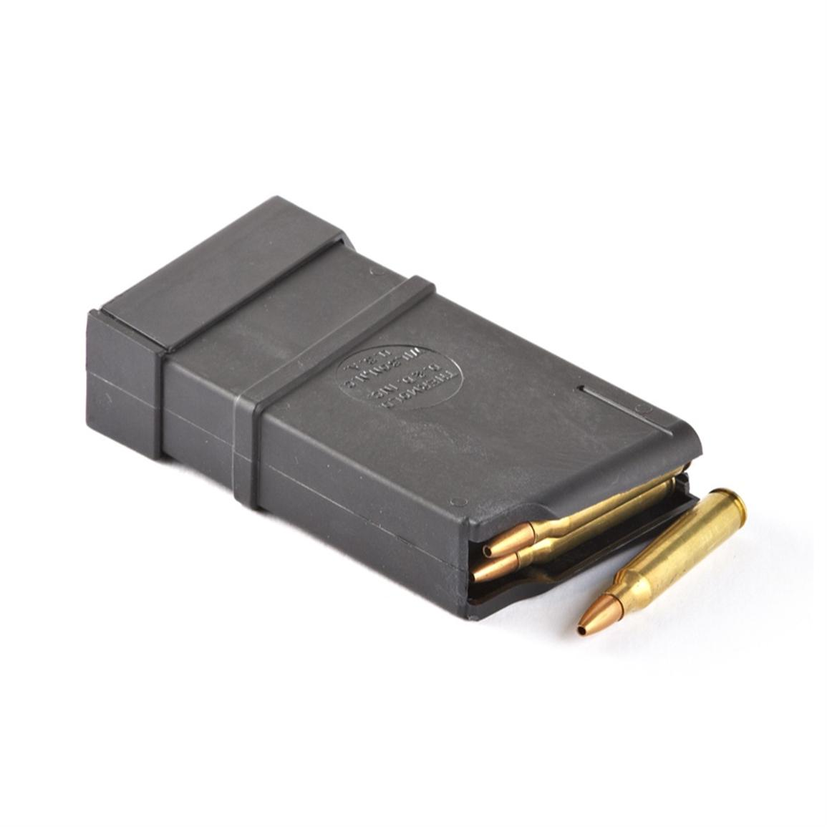
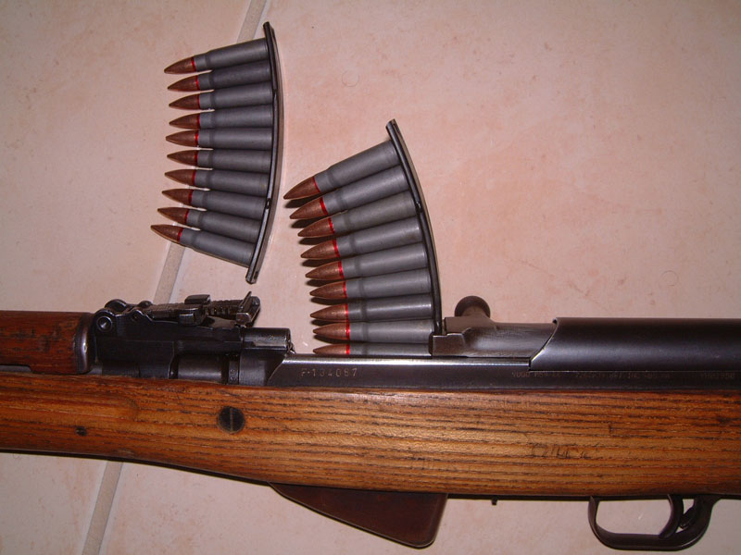
Loading – Clip vs. Magazine
Clip
Magazine
Used to more easily load magazines/firearms
Contains rounds until ready to fire
Can be internal or detachable

Slide 37
Shooting Fundamentals
Remember the Four Main Rules!
Know your dominant hand and eye
Select your position
Bone-on-bone, not muscle-on-bone
Ensure that you are comfortable, relaxed, and balanced
Control your sight picture
Control breath and trigger break
Follow through

Slide 38
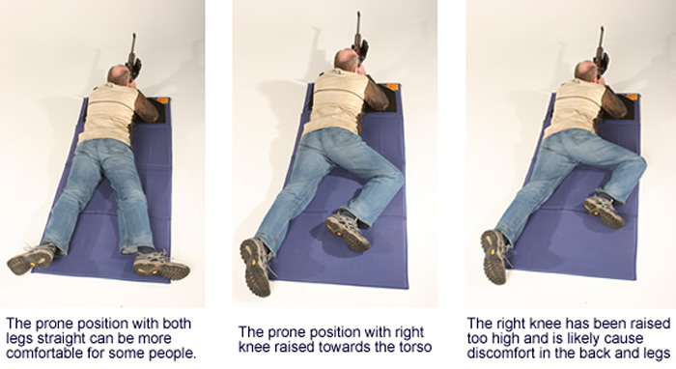
Prone Position
Allows for the most precision
Used for zeroing sights

Slide 39
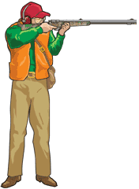
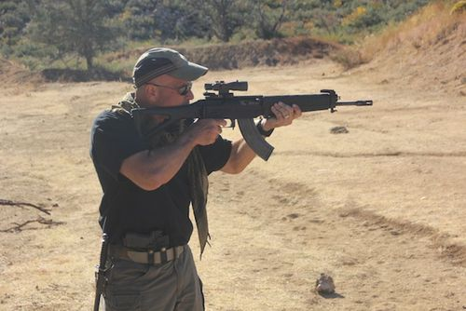
Standing Position
Can use supporting arm to steady the firearm or can fire freehand
“Chicken Wing” can become a bad habit
Supported Stance
Offhand Stance

Slide 40
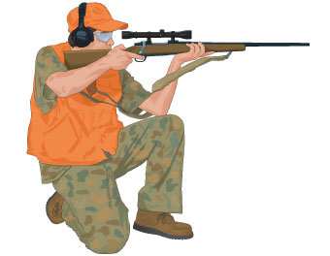
Kneeling Position
More precise than standing
Rest supporting elbow on the knee of the same side’s leg

Slide 41
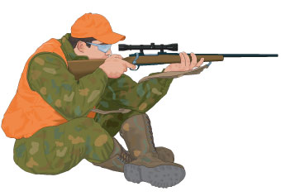
Sitting Position
Common in hunting situations
Rest both elbows on their respective knees

Slide 42
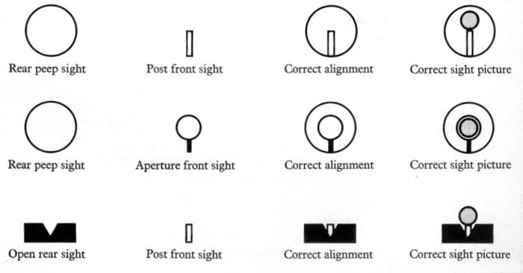
Sight picture
Keep the top of the front sight centered in the rear sight with the top of it on the target

Slide 43
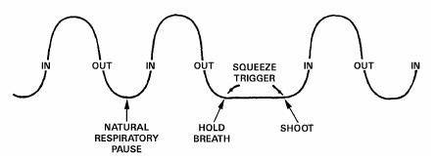
Breath Control
Pause your breathing at the bottom of a natural breath cycle (post-exhalation)
Don’t force it – If you wait too long and begin shaking, just inhale and try again

Slide 44
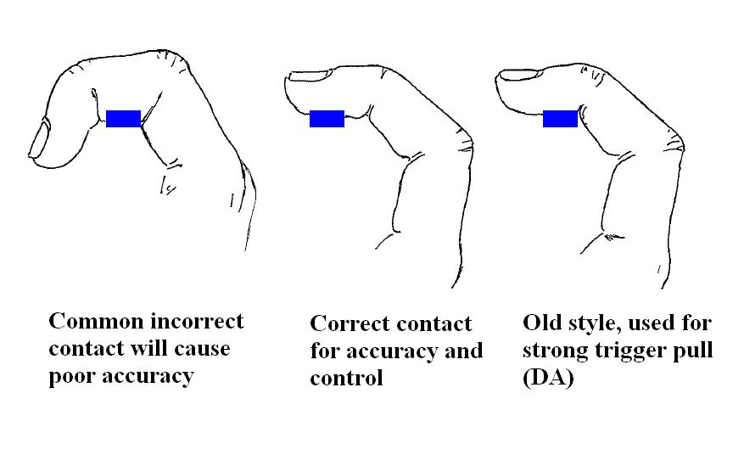
Trigger Control
Use the pad of your finger
Don’t stick your whole finger into the guard
Don’t “pull”, but rather “press”
Don’t allow for sideways movement

Slide 45
Follow-Through
Remember, bullets do not travel instantaneously!
Hold position and do not stop looking down the sights immediately after firing

Slide 46
Common Errors and Their Causes

Slide 47
Range Safety
Obey all basic firearms safety rules.
Make sure you are aware of the specific rules of a range before entering.
Always obey the Range Safety Officers.
Unload all firearms before entering range property

Slide 48
Range Safety
Upon arriving at any range which is occupied by other shooters, determine whether or not the firing line is HOT or COLD, and follow the procedures listed under Hot and Cold Ranges listed below. If a Range Safety Officer is not present, the range will be self policed. Read and follow the safety rules.

Slide 49
Range Safety
Report any safety rules violations to range safety/security officials.
Always keep the muzzle pointed up or down while carrying a firearm, and pointed down range if on the firing line. Never carry your firearm with the barrel parallel to the ground.
No shooting into ground or air at any angle.

Slide 50
Range Safety
Any cased firearm will be uncased and cased on a shooting bench or the firing line. Any uncased firearm will be unloaded with action open and a chamber flag inserted in the chamber while moving that firearm.
All unattended firearms must be unloaded and have the actions open
Eye and ear protection must be worn at all times while shooting or near the firing line.

Slide 51
Range Safety
Stop shooting immediately upon command “Cease Firing” and follow directions from whomever is in charge: A RSO, if present, will take control in solving the situation. If no RSO is present, the person who called the cease fire will take control, or submit control to another person who can handle the situation.

Slide 52
Hot Range Procedures
Hot Range is defined as firearms being handled and/or fired on the firing line, and no one is permitted down range
Hot Range begins with all shooters behind the yellow line or 5 feet behind the firing line where there is no yellow line.
Double check for anyone downrange.

Slide 53
Hot Range Procedures
On command “Range is hot,” shooters may move forward to the firing line, handle firearms/commence firing, pick up brass around their positions, and move firearms and equipment to and from their vehicles
If a firearm is to be cleaned while on a range, the firearm will be cleaned only while the range is hot. Shooters will not go forward of the firing line for any reason to include picking up brass, cleaning patches, etc.

Slide 54
Cold Rang Procedures
Cold Range is defined as firearms are cleared (unloaded, actions open, and removable magazines removed), no one handling a firearm, and shooters being permitted to go downrange.
Cold Range begins with the command “The range is cold” followed by “Unload all firearms” at which time shooters will unload their firearms, open actions, remove removable magazines, and move behind the yellow line or 5 feet behind the firing line when there is no yellow line.

Slide 55
Cold Range Procedures
All firearms will then be checked to ensure they are unloaded
On command “The firing line is safe,” shooters may go downrange to service targets, pick up brass in front of the firing line, and move equipment (no firearms) to and from vehicles.

Slide 56
Any questions comments or concerns?

