Slide 1
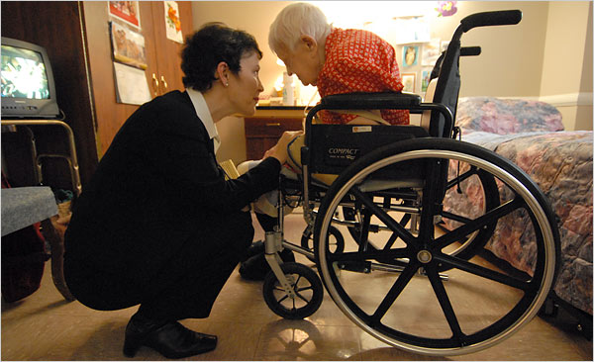
INTERDISCIPLINARY AGING SERVICES
Tuesday, December 6, 2016
UMBC – Sherman Room 145
FUTURE AGING JOBS/CAREERS
Free Pizza Informational Lunch
Co-Sponsored By: NASW Aging Committee
UMBC Social Work Student Association
PANEL MEMBERS Melissa Cuerdon, MSW (Catholic University-2010)
Policy Analyst, Centers for Medicare & Medicaid Services, Baltimore, MD
Christopher Moore, M.A. (UMBC Erickson School-2015)
Information & Assistance Program
Anne Arundel County Department of Aging & Disability, Annapolis, MD
Edward K. Featherson, BSW (UMBC Department of Social Work-2013)
Expressive Therapist, Hebrew Home of Greater Washington, Bethesda, MD
___________________________________________________________
Wednesday, December 7, 2016, 12:00n – 1:00pm Lecture
UMBC Sherman Hall – 334
Ethical Issues in Long Term Care
Nancy Kusmaul, PhD, MSW
Assistant Professor
UMBC Baccalaureate Social Work Program

