Slide 1
UMBC
Landscape & Stewardship Committee
May 13, 2015

Slide 2
UMBC
Landscape & Stewardship Committee
Long-Range Planning Studies – Stormwater IMP
UMBC is embarking on a stormwater management plan that will:
analyze the way the campus currently captures and treats rain water discharges on campus;
integrate water management with open space;
propose phased improvements throughout the campus;
submit an Institutional Stormwater Management Plan (IMP) with the Maryland Department of the Environment (MDE); and
develop guidelines to instruct A/E’s for future projects.

Slide 3
UMBC
Landscape & Stewardship Committee
Long-Range Planning Studies – Stormwater IMP
Goals of the Study
To develop a stormwater management plan, which recognizes the potential to advance a broad set of interrelated goals, including improving water quality, creating natural habitat, controlling flooding, creating recreational opportunities, educating the campus community and furthering research.
To prepare an IMP that will serve as a framework for discussions with environmental regulatory agencies, increasing predictability when projects are reviewed for permitting.
To develop an asset management tool that will allow the university to track ongoing stormwater improvements and coordinate management and maintenance programs.
To codify and clarify standards of appropriate project response regarding site development, open space development, and landscaping, ultimately leading to a more unified campus environment, while addressing stormwater management.

Slide 4
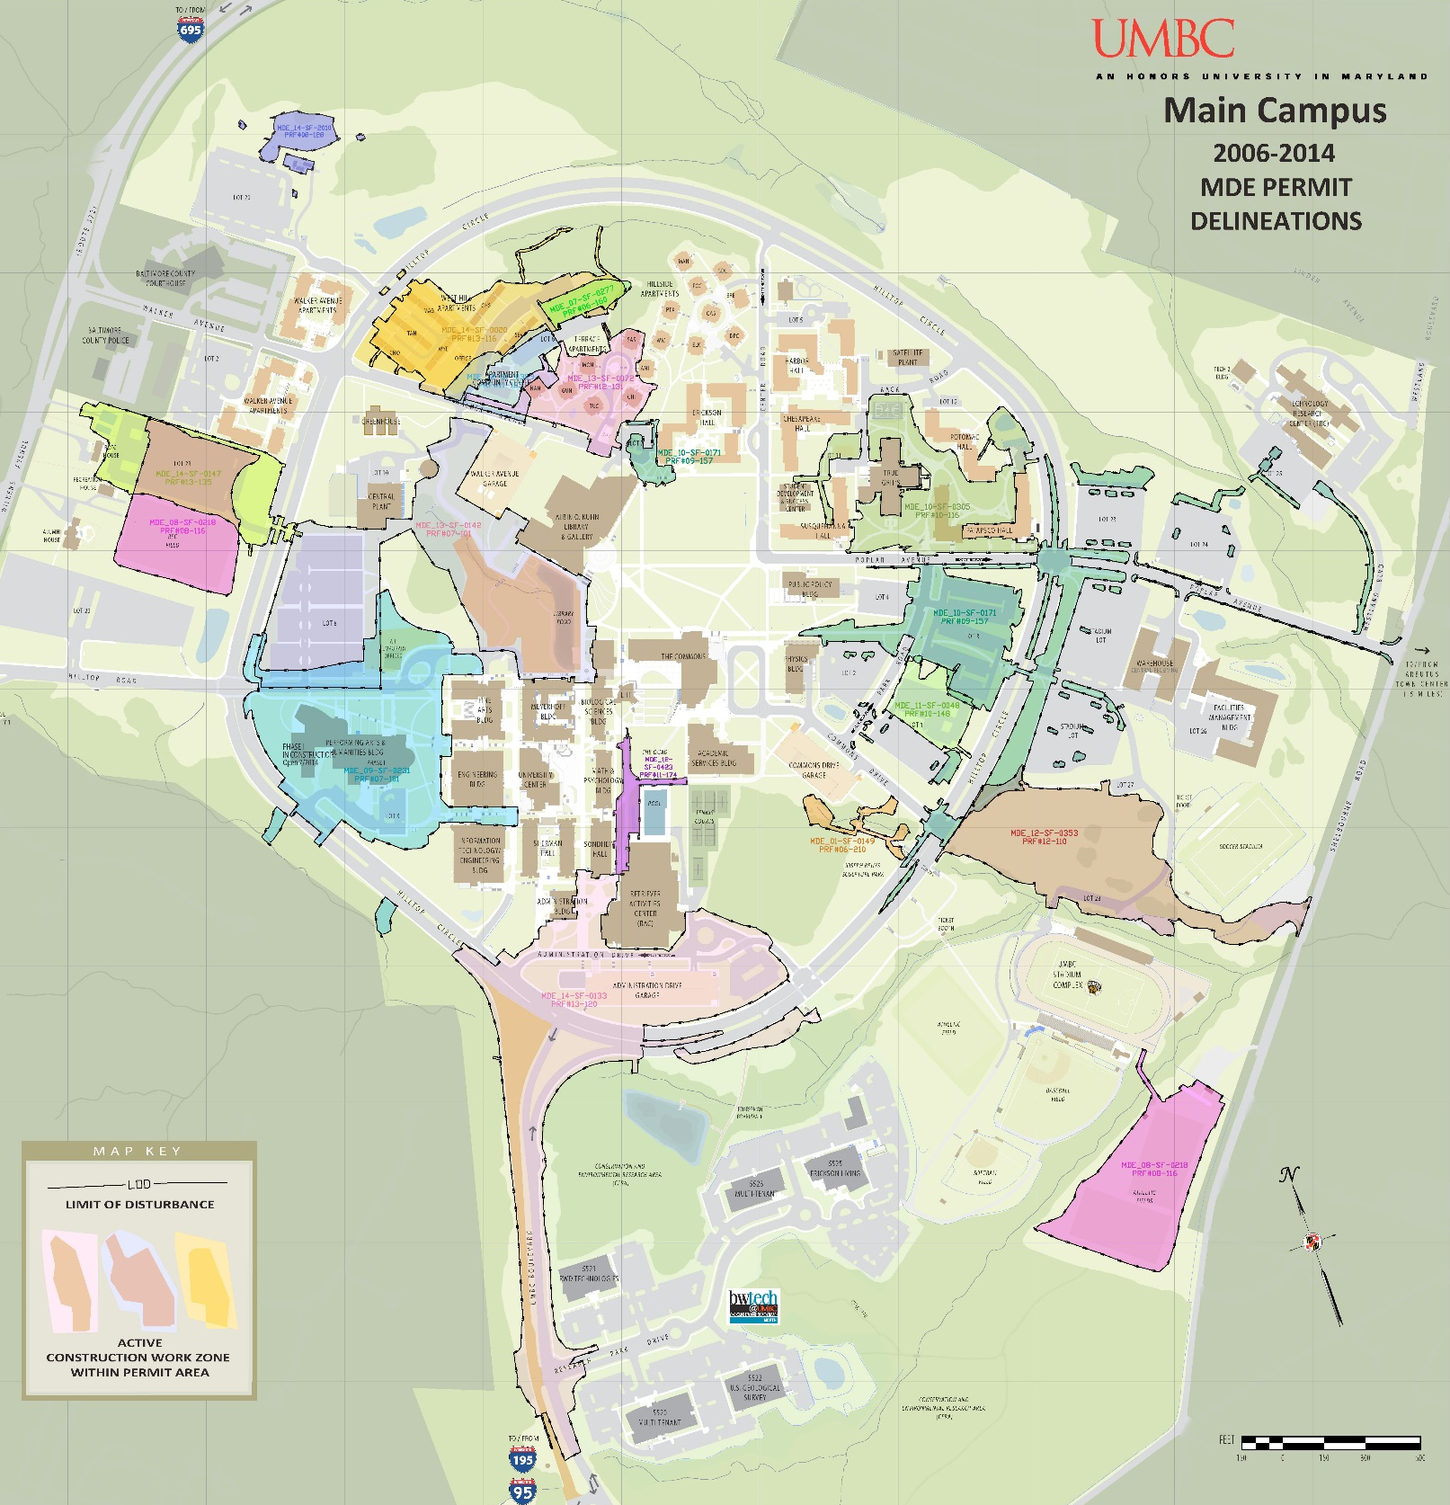
UMBC
Landscape & Stewardship Committee
Long-Range Planning Studies – Stormwater IMP
MDE Permits
Since 2006

Slide 5
UMBC
Landscape & Stewardship Committee
Long-Range Planning Studies – Stormwater IMP
Schedule
JUN
JUL
AUG
SEP
OCT
NOV
DEC
JAN
RESEARCH & OBSERVATIONS
DATA COLLECTION
FIELD RECONNAISSANCE
SITE ANALYSIS
ANALYSIS AND MODELING
FOCUS GROUPS WORKSHOPS
STORMWATER MODELING
ANALYSIS
ASSET MANAGEMENT TOOL
IMP DEVELOPMENT
MDE COORDINATION
DRAFT MDE INSTITUTIONAL MANAGEMENT PLAN
FINAL REPORT

Slide 6
UMBC
Landscape & Stewardship Committee
Long-Range Planning Studies – Stormwater IMP
Focus Groups
The consultants will be engaging members of the campus community, including:
The Landscape and Stewardship Committee
Environmental and natural systems researchers
Facilities Management personnel engaged in the design, maintenance and management of stormwater facilities

Slide 7
UMBC
Landscape & Stewardship Committee
Interdisciplinary Life Sciences Building
UMBC’s Interdisciplinary Life Sciences Building will seamlessly connect teaching and research activities to enhance and further stimulate collaborative approaches to advancing the State’s biotechnology industry and increasing the number of STEM graduates.

Slide 8
UMBC
Landscape & Stewardship Committee
Interdisciplinary Life Sciences Building
The Interdisciplinary Life Sciences Building will aid the university in achieving strategic goals as outlined in the UMBC Strategic Framework for 2016.
It will provide a place for “distinctive undergraduate experience” by providing state-of-the-art facilities to promote active learning while leveraging technology to support course redesign to enhance student learning and success.
It will provide flexible and dynamic, interdisciplinary life science research laboratories and core support facilities as the basis to “build research and graduate education”.

Slide 9
UMBC
Landscape & Stewardship Committee
Interdisciplinary Life Sciences Building
The ILSB will help UMBC achieve these objectives of the Strategic Framework:
“Play a proactive role in the State's economic development initiatives through sponsored research activities, technology transfer and commercialization, professional workforce development “
“Encourage the development of cross-disciplinary or interdisciplinary clusters and programs”
“Anticipate the University’s need for increased space to support its mission”
“Strengthen existing infrastructure to support growing research activity”

Slide 10
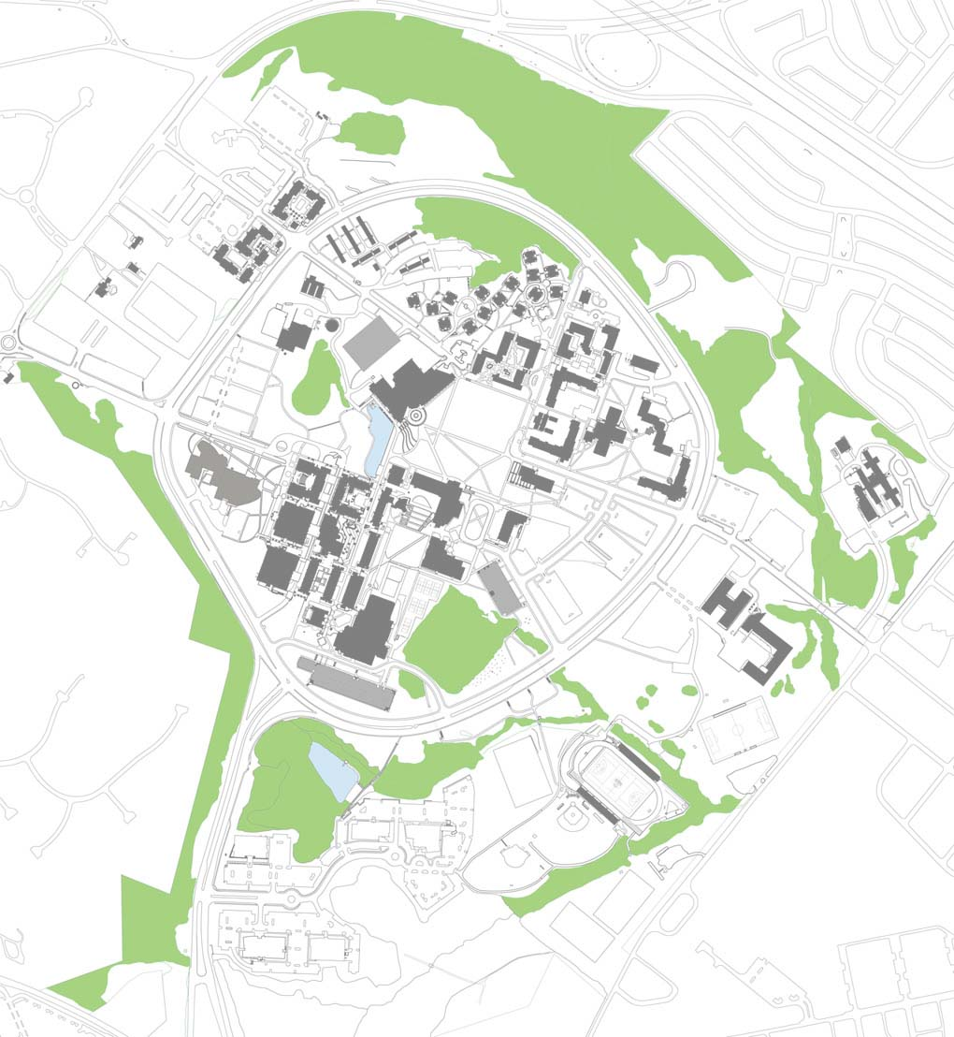
UMBC
Landscape & Stewardship Committee
Departments supported by the ILSB
Biological Sciences
Chemical, Biochemical and Environmental Engineering
Chemistry and Biochemistry
Geography and Environmental Systems
Mechanical Engineering
Mathematics and Statistics
Physics
Psychology
I L S B
Academic Services Building
The ILSB will serve as a bridge linking the western, dense academic core with the east academic area and future campus growth.

Slide 11
UMBC
Landscape & Stewardship Committee
The Commons Plaza
Points of Pedestrian Access
I L S B
The Quad
Service Access

Slide 12
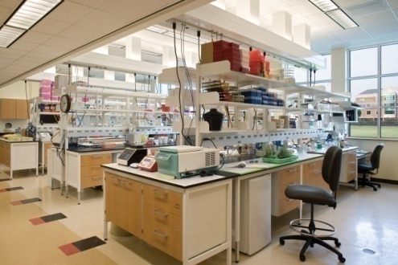
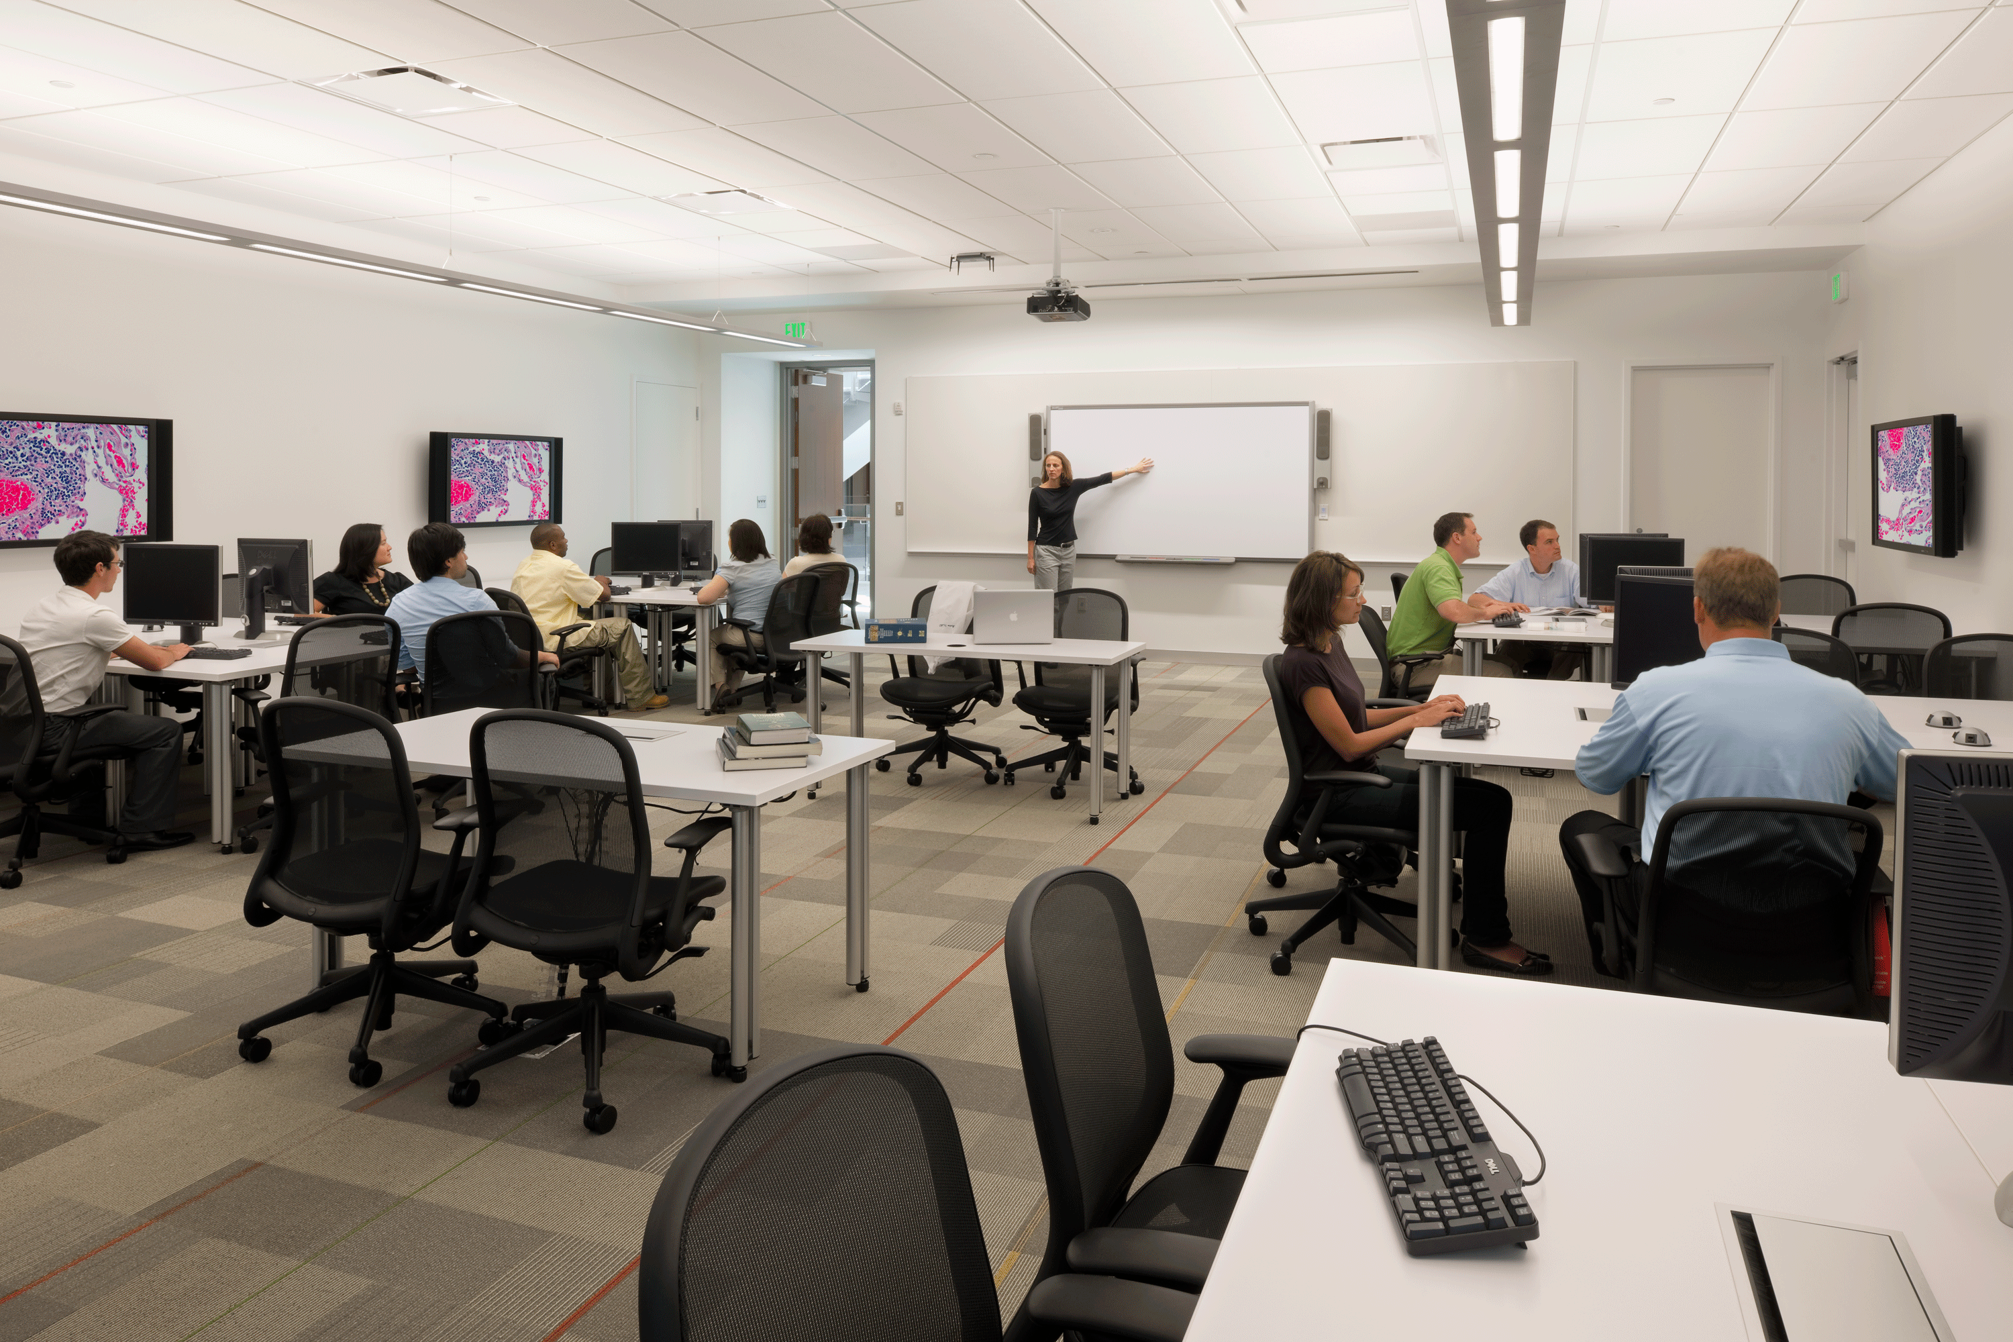
UMBC
Landscape & Stewardship Committee
Interdisciplinary Life Sciences Building
Active-Learning Classrooms
Flexible Research Labs

Slide 13
UMBC
Landscape & Stewardship Committee
Interdisciplinary Life Sciences Building
The new ILSB will provide:
active-learning classrooms, seminar rooms, and teaching labs in support of UMBC’s science, technology, engineering, and mathematics programs;
flexible and adaptable laboratories that are assigned for targeted life science research activities involving faculty from multiple departments and colleges;
animal holding and procedure facility to support animal-based research; and,
other core research facilities to support campus-wide research and education activities, which are centrally managed and operated.

Slide 14
UMBC
Landscape & Stewardship Committee
Interdisciplinary Life Sciences Building
The Interdisciplinary Life Sciences Building will support course redesign with dynamic high-technology classrooms, seminar rooms and teaching labs.
Quantity
4 | 90 station Active Learning Classrooms
4 | 48 station Active Learning Classrooms
1 | Teaching Ready Room
1 | Observation and Research Lab
4 | 32 station Teaching Labs
2 | shared Teaching Lab Prep and Storage Rooms
3 | 24 station Seminar Rooms
3 | 12 station Seminar Rooms
1 | 12 station GMP Lab Training Facility
6 | Collaborative Project Rooms for 5 students

Slide 15

UMBC
Landscape & Stewardship Committee
Interdisciplinary Life Sciences Building
Project Vision

Slide 16
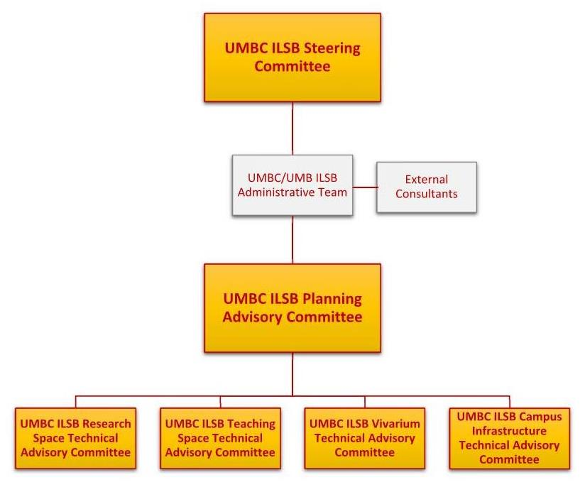
UMBC
Landscape & Stewardship Committee
Interdisciplinary Life Sciences Building
Committee Structure

Slide 17
UMBC
Landscape & Stewardship Committee
Interdisciplinary Life Sciences Building
Steering Committee
Philip Rous (Co-Chair) | Provost
Lynne Schaefer (Co-Chair) | VP of Administration and Finance
Bill LaCourse | Dean, College of Natural and Mathematical Sciences
Scott Casper | Dean, College of Arts, Humanities and Social Sciences
Julia M. Ross | Dean, College of Engineering and Information Technology
Karl V. Steiner | VP for Research
Terry Cook | Senior Assoc. VP for Administrative Services
Antonio Moreira | Vice Provost for Academic Affairs

Slide 18
UMBC
Landscape & Stewardship Committee
Interdisciplinary Life Sciences Building
Planning Advisory Committee
Bill LaCourse (Chair) | Dean, College of Natural and Mathematical Sciences
Phil Farabaugh | Professor, Department of Biological Sciences (on sabbatical – part of time)
Jeff Leips | Professor, Department of Biological Sciences
Kathleen Hoffman | Professor, Department of Math/Stat
Zeev Rosenzweig | Professor, Chemistry / Boichemistry
Rachel Brewster | Associate Professor, Department of Biological Sciences
Upal Gosh | Professor, Chemical and Biochemical Engineering
Andrew J. Miller | Professor, Department of Geography and Environmental Studies
Steve Freeland | Interdisciplinary Studies
Dean Drake | Assoc. VP for Research
Anthony Moreira | Vice Provost for Academic Affairs
Rusty Postlewate | Assistant Vice President for Facilities Management
Joseph Rexing | University Architect

Slide 19
UMBC
Landscape & Stewardship Committee
Interdisciplinary Life Sciences Building
Research Space Technical Advisory Committee
Dennis Cuddy | Administration and Facilities, Chemistry and Biochemistry
Jim Milani | College of Engineering and Information Technology
Mathew Baker | Professor, Department of Geography and Environmental Systems
Jennie Leach | Associate Professor, Chemical and Biochemical Engineering
Mauricio Bustos | Associate Professor, Department of Biological Sciences
Dave Eisenmann | Associate Professor, Department of Biological Sciences

Slide 20
UMBC
Landscape & Stewardship Committee
Interdisciplinary Life Sciences Building
Teaching Space Technical Advisory Committee
Kathy Sutphin | Assistant Dean College of Natural and Mathematical Sciences
Sarah Leupen | Senior Lecturer, Biological Sciences
Allison Tracy | Lecturer, Chemistry and Biochemistry
Lili Cui | Senior Lecturer, Physics
Steve Mang | Lecturer, Chemistry and Biochemistry
Don Snyder | Lecturer, Media and Communication Studies
Suzanne Braunschweig | Lecturer & Director, Interdisciplinary Science
Anne Spence | Professor of the Practice, Mechanical Engineering
Steve Caruso | Senior Lecturer, Biological Sciences
Linda Hodges | Director, Faculty Development Center
Anthony Moreira | Vice Provost for Academic Affairs

Slide 21
UMBC
Landscape & Stewardship Committee
Interdisciplinary Life Sciences Building
Vivarium Design Technical Advisory Committee
Charles Bieberich | Professor, Department of Biological Sciences
Weihong Lin | Associate Professor, Department of Biological Sciences
Suzanne Ostand-Rosenberg | Professor, Robert and Jane Meyerhof Chair of Biochemistry
Bernard Rabin | Professor, Psychology
Liang Zhu | Professor, Mechanical Engineering.
Tim Sparklin | Research Compliance Officer, Research Administration

Slide 22
UMBC
Landscape & Stewardship Committee
Interdisciplinary Life Sciences Building
Campus Infrastructure Technical Advisory Committee
Joseph Rexing | Dir. of Planning and Construction Services, University Architect
Mike Pound | Director, UMBC Environmental Safety & Health
Robert McHenry | Asst. Director, UMBC Environmental Safety & Health
Paul Dillon | Deputy Chief, UMBC Police
Ken Joy | Manager, UMBC HVAC and Central Plant
Mark Cather | Chief Information Security Officer, UMBC Information Technology
David Toothe | Asst. Director, UMBC Division of Information Technology
Steve Anderson | Mgr. - Instructional Technology, UMBC Information Technology
Gary DeBethizy | HVAC Chief, UMBC Facilities Management
Tom Murphy | UMBC Electrical Shop
Greg Linz | FM Plumbing Shop
Donna Anderson | Mgr. of Landscape and Grounds, UMBC Facilities Management
Phillip Cho | UMBC MDE Liaison, UMBC Landscape Architect
Shawn Blum | FM Energy Manager
Larry Hennessey | UMBC PCS quality control
Joe Geluso | UMB Mechanical Engineer
Judy DeGraw | UMB Electrical Engineer
Julianne Simpson | Asst. Director for Planning, Program Verification

Slide 23
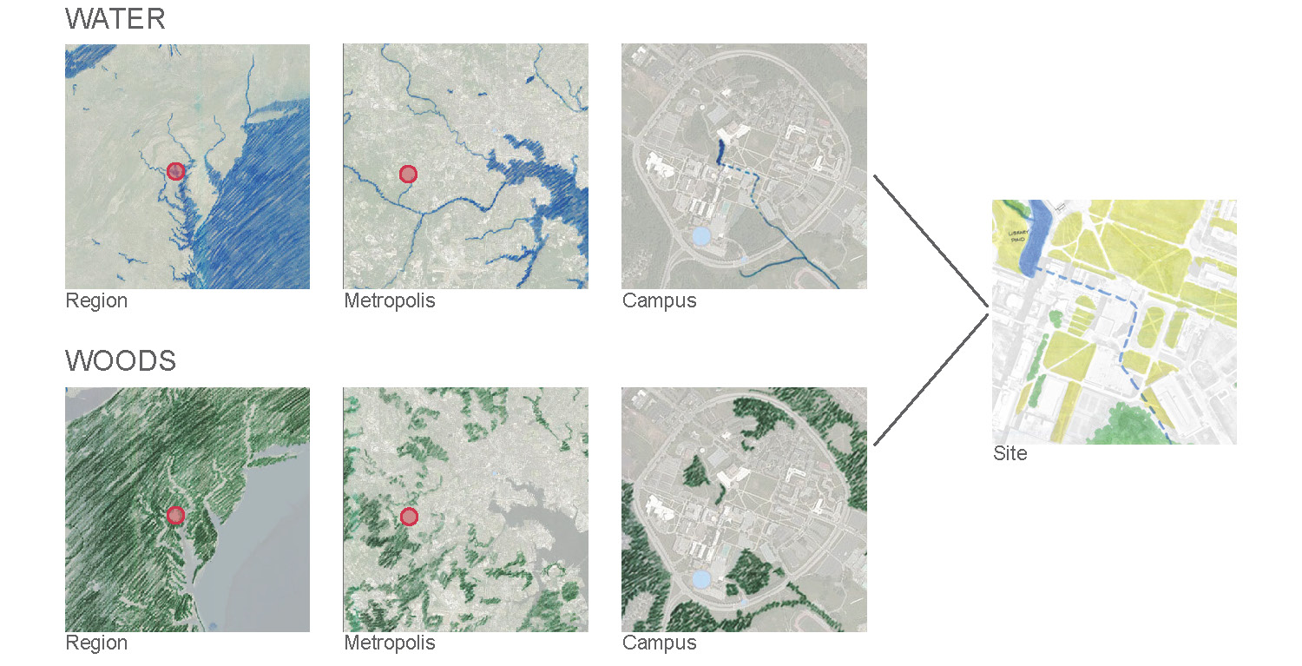
UMBC
Landscape & Stewardship Committee
Interdisciplinary Life Sciences Building
Big Picture – Life Sciences

Slide 24
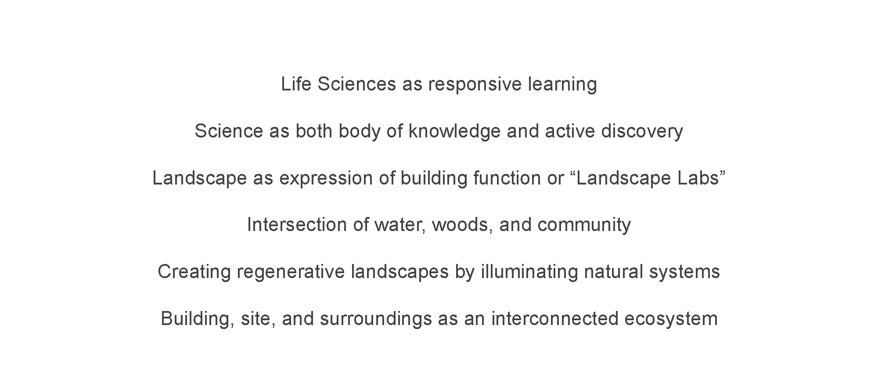
UMBC
Landscape & Stewardship Committee
Interdisciplinary Life Sciences Building
Emergent Site Themes

Slide 25
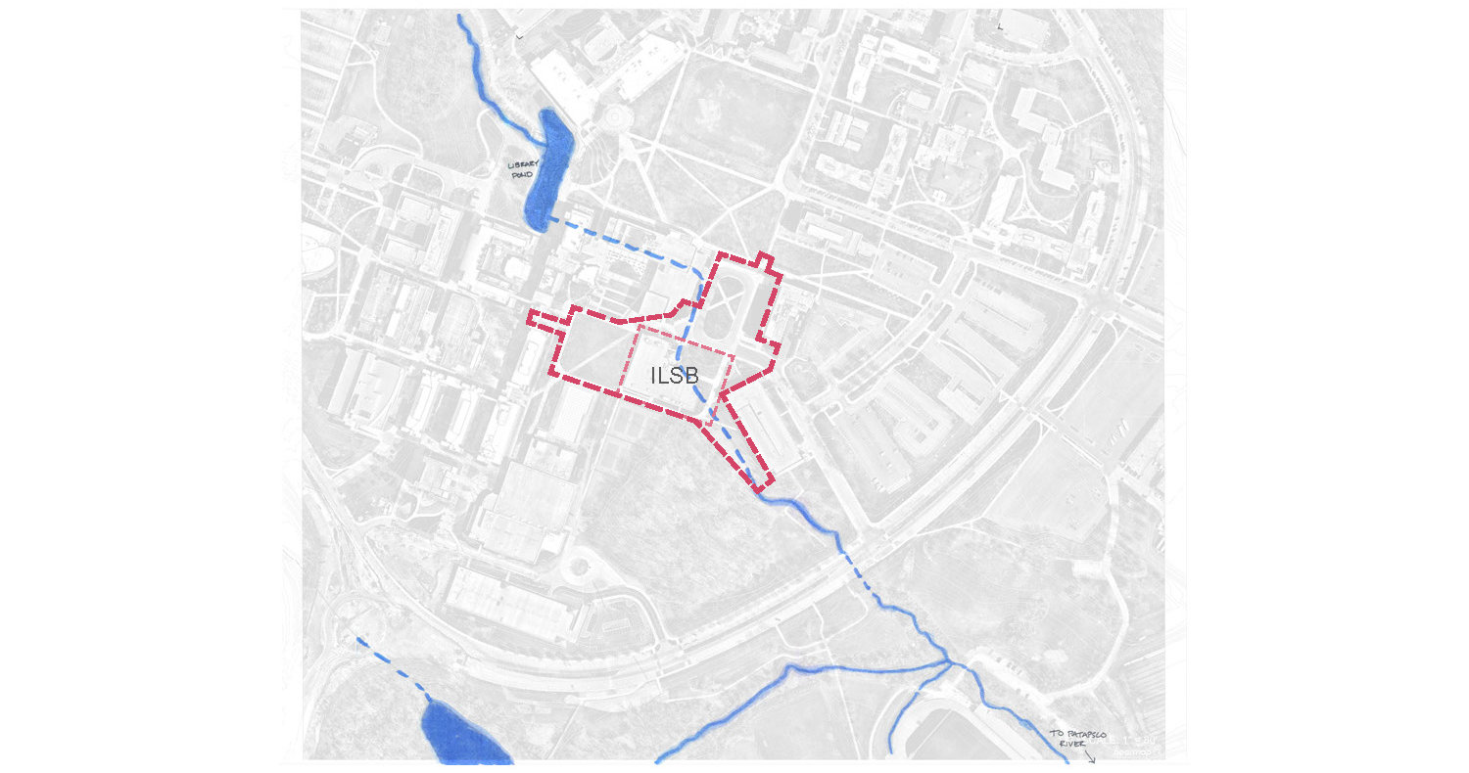
UMBC
Landscape & Stewardship Committee
Interdisciplinary Life Sciences Building
Water

Slide 26
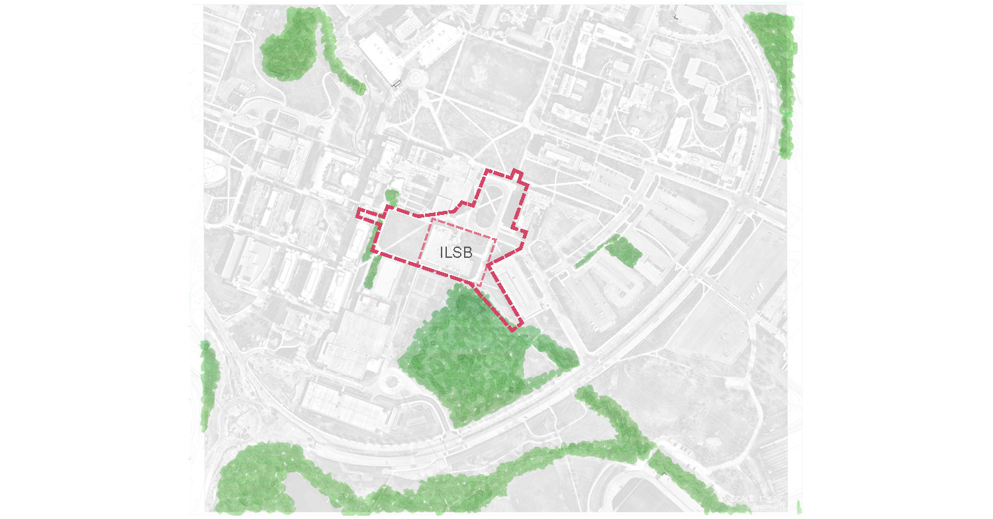
UMBC
Landscape & Stewardship Committee
Interdisciplinary Life Sciences Building
Woods

Slide 27
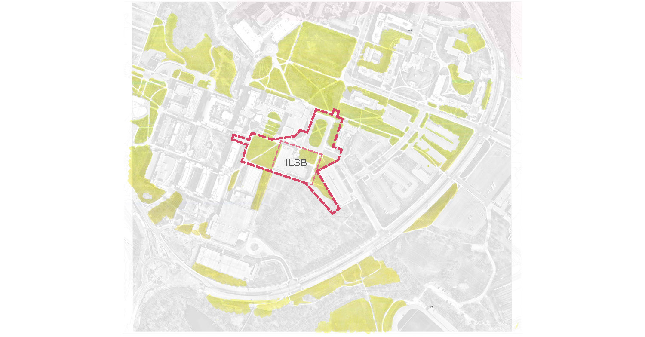
UMBC
Landscape & Stewardship Committee
Interdisciplinary Life Sciences Building
Lawn

Slide 28
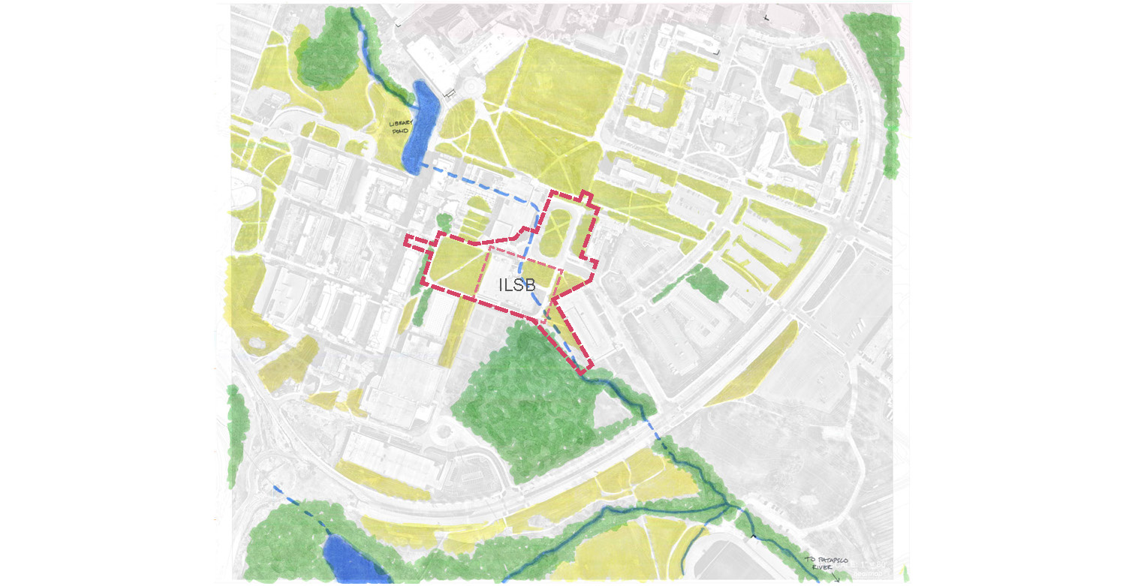
UMBC
Landscape & Stewardship Committee
Interdisciplinary Life Sciences Building
Composite

Slide 29
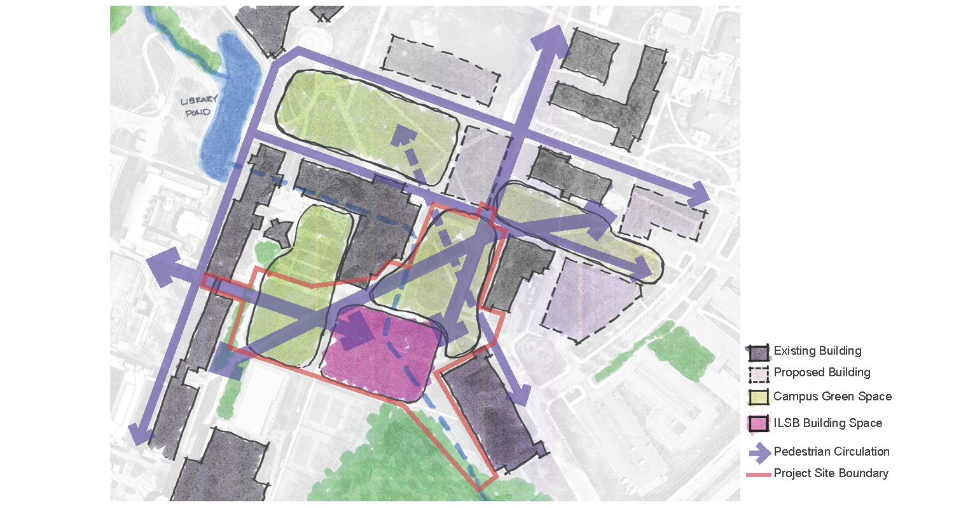
UMBC
Landscape & Stewardship Committee
Interdisciplinary Life Sciences Building
Existing & Future Conditions

Slide 30
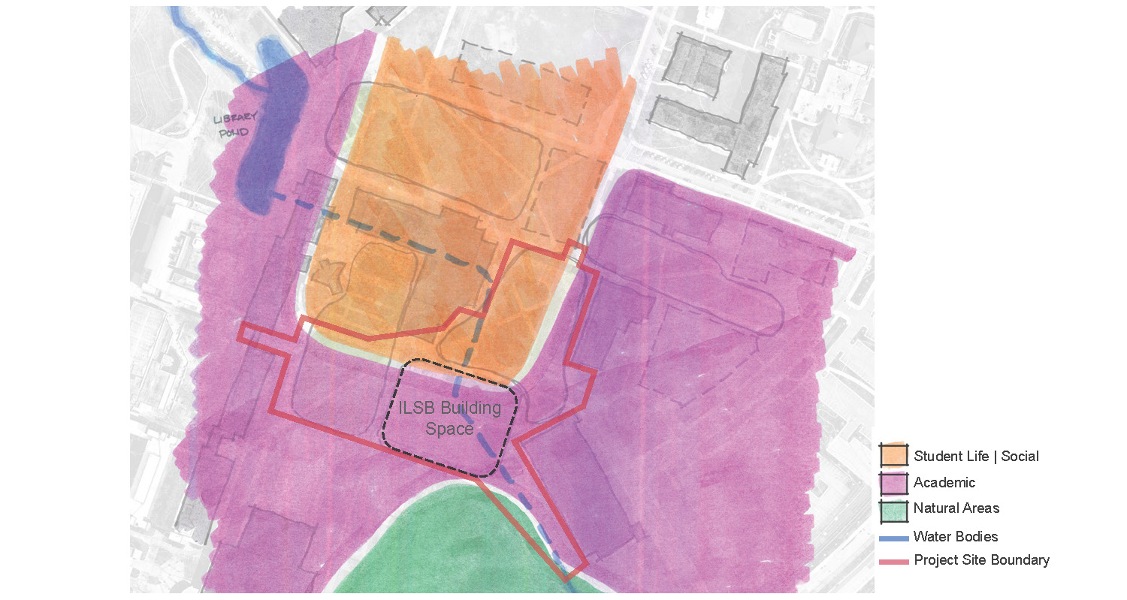
UMBC
Landscape & Stewardship Committee
Interdisciplinary Life Sciences Building
Existing Land Use

Slide 31
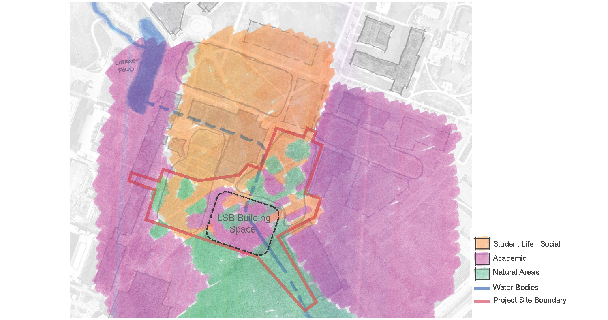
UMBC
Landscape & Stewardship Committee
Interdisciplinary Life Sciences Building
Concept

Slide 32
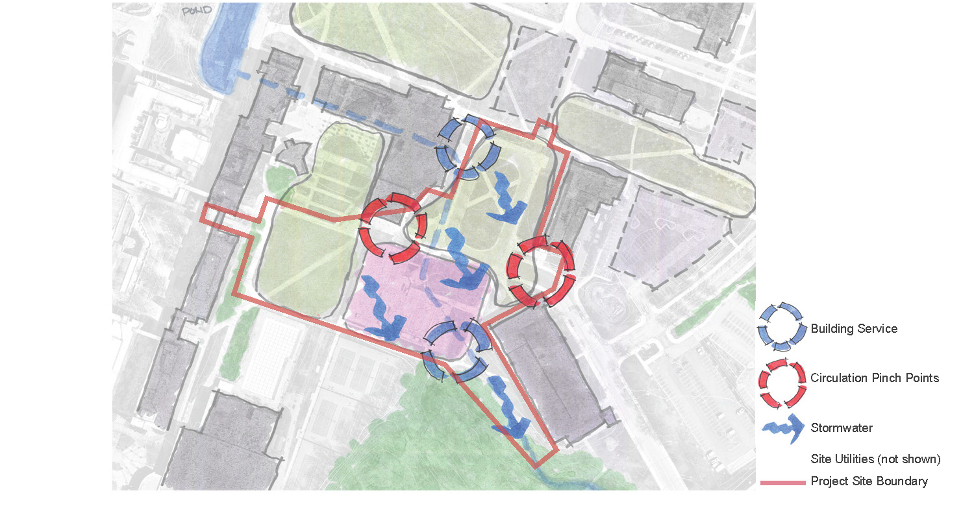
UMBC
Landscape & Stewardship Committee
Interdisciplinary Life Sciences Building
Challenges

Slide 33
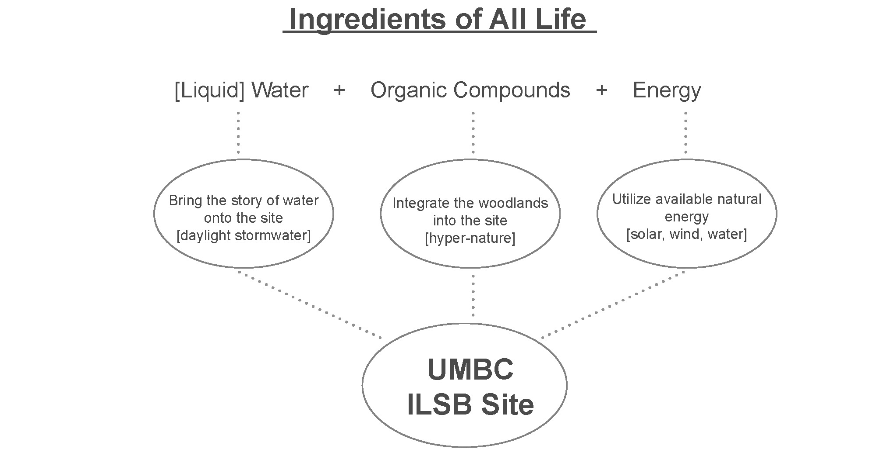
UMBC
Landscape & Stewardship Committee
Interdisciplinary Life Sciences Building
Site Influence

Slide 34

UMBC
Landscape & Stewardship Committee
Interdisciplinary Life Sciences Building
Precedents

Slide 35
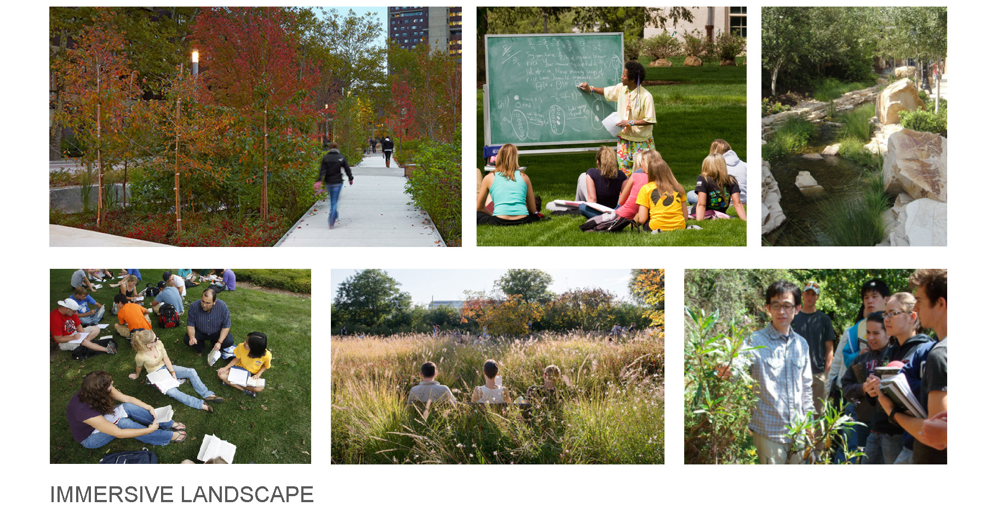
UMBC
Landscape & Stewardship Committee
Interdisciplinary Life Sciences Building
Precedents

Slide 36
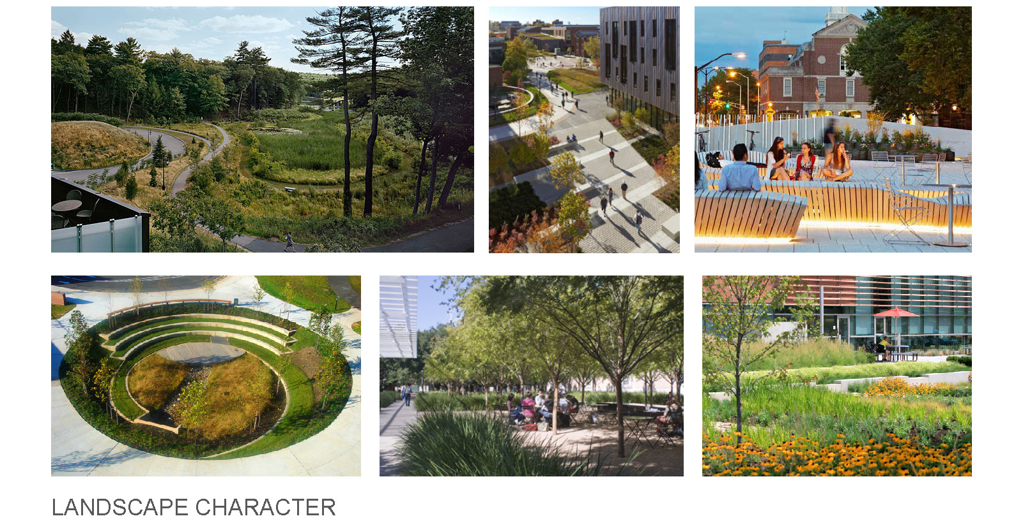
UMBC
Landscape & Stewardship Committee
Interdisciplinary Life Sciences Building
Precedents

Slide 37
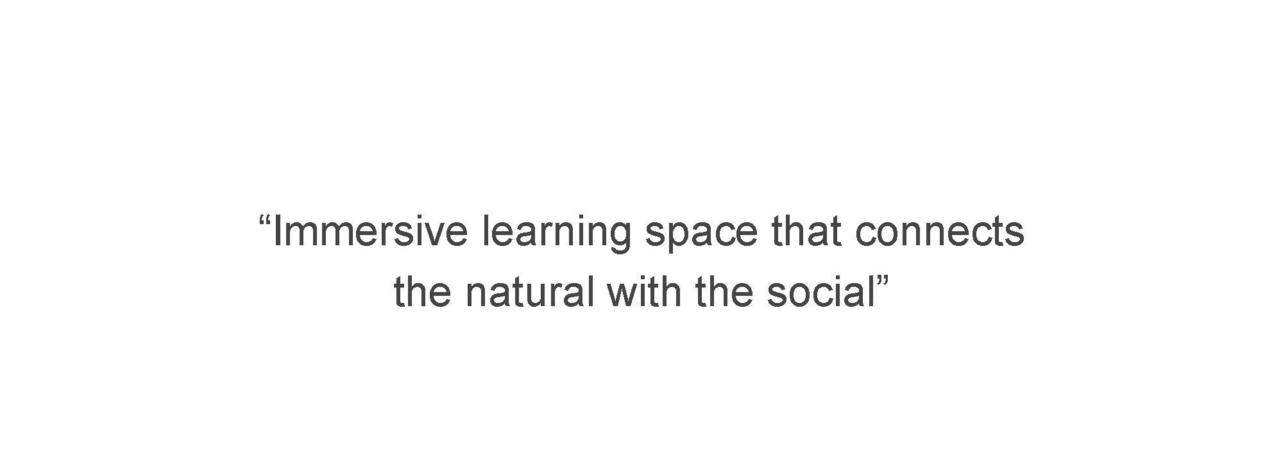
UMBC
Landscape & Stewardship Committee
Interdisciplinary Life Sciences Building
Statement of Design Intent

Slide 38
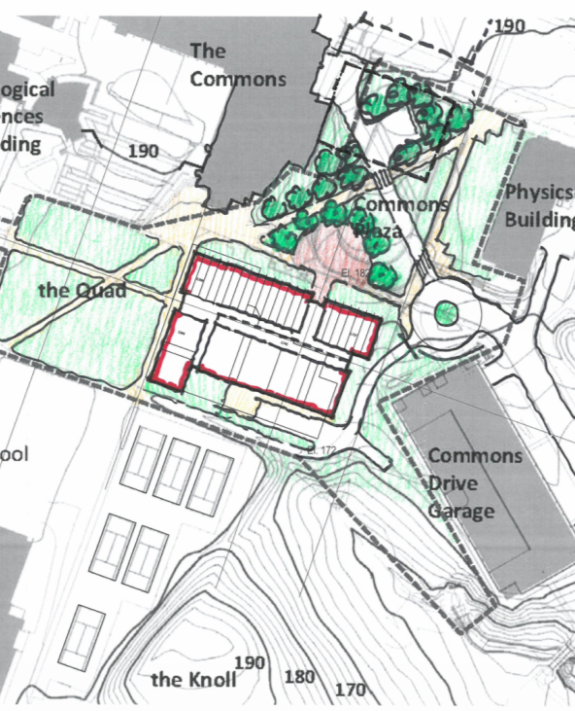
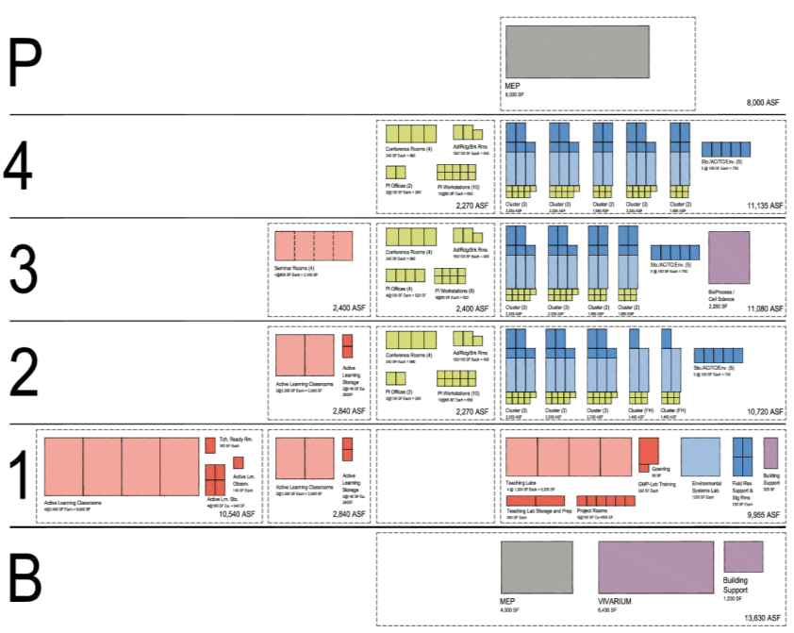
UMBC
Landscape & Stewardship Committee
Interdisciplinary Life Sciences Building
Stacking Option 1: Four Program Floors with Basement

Slide 39
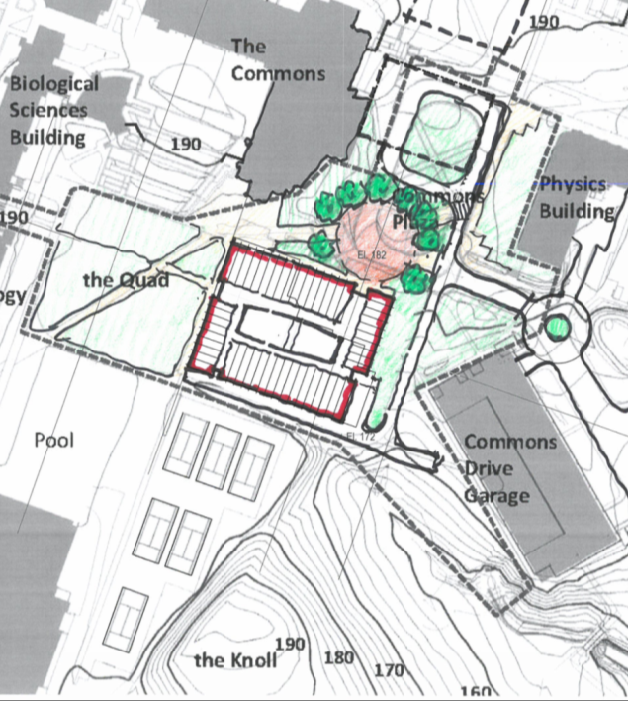
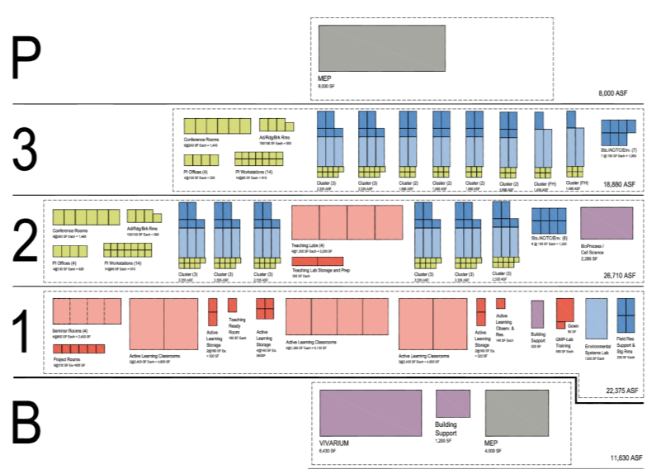
UMBC
Landscape & Stewardship Committee
Interdisciplinary Life Sciences Building
Stacking Option 2: Three Program Floors with Basement

Slide 40
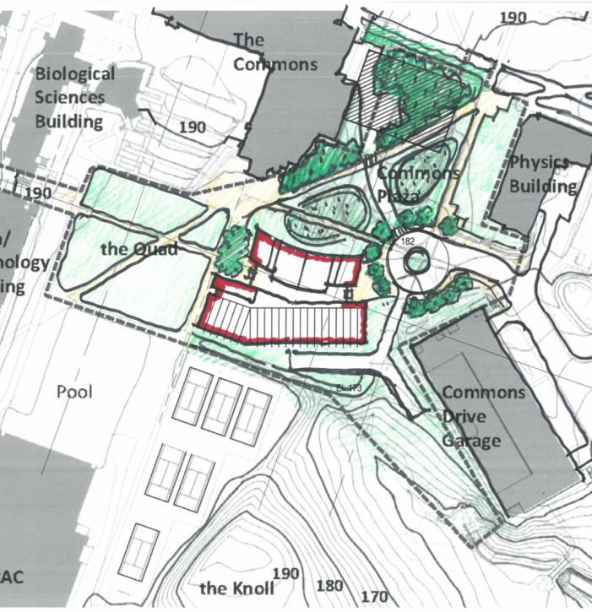
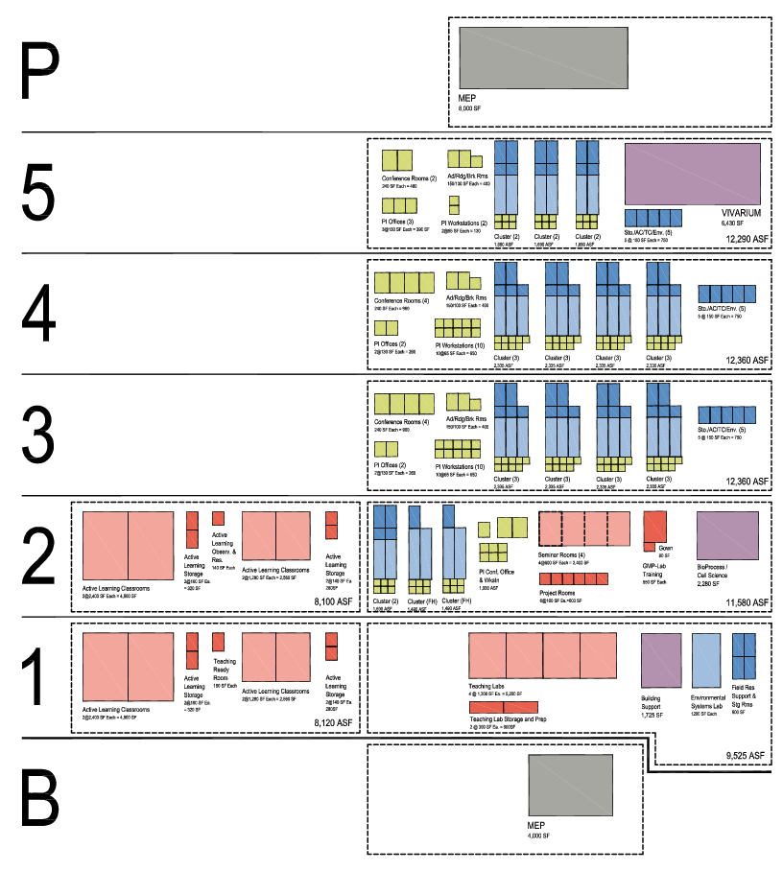
UMBC
Landscape & Stewardship Committee
Interdisciplinary Life Sciences Building
Stacking Option 3: Five Program Floors with Basement

Slide 41
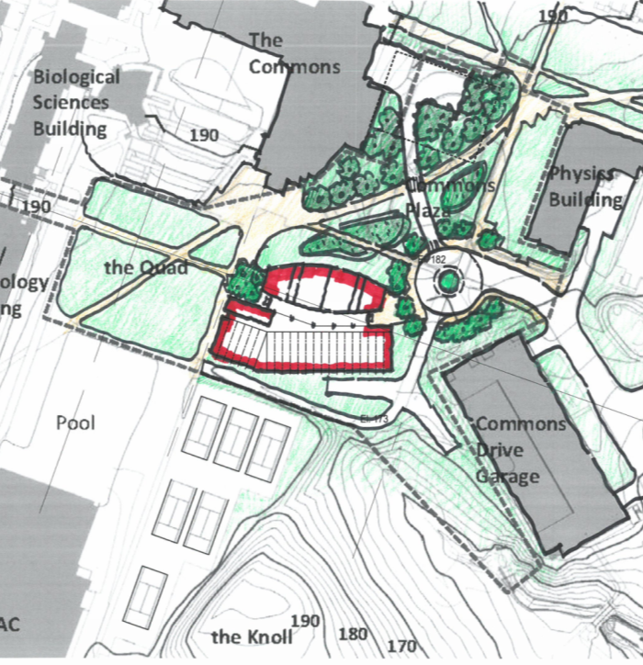
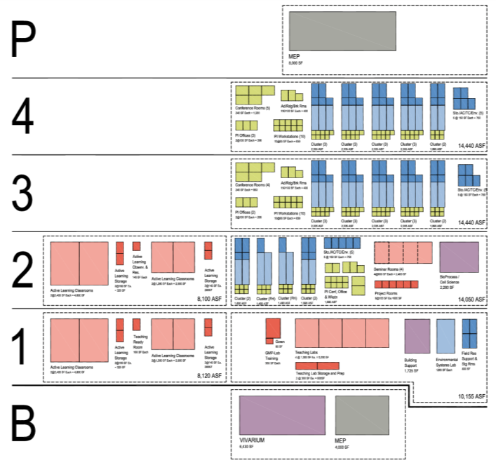
UMBC
Landscape & Stewardship Committee
Interdisciplinary Life Sciences Building
Stacking Option 3A: Four Floors with Basement

Slide 42
UMBC
Landscape & Stewardship Committee
Interdisciplinary Life Sciences Building
2011
2012
2013
2014
2015
2016
2017
2018
2019
Part I Program
Part II Program
Design*
Construction*
Part I Submitted
Part II Submitted
* Earliest possible schedule based upon current USM capital budget request

Slide 43
UMBC
Landscape & Stewardship Committee
Interdisciplinary Life Sciences Building

Slide 44
UMBC
Landscape & Stewardship Committee
Interdisciplinary Life Sciences Building
Schedule
 |  |  | 20 months | Design Phases 1-4:
1 | Apr 2015 | Jun 2015 | 2 months | Concept Design/Program Verification Phase Verify 2012 Part II Facility Program Blocking & stacking options Test fit program Develop 3 concept options Initial Cost Model: Confirm Budget/Scope/Quality
2 | Jun 2015 | Oct 2015 | 4 months | Schematic Design Phase All spaces shown Proper size and configuration for intended use Correct locations/adjacencies Initiate permitting/approval process (PDRM) Major systems selected
3 | Oct 2015 | Mar 2016 | 5 months | Design Development Phase Development of architectural, engineering and site systems
4 | Mar 2016 | Dec 2016 | 9 months | Construction Documents Phase Final technical drawings and specifications to construct 50% CD, 95% CD reviews
5 | Dec 2016 | Apr 2017 | 4 months | Bidding/GMP CM bids to trade subcontractors (3 months) CM/UMBC Finalize GMP BPW approval (1 month)
6 | Apr 2017 | Apr 2019 | 24 months | Construction Start construction April 2017 Substantial Completion April 2019
7 |  |  |  | Post Construction: 2 year warranty period

Slide 45
UMBC
Landscape & Stewardship Committee
Questions?

