Slide 1
UMBC New Roots Garden

Slide 2
Partnership with International Rescue Committee (IRC)
-IRC: international non-profit est. 1933
-Resettles refugees and provides
humanitarian support in 40 countries,
22 cities
-In U.S.the government governs
process and provides a majority
of the funding

Slide 3
New Roots Program
-IRC program that ensures improved nutrition and food security for refugees through gardening and education
-Gardens in Baltimore, New York, Seattle, Salt Lake City, Phoenix, San Diego, and Boise
https://youtu.be/XB_7_9vtr4M?list=PLTmviuzVZKkfhp4VkNODPxJyjlGU2XkXG

Slide 4
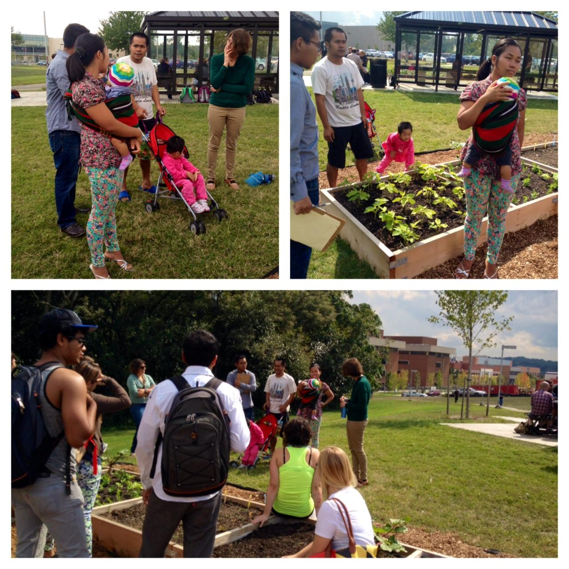
Successful Course-Component Fall 2014
-A pilot of this project
-Burmese family gardened in The Garden plots and engaged both formally and informally with students
-Beautiful cultural exchange and learning

Slide 5
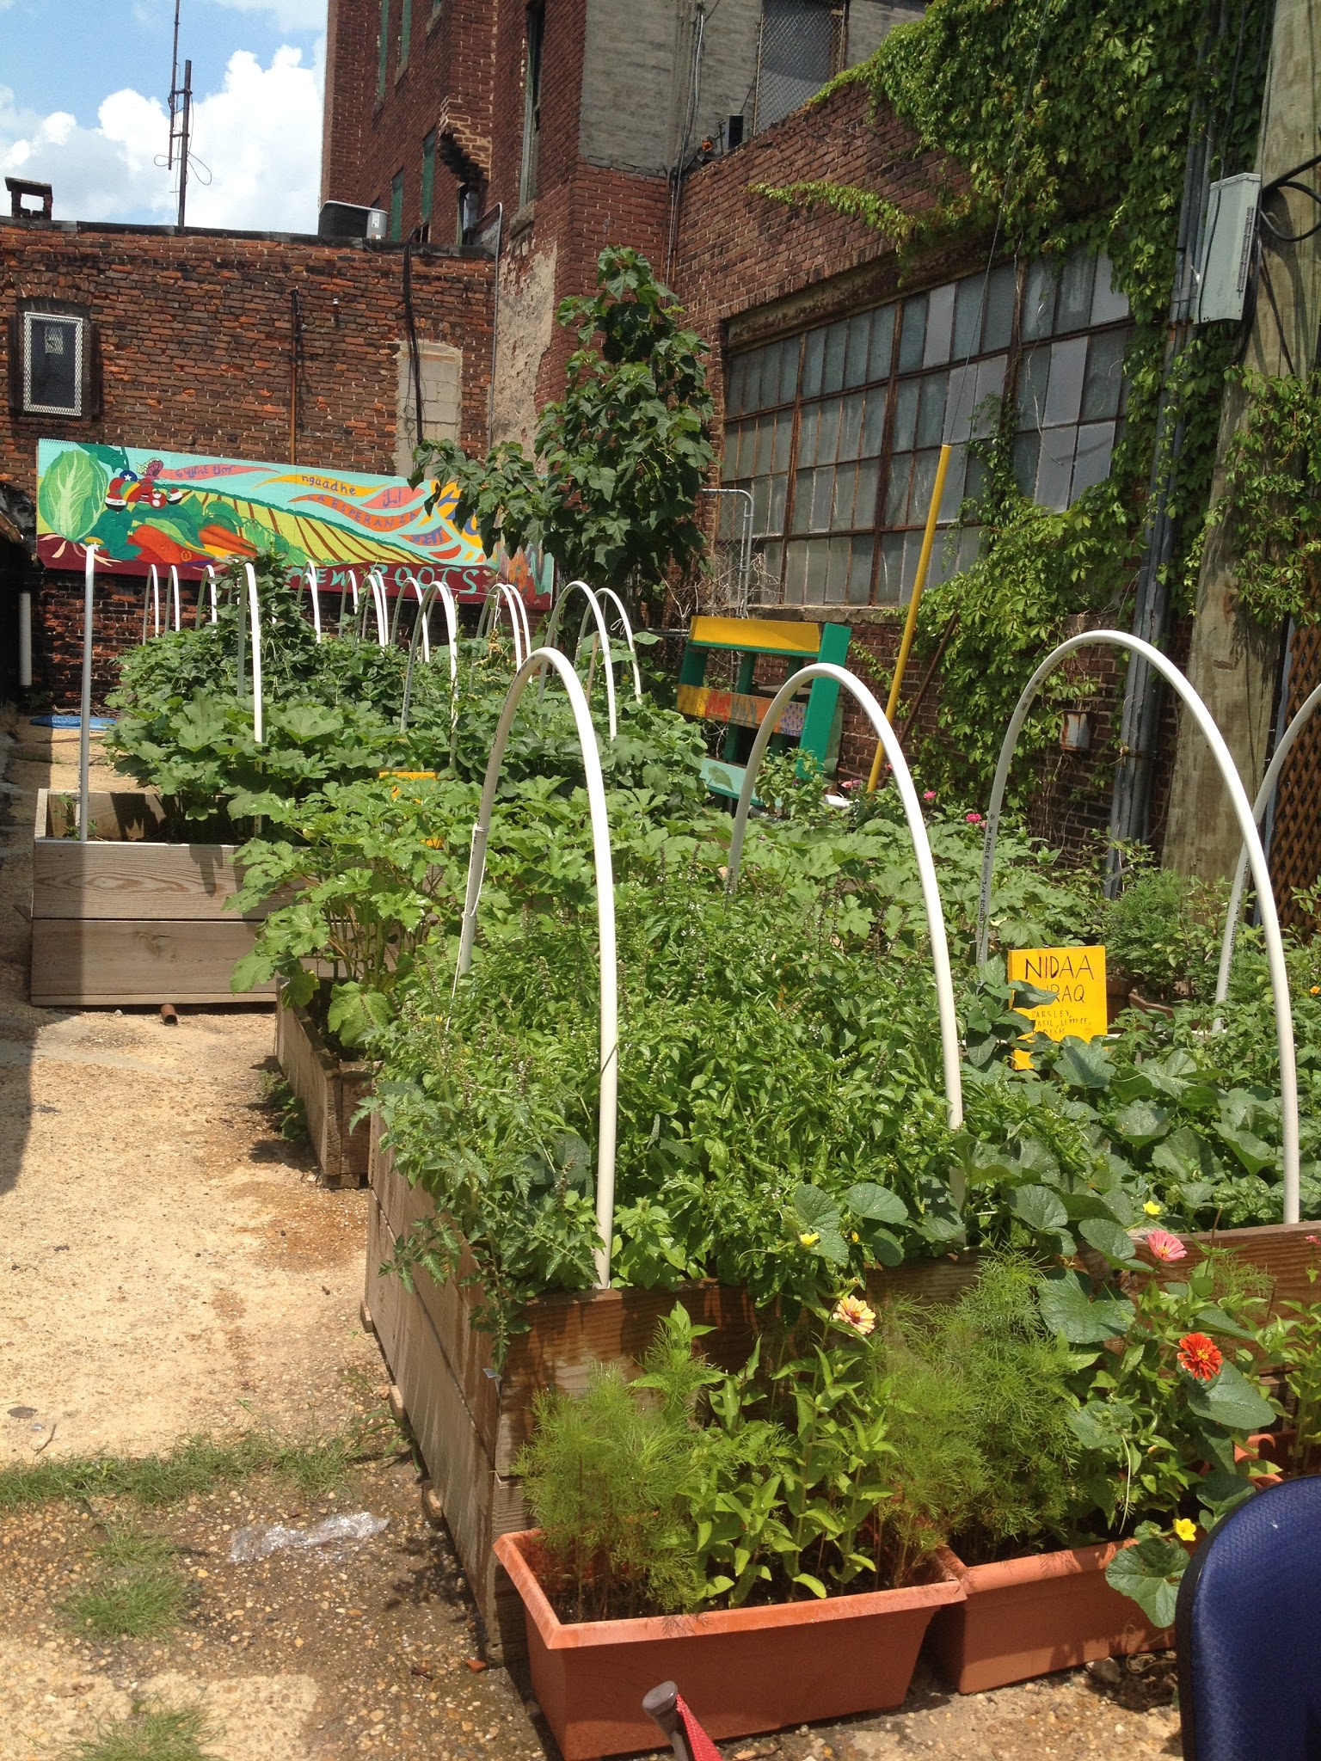
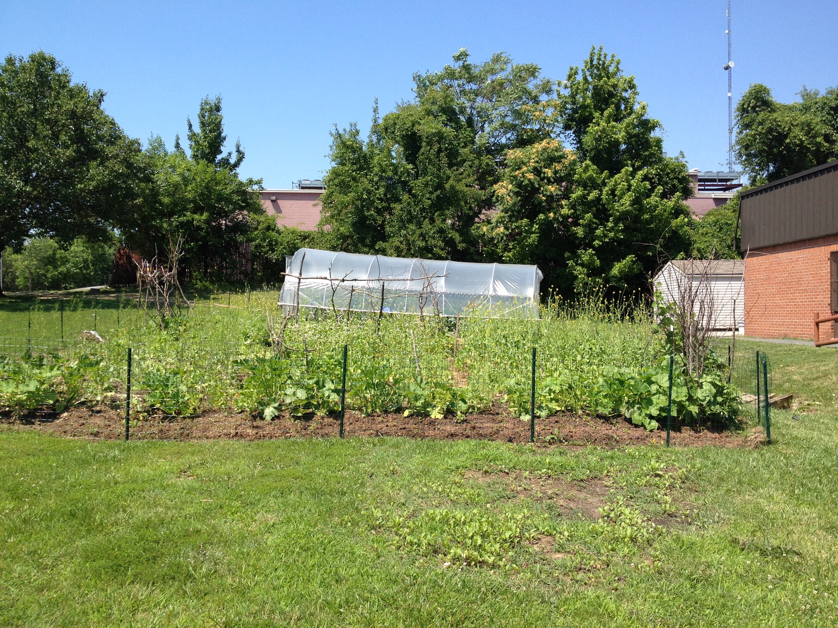
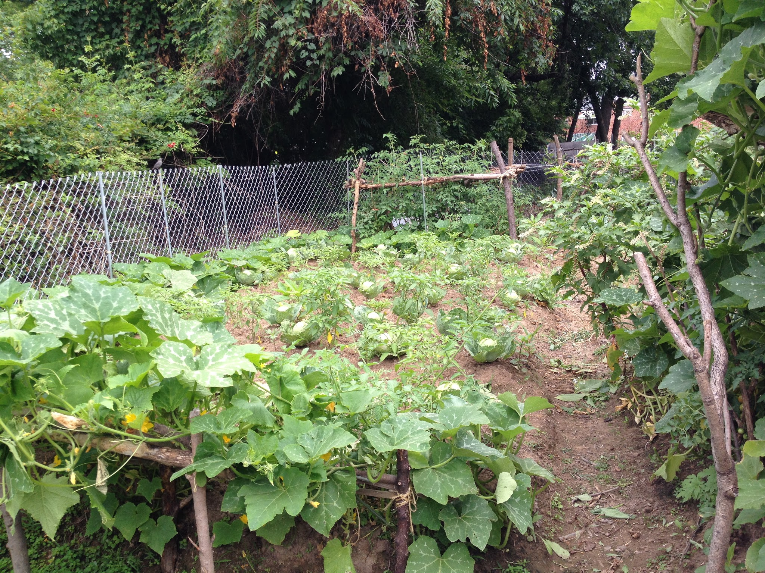
Current New Roots Gardens in Baltimore

Slide 6
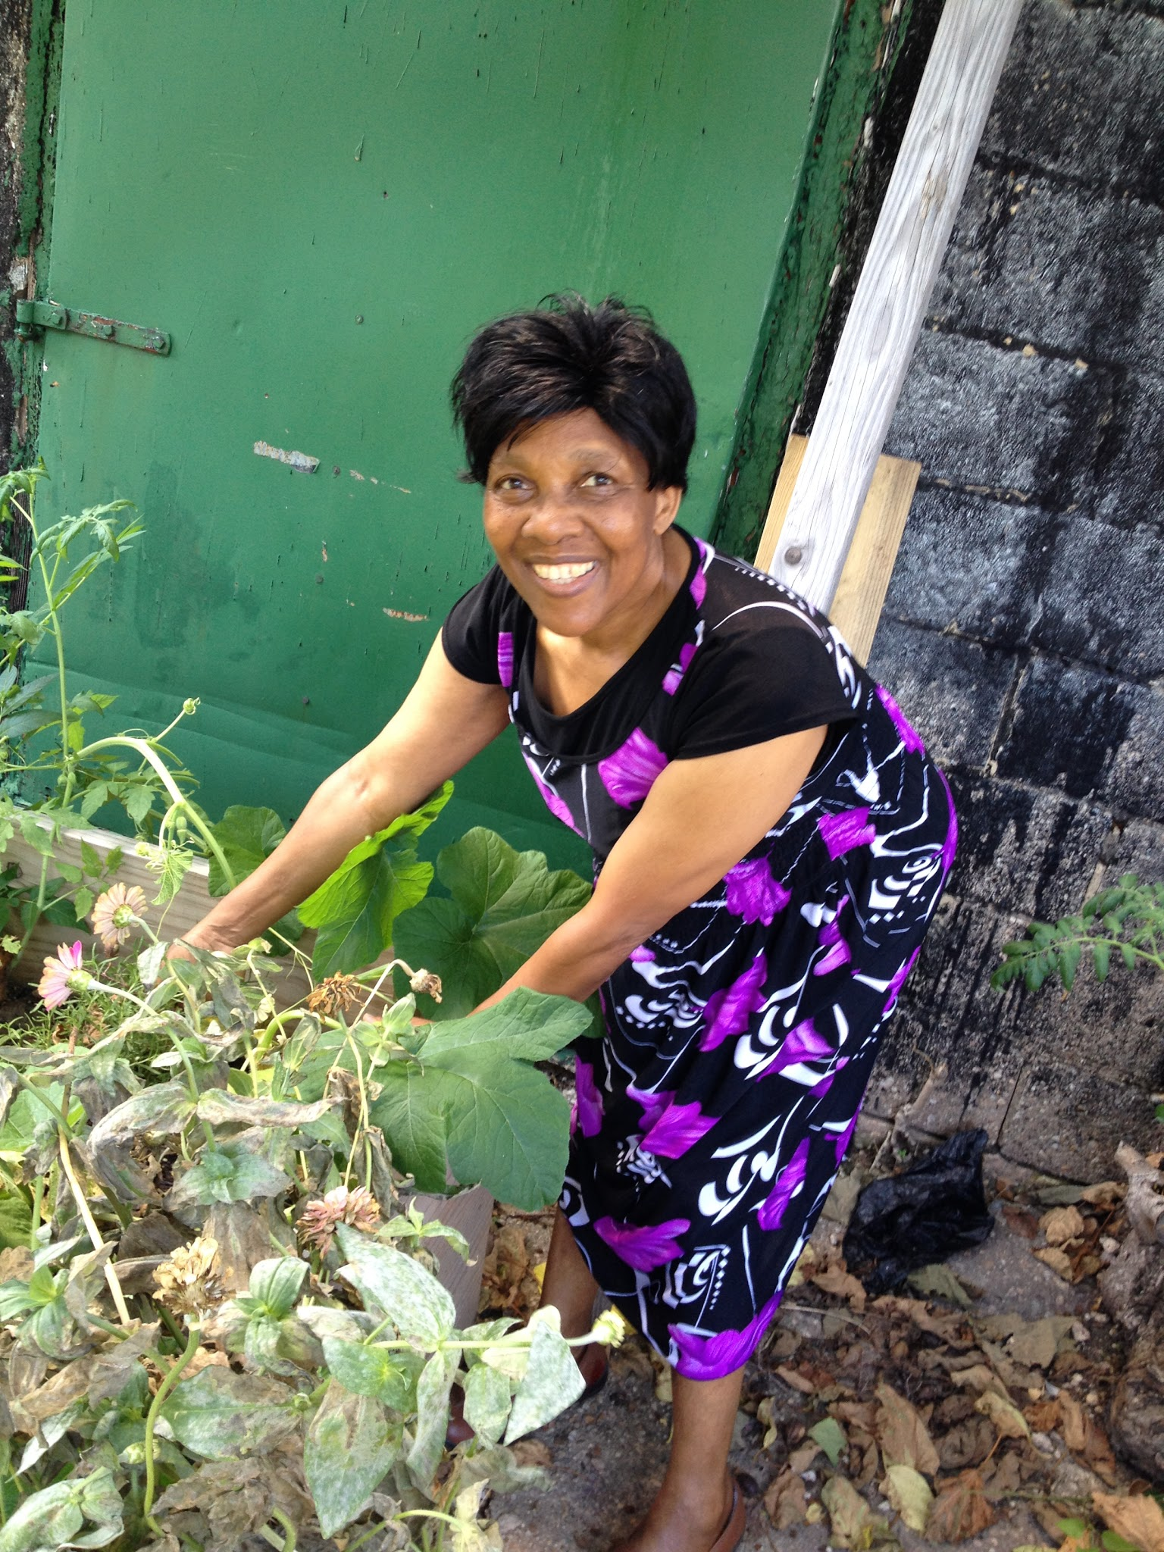
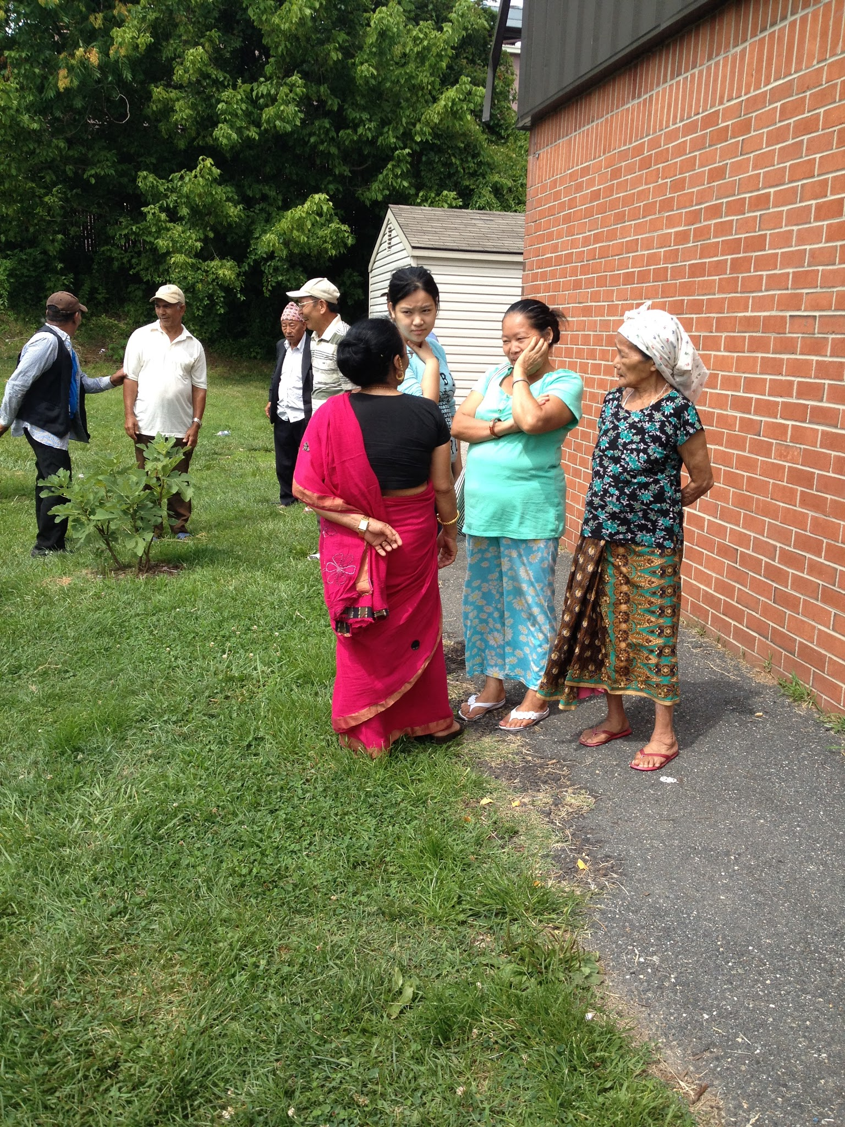
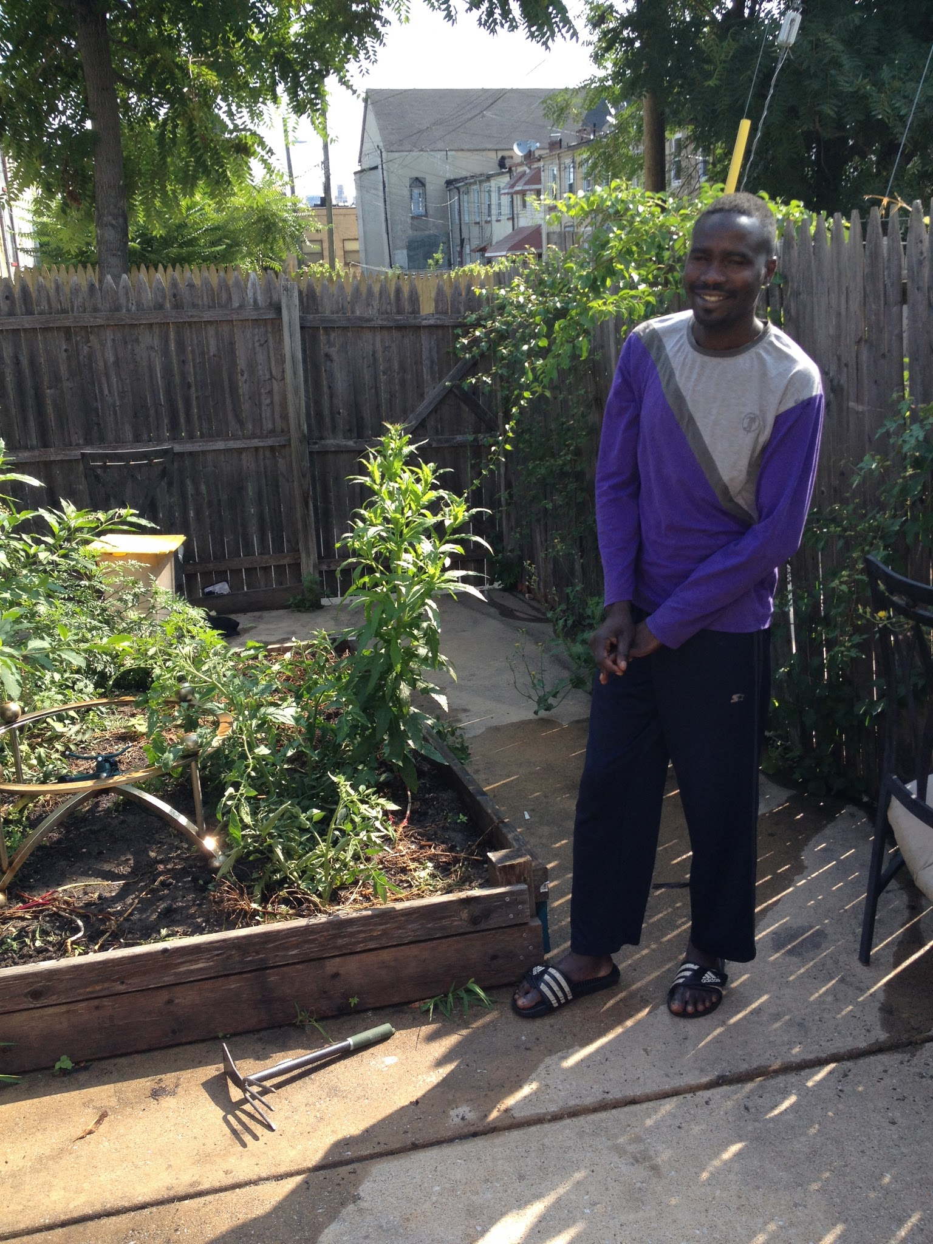
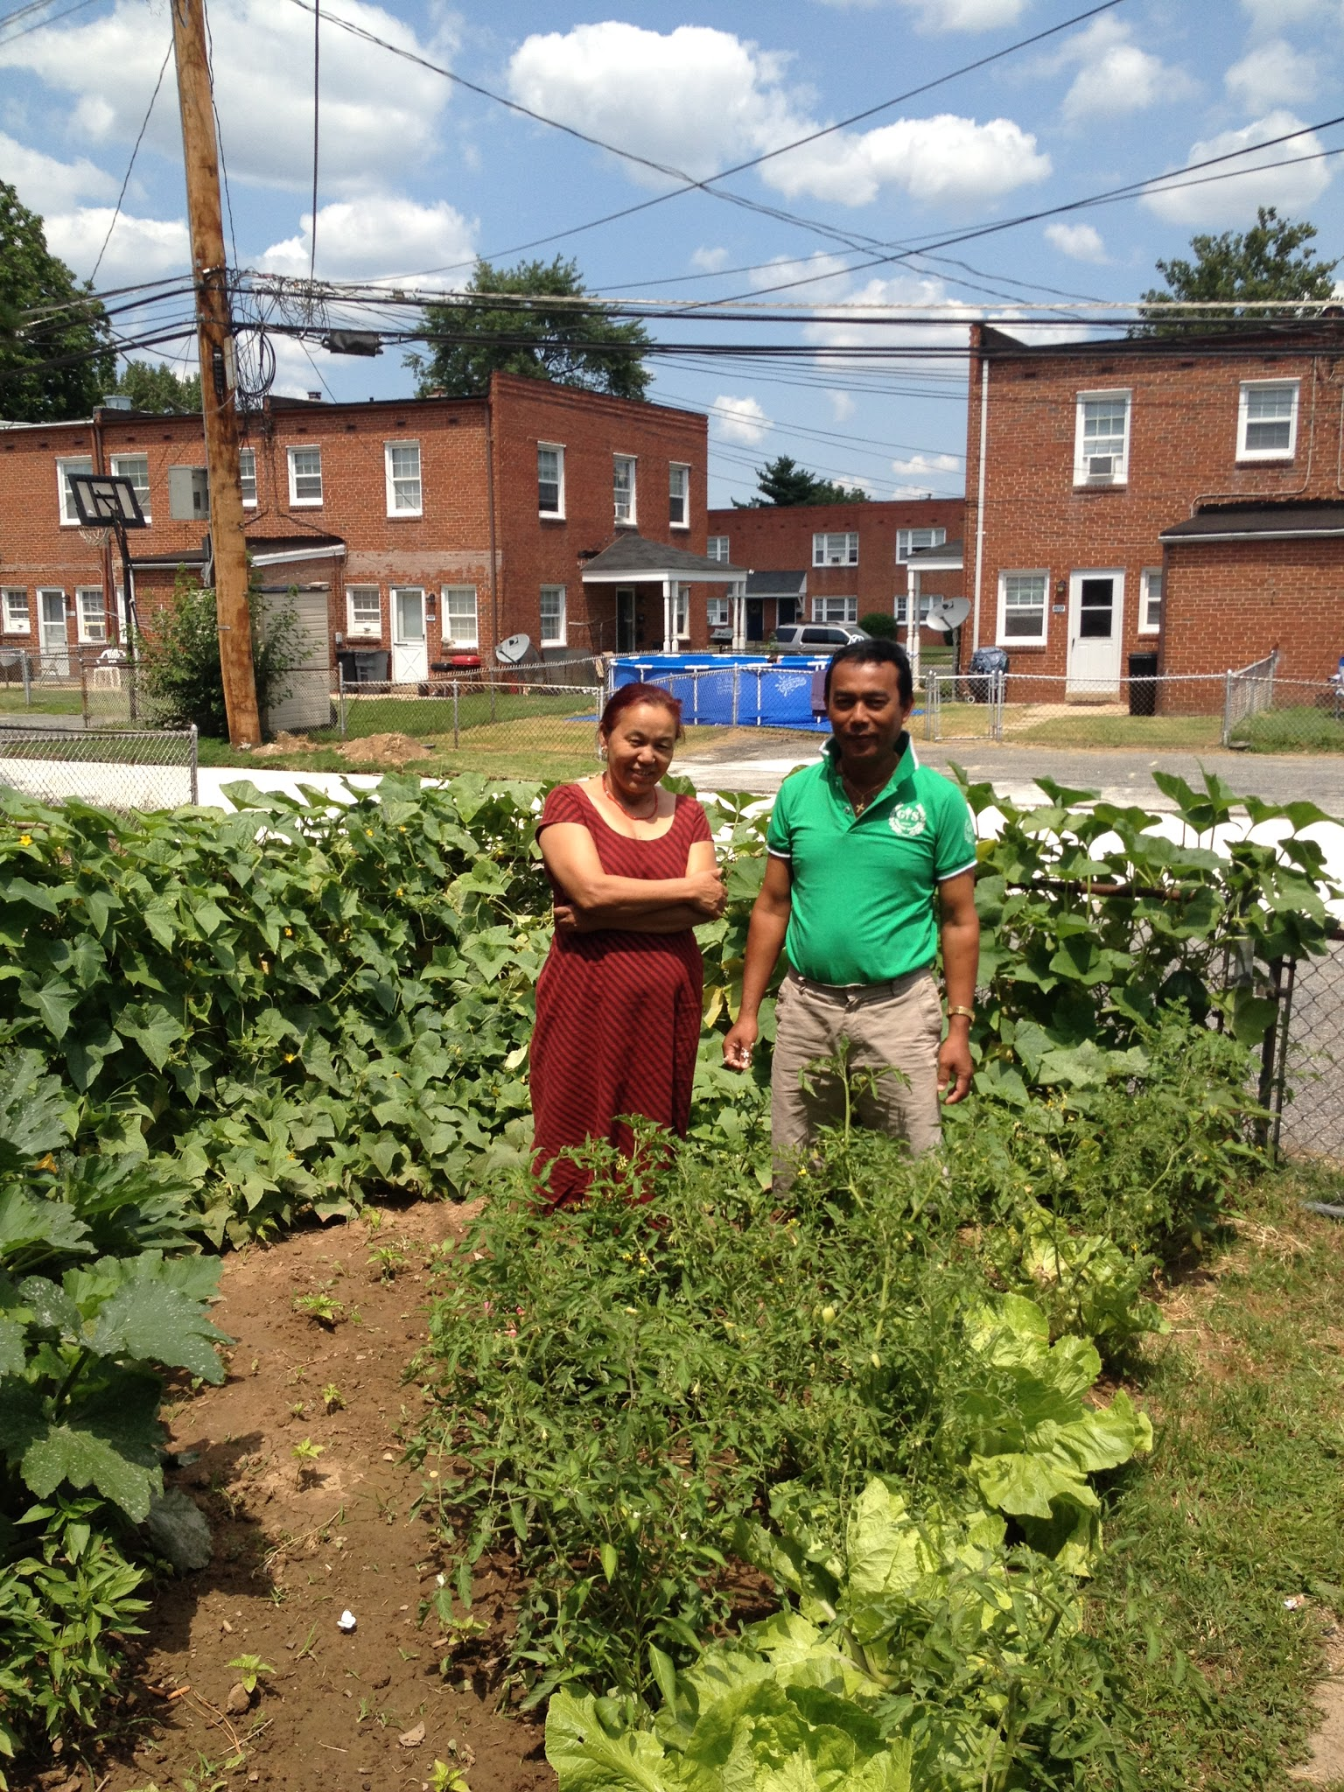
Vision
-We want to create a garden where refugees, students, and faculty can not only grow together but exchange ideas, practices, and cultures!

Slide 7
Why Does it Matter?
The University has identified the following institutional objectives and outcomes:
“To enhance the quality of undergraduate education … enriched by research and service learning experiences … and cultivates a sense of civic responsibility”
“To promote cutting edge research, creative activity”
“By enhancing student life outside of the classroom”
“To bring the knowledge resources of the University to bear on the problems and concerns of the communities we serve … by continuing to serve as a national model in promoting service learning and civic engagement; by improving public policy and welfare in the State … by expanding our outreach efforts and university/community partnerships”

Slide 8
Opportunities for Students
-Live learning lab for students of a variety of majors
-Research (ex: Global Studies)
-Internships (ex: HAPP)
-Service-Learning (ex: IRC student volunteers)
-More course-components (ex: Immigrants and Refugees in Social Work course)
-IRC has partnership with Johns Hopkins

Slide 9
Official Support: Campus Departments and Programs
-Interdisciplinary Studies: Dr. Stephen Freeland, Jill Wrigley, Eric Brown
-Health Administration and Policy: Dr. Luis Pinet-Peralta
-Social Work: Dr. Carolyn Tice
-Sondheim Public Affairs Scholars Program: Dr. Arthur Johnson, Jessica Cook
-Alumni: Former Honors College and Scholars Program students Katie Golden and Gagan Singh

Slide 10
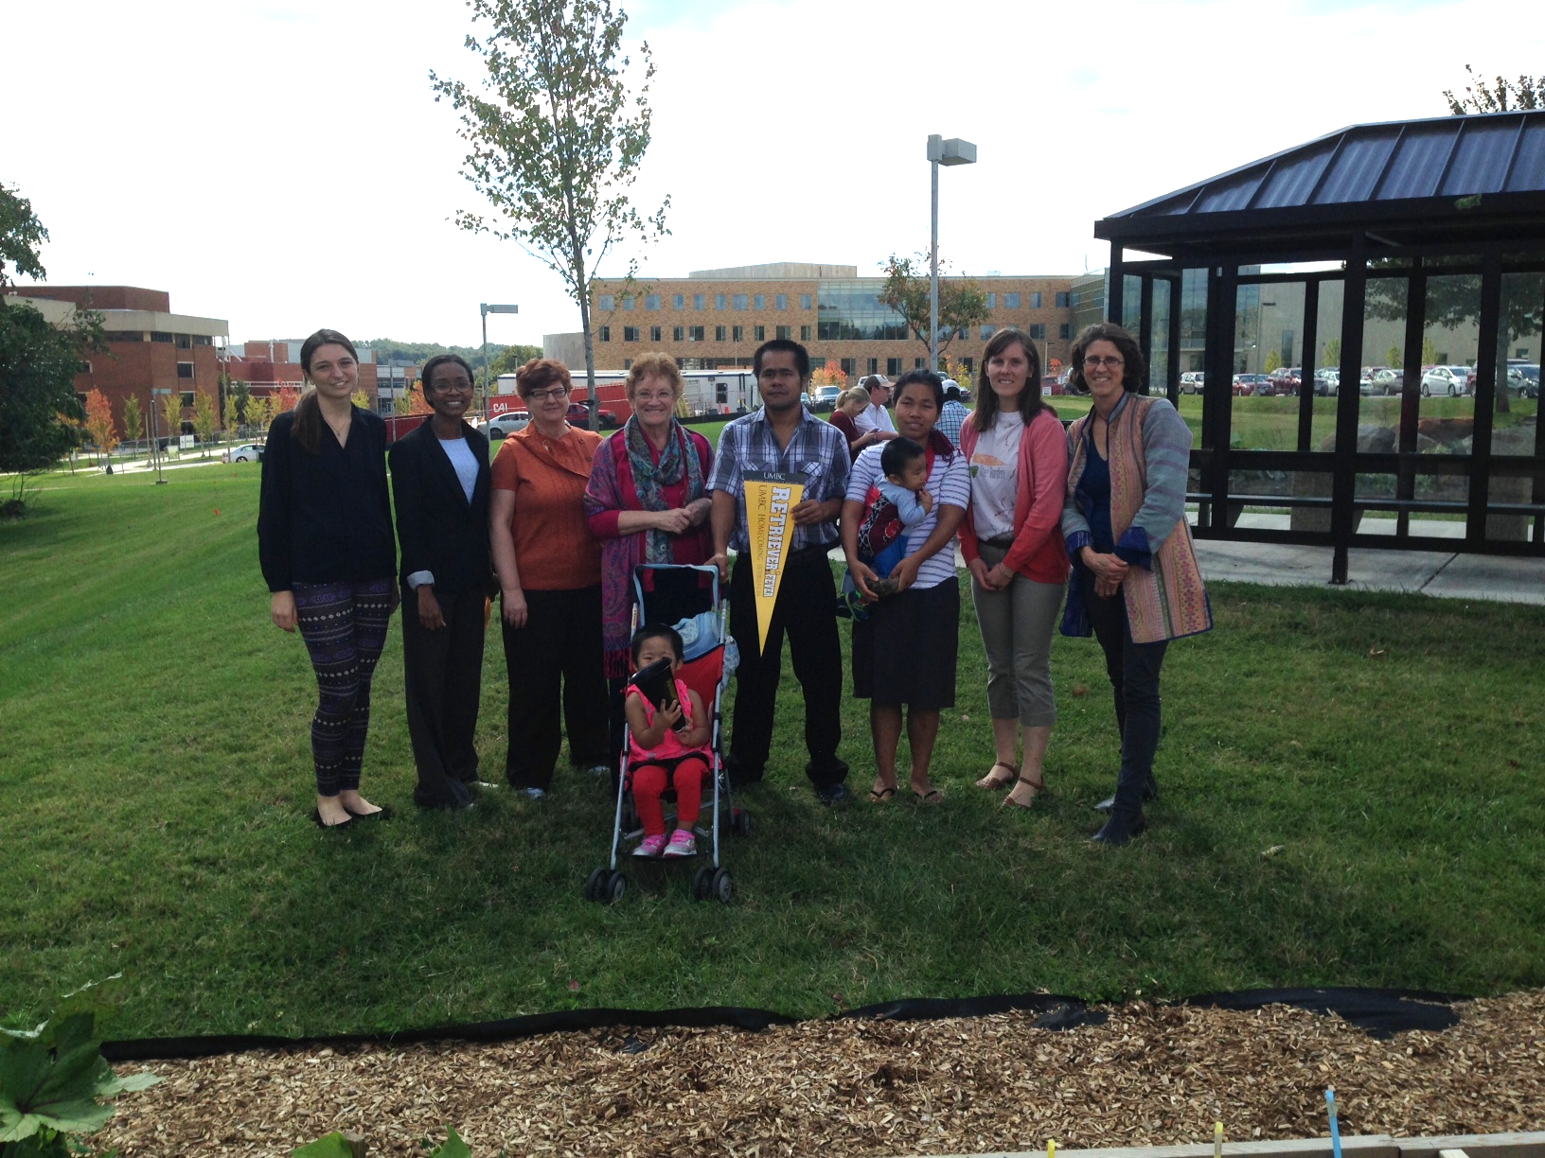
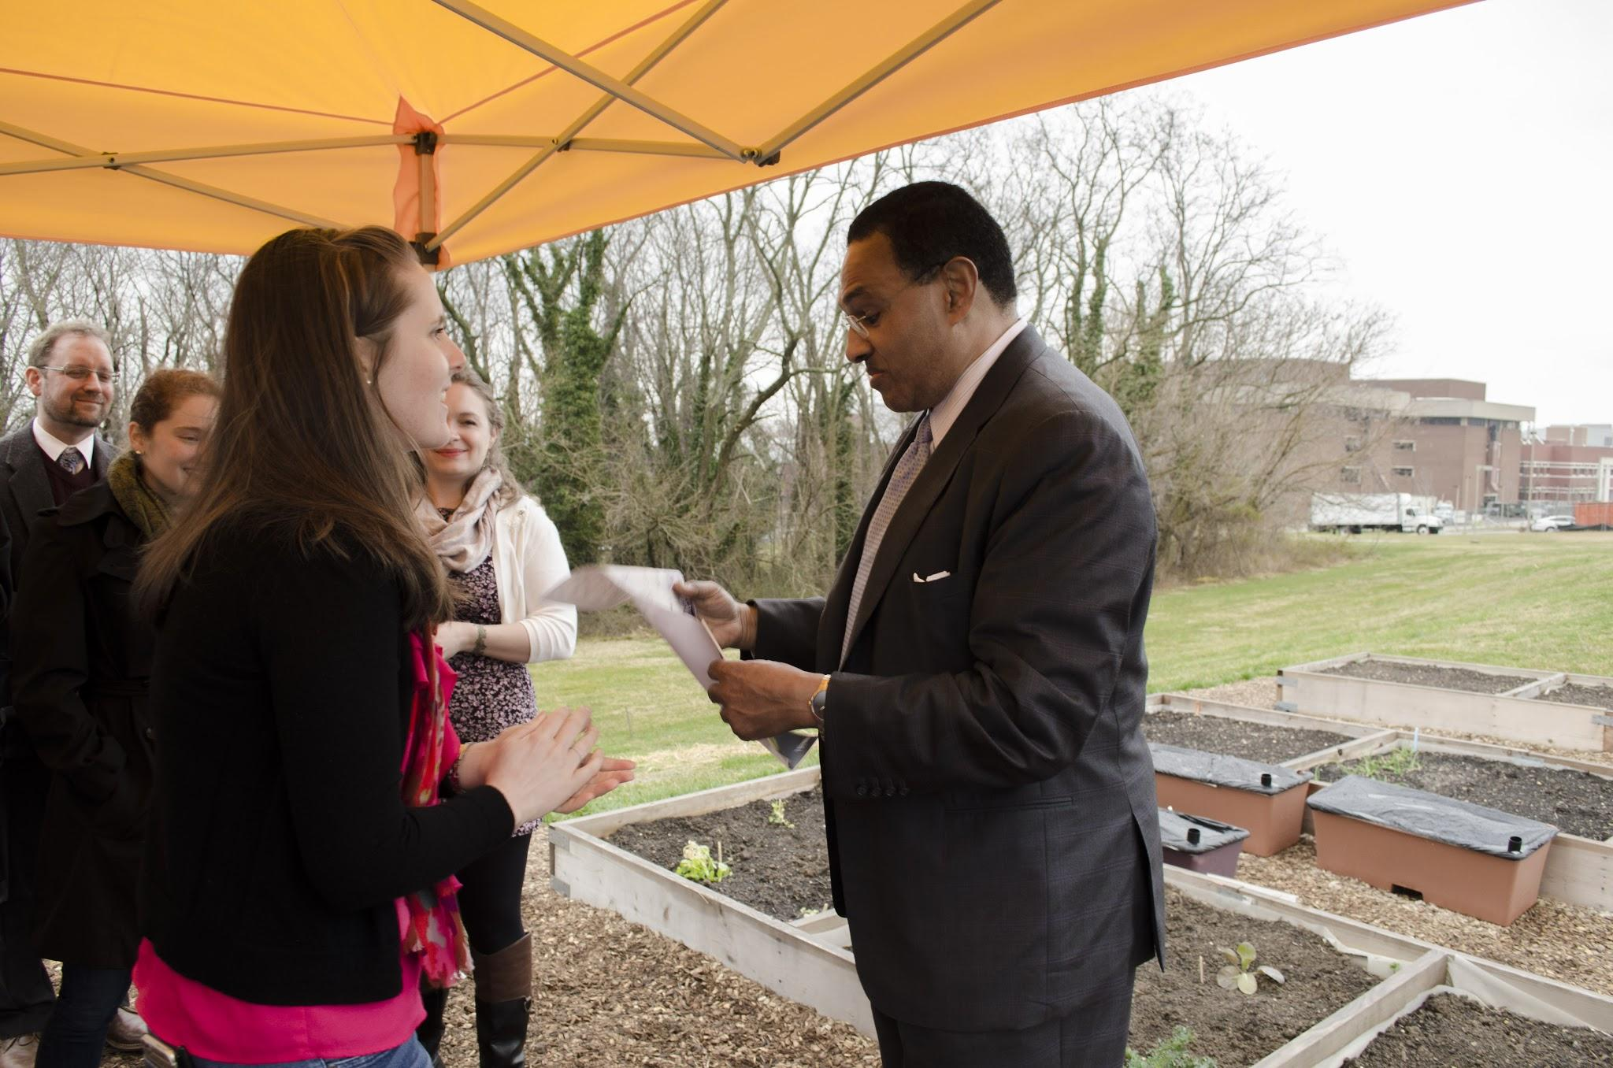
Official Support: Administrative
-Vice Provost and Dean of Undergraduate Education: Diane Lee
-Legal Counsel of UMBC: David Gleason
-Unofficial support: President Hrabowski

Slide 11
Its Been Done Before and it Works
Laney College - Oakland, California
-3 years running
-3500 sq feet
-15 refugee gardeners
-Students learning new agricultural techniques
-Biology and ESL courses engage with refugees
-Excess produce goes to university dining

Slide 12
Sustainability of Project
-IRC signs MOU with UMBC, agrees to take responsibility
-Each refugee gardener signs a contract prior to gardening
-IRC will use funding from LSP grant to fully fund construction and maintenance of UMBC New Roots Garden

Slide 13
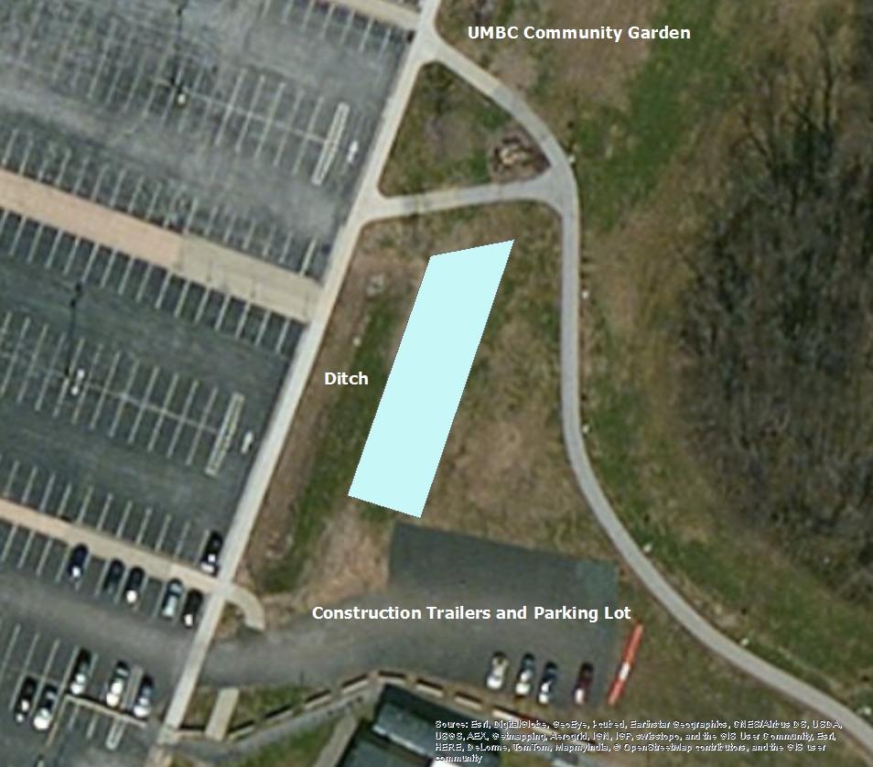
Logistics
-Roughly 4,015 sq. ft.
-10-14 garden plots
-Refugees live ~1 mile
from campus
*We are open to any
land available

