Slide 1

How to Write a STEM Literature Review
Semhar Yohannes
Science Reference and Instruction Librarian
her/she
semhar@umbc.edu
Beck Hertl
Library Services Specialist
they/them
beckhertl@umbc.edu

Slide 2


Introduction
Name
Major/department
Year

Slide 3
Overview
Background
Steps to writing a literature review
Checklist

Slide 4
Background

Slide 5
Quiz
What is the definition of a literature review?
A summary and evaluation report of info found in the literature related to your selected topic
Summary of info in the literature related to your selected topic
Collection of a body of research that addresses a research question

Slide 6
What is a Literature Review
It is a summary AND evaluation of various pieces of research
Literature review:
  informs the previous research that has been done in the field
  critiques previous methodology
  evaluates prior studies to show information gap which will be filled with your own research

Slide 7
Why do a Literature Review
Avoid making the same mistakes as others
Carry on where others have reached
Increase your breath of knowledge in your subject area
Identify key works, information and needs in your area
Identify and learn terminology
Position your own work in context
Identify opposing views
Demonstrate that you can access research in the field
Identify methods relevant to your research
Identify studies that are worth replicating or improving
Find experts in your field in whom you could contact

Slide 8
Types of Literature Review?
Argumentative Review: This form examines literature selectively in order to support or refute an argument, deeply embedded assumption, or philosophical problem already established in the literature. The purpose is to develop a body of literature that establishes a contrarian viewpoint. Given the value-laden nature of some social science research [e.g., educational reform; immigration control], argumentative approaches to analyzing the literature can be a legitimate and important form of discourse.
Integrative Review: Considered a form of research that reviews, critiques, and synthesizes representative literature on a topic in an integrated way such that new frameworks and perspectives on the topic are generated. The body of literature includes all studies that address related or identical hypotheses or research problems. A well-done integrative review meets the same standards as primary research in regard to clarity, rigor, and replication. This is the most common form of review in the social sciences.
Historical Review: Few things rest in isolation from historical precedent. Historical literature reviews focus on examining research throughout a period of time, often starting with the first time an issue, concept, theory, phenomena emerged in the literature, then tracing its evolution within the scholarship of a discipline. The purpose is to place research in a historical context to show familiarity with state-of-the-art developments and to identify the likely directions for future research.

Slide 9
Types of Literature Review?
Methodological Review: A review does not always focus on what someone said [findings], but how they came about saying what they say [method of analysis]. Reviewing methods of analysis provides a framework of understanding at different levels [i.e. those of theory, substantive fields, research approaches, and data collection and analysis techniques], how researchers draw upon a wide variety of knowledge ranging from the conceptual level to practical documents for use in fieldwork in the areas of ontological and epistemological consideration, quantitative and qualitative integration, sampling, interviewing, data collection, and data analysis. This approach helps highlight ethical issues which you should be aware of and consider as you go through your own study.
Systematic Review: This form consists of an overview of existing evidence pertinent to a clearly formulated research question, which uses pre-specified and standardized methods to identify and critically appraise relevant research, and to collect, report, and analyze data from the studies that are included in the review. The goal is to deliberately document, critically evaluate, and summarize scientifically all of the research about a clearly defined research problem. Typically it focuses on a very specific empirical question, often posed in a cause-and-effect form, such as "To what extent does A contribute to B?" This type of literature review is primarily applied to examining prior research studies in clinical medicine and allied health fields, but it is increasingly being used in the social sciences.
Theoretical Review: The purpose of this form is to examine the corpus of theory that has accumulated in regard to an issue, concept, theory, phenomena. The theoretical literature review helps to establish what theories already exist, the relationships between them, to what degree the existing theories have been investigated, and to develop new hypotheses to be tested. Often this form is used to help establish a lack of appropriate theories or reveal that current theories are inadequate for explaining new or emerging research problems. The unit of analysis can focus on a theoretical concept or a whole theory or framework.

Slide 10
Steps to writing a Literature Review

Slide 11
Outline
Steps to writing a literature review
Get started
Select/refine topic
Search for literature
Evaluate literature
Note taking
Keep current
Stop searching
Organization

Slide 12
Getting Started
What is the main purpose of this literature review?
Who is your target audience? (professor, editor, conference)
What will the final product be?
  Thesis or dissertation
  Journal article
  Grant proposal
  Technical report

Slide 13
Select/refine topic
Consider personal interests
Top scholarly journals in your field, skim titles and abstracts of the latest issues of the journals
Browse "Annual Reviews" publications in the field, if available
Read theses or dissertations in the area of your interest
Browse conference opportunities
Brainstorm a list of possible topics

Slide 14
Search for literature
Search most relevant databases in the topic field
  Articles Tab
  Subject Guide
  Individual database/journal search- * Web of Science
Use citation databases (i.e., Web of Science)
Identify key authors and search for their publications (Web of Science)
Create a log that documents how the literature search was conducted and what materials were read/scanned
Save searches
Establish alerts on “topics”

Slide 15
Search for literature
Other Sources
Conference papers and proceedings
Standards manuals / handbooks (current and older)
Chemical and materials property data sources
Government agency technical reports
Professional association magazine articles
Company and trade association white papers
Patent applications and patent documents
Data sets

Slide 16
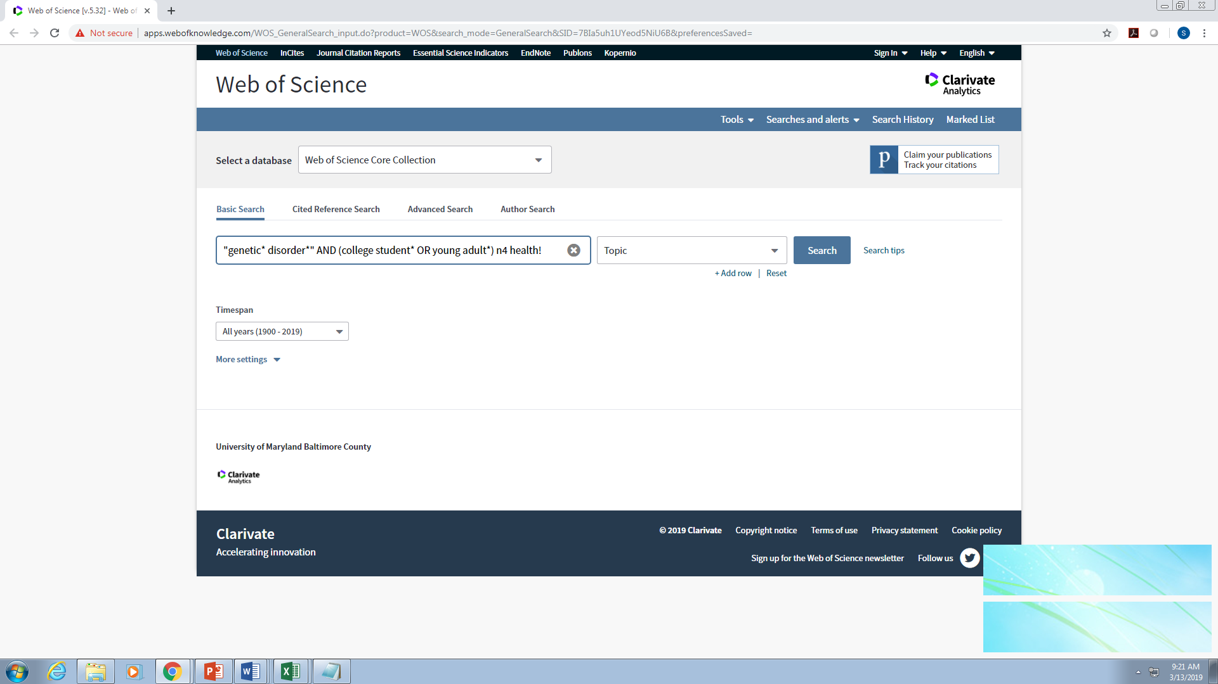
Search for literature
Keywords
AND, OR, NOT, *, and “ ”
Author searching
Subject Headings, linked keyword lists
Footnote chasing / using bibliographies • Citation tracking (Web of Science & Scopus)
Keep track of where you’ve looked, what keywords you used

Slide 17
Evaluate literature
What to Consider to Evaluate Works
What to Consider to Evaluate Works
The author: credibility, reputation
A list of references or other citations
The intended audience
The content of the source: fact, opinion, or propaganda
Comprehensive coverage
Objective language
Generalization with no overstating or oversimplifying of a matter
Accuracy
Timeliness of the source
Cross-checking of the given information
Generalization backed up with evidence
Balanced arguments acknowledging other viewpoints

Slide 18
Note taking
Tell a story…..
Who?
What?
When?
Where?
Why?
How?
A good literature review (story) ALSO answers: Useful words for a Keyword Search

Slide 19
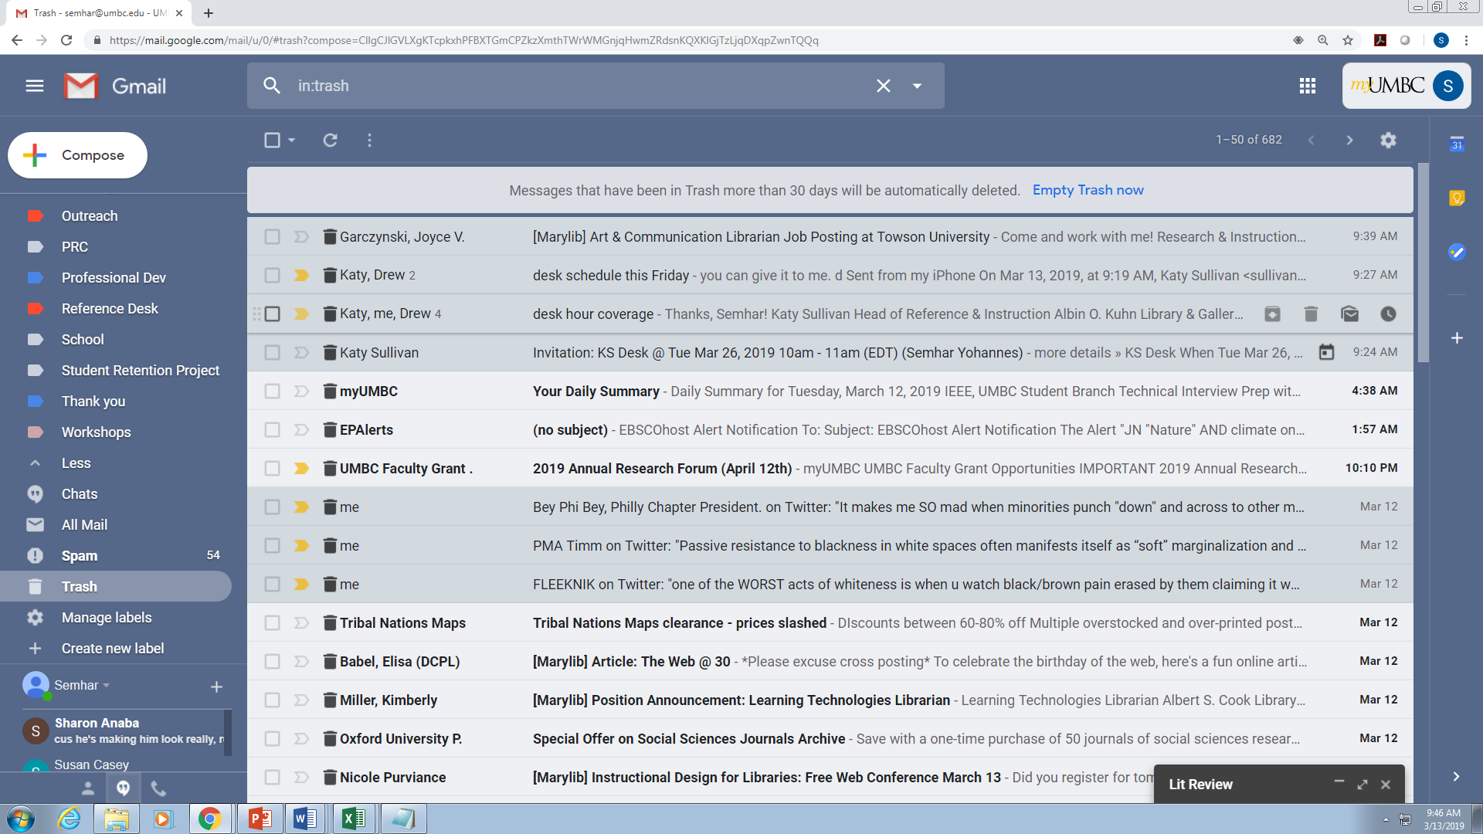
Keep current
Search alerts in databases
Table of Contents (TOC) alerts
RSS feeds for journal and other webpages

Slide 20
When is it time to stop searching?
Recurring authors
Recurring institutions, labs
Recurring settings for experiments/measurements
Recurring methods or results
Patterns that let you know you are done with your search
  Law of diminishing returns
  Materials found are too old
  (OR you run out of time…)

Slide 21
Organization
Chronological: write about the sources according to when they were published
  Publication: order your sources by publication chronology
  Trend: examine the sources according to trend within a period
Thematic: organized around a topic or issue, rather than the progression of time
Methodological: usually does not have to do with the content of the material. Instead, it focuses on the “methods” of the researcher or writer

Slide 22
Website

Slide 23
Checklist
Notes:
https://umbc.box.com/s/vn6vdsontvhiznnqjl2u4b5k9naq75mv

Slide 24
Handout
Checklist for Analyzing a Literature Review
Introduction to the Review
Organization and Writing Qualities of the Review
Presentation of Studies Being Reviewed
**Evidence of Analysis, Synthesis, Critique Taking Place within the Review
Conclusion to the Review

Slide 25


