Slide 1

Creating an Academic Research Poster Using Canva
recorded

Slide 2



Introduction
Semhar Yohannes
semhar@umbc.edu
she/her
Jasmine Shumaker
jshumake@umbc.edu
she/her
library.umbc.edu

Slide 3

Agenda
Academic Research Poster Overview
  Definition
  Content/layout/color & font
Canva
  Template
  Create a New Design
Demo
library.umbc.edu

Slide 4
Academic Research Poster
Definition: A visual communication tool that allows you to present your research in a clear, concise, and graphic format. It attracts attention, conveys information clearly, should initiate conversations, and can represent any stage of the research process. Researchers often create posters before the completion of the research project in order to invite feedback or collaboration.
library.umbc.edu

Slide 5
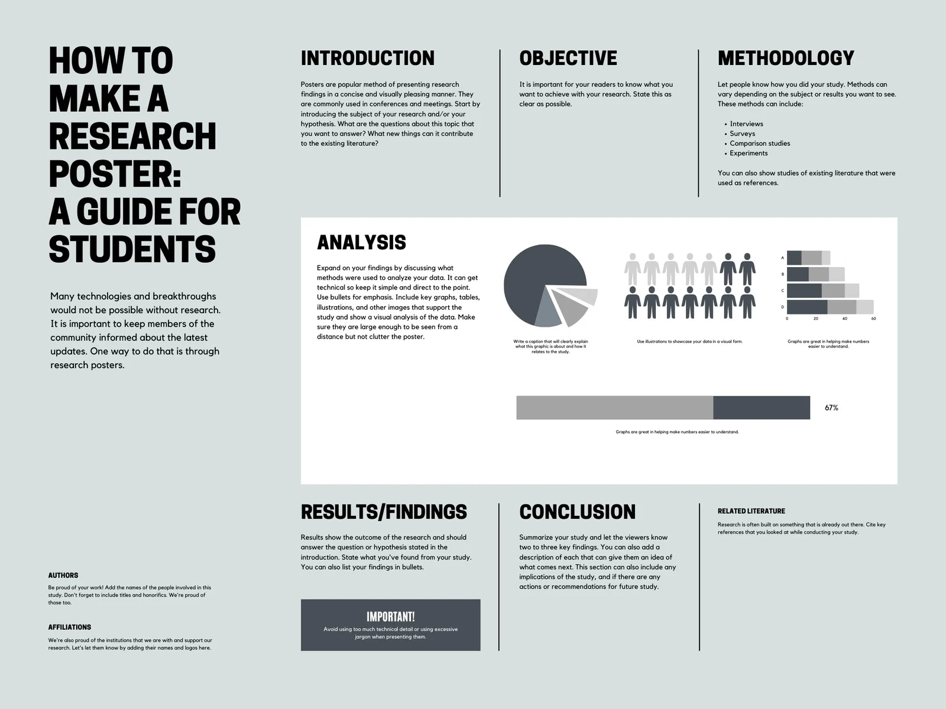
Planning Stage
Step 1: Content
Step 2: Layout
Step 3: Color/font
library.umbc.edu

Slide 6
Poster Content
It’s important to create the content beforehand and have it readily available either in word doc or excel file so you can cut/paste or uploading into Canva
Time and energy…..
library.umbc.edu

Slide 7
Planning Stage: Content
Title: catchy ~1-2 lines
Author: your name, faculty advisor’s name, names of collaborators, department & institution
Introduction/Abstract/Summary: short synopsis of your research~200 words
library.umbc.edu

Slide 8
Planning Stage: Content
Objectives:
  the goals of the research
  most often formatted in a bulleted list
Materials/Methods:
  describe equipment and procedures
  figures and flow charts
  photograph or labeled drawing of organism or setup/~ 200 words
library.umbc.edu

Slide 9
Planning Stage: Content
Results:
  did the experiment work?
  describe qualitative and descriptive results
  refer to supporting charts or images/~ 200 words
Conclusion:
  major results
  state whether your hypothesis was supported
  state the relevance of your findings to other published work
  future directions/ ~300 words
library.umbc.edu

Slide 10
Planning Stage: Content
References:
  may use smaller font in this section to save room and then print a readable bibliography to pass out
Acknowledgments:
  thank individuals for specific contributions and funding
  include in this section explicit disclosures for any conflicts of interest and conflicts of commitment
  ~40 words
library.umbc.edu

Slide 11
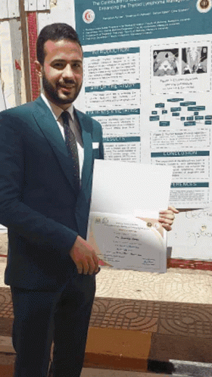
Planning Stage: Content
A poster that only includes text is dull
Types of images:
  Photographs
  Diagrams
  Charts/graphs
  Artwork
library.umbc.edu

Slide 12
Planning Stage: Content
Image resolution should be no lower than 150 dpi to ensure their ability to print (over 600 pixels)
  PG (or JPEG): primarily for photos; not good for images with text
  PNG: high image quality and good color representation; supports transparency/opacity; works well for graphics, logos, charts, etc.; displays text and solid blocks of color without pixelation
  GIF: only file type that supports animation
  PDF: use Canva's PDF Converter best for displaying whole documents online, such as a pamphlet/guide/manual, e-book, etc
library.umbc.edu

Slide 13

Planning Stage: Layout
Simple!
Group related content
Images/text
White/negative space
library.umbc.edu

Slide 14
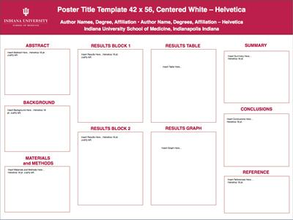
Planning Stage: Layout
library.umbc.edu

Slide 15
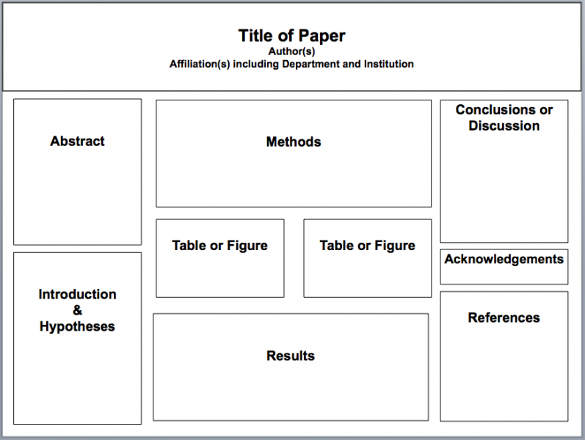
Planning Stage: Layout
library.umbc.edu

Slide 16
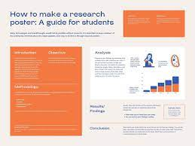
Planning Stage: Color/Font
Color
  2 or 3 colors only
  Text: Black font
  Background: Light colors
    (avoid dark background)
  Shade difference
library.umbc.edu

Slide 17
Planning Stage: Color/Font
Font Size
  Title: 80-120
  Subtitle (author): 48-80
  Section Headers (ex: Introduction): 36-72
  Body Text: 30-48
Font Style: Times New Roman, Arial, Arial Black, Franklin Gothic Heavy, Tahoma, Trebuchet, Verdana, Garamond, Book Antiqua, or Bookman Old Style
library.umbc.edu

Slide 18
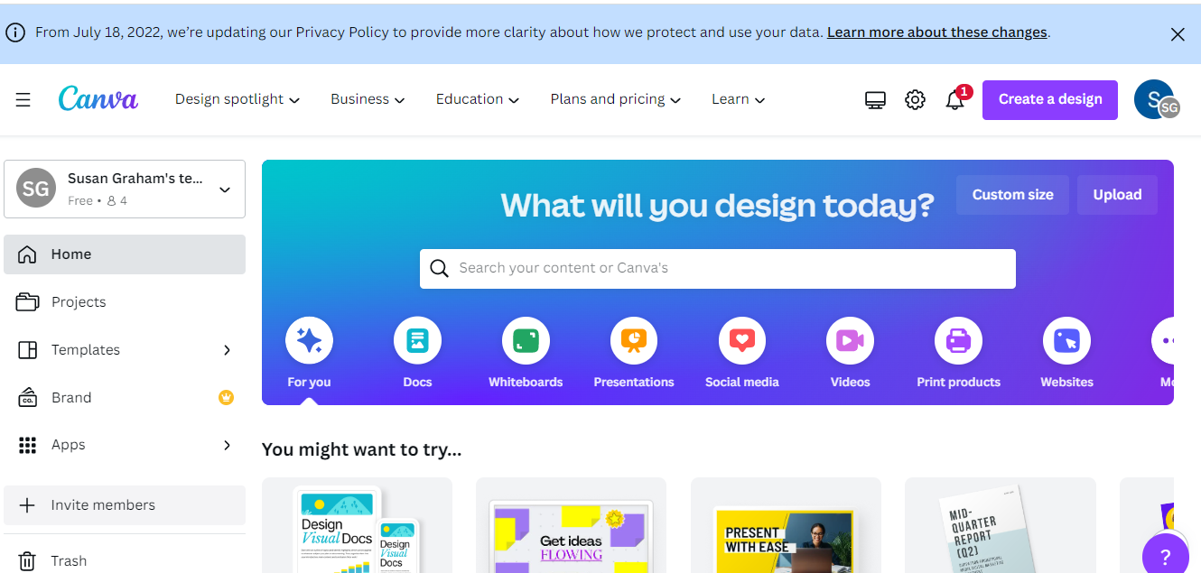


Slide 19
Definition
Canva: a free (with paid tier plans) graphic-design tool. A web based content management and publishing resource the users use to create the following….
Canva documents:
Posters
Presentations
Invitations
Business Cards
Social Media Posts
Photo Books
Calendars
Newsletters
library.umbc.edu
Notes:
Read slides

Slide 20
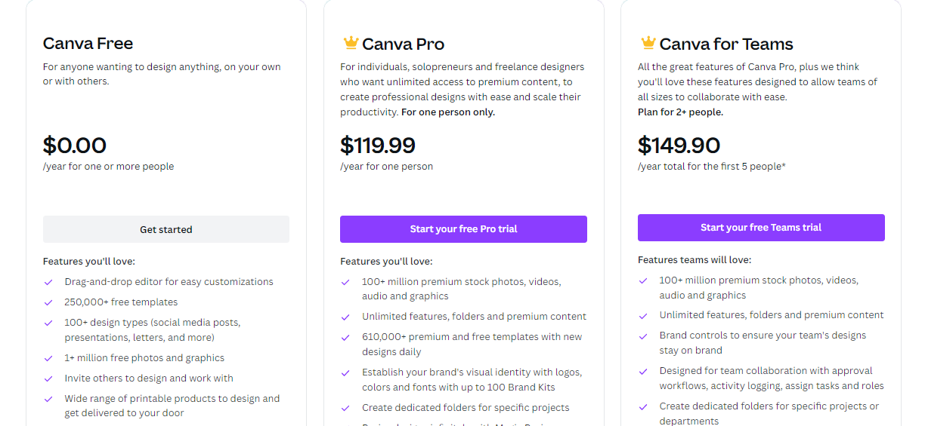
library.umbc.edu

Slide 21
Dashboard
Canva Dashboard:
Create a new design with custom dimensions or start with a template
View all items you have created
Upload images you plan to include on your poster
Make duplicates of items to edit
Delete items you no longer need
View items that have been shared with you by colleagues
library.umbc.edu

Slide 22
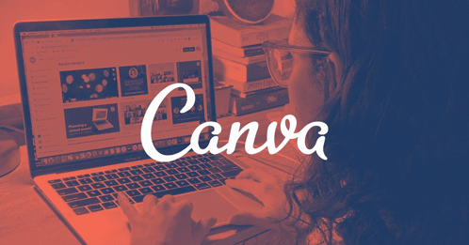
Template vs
Create a New Design
library.umbc.edu

Slide 23
Template
These are the easiest way to get started
Canva offers many templates that you can browse and use as a base for your creative work
There are templates for almost everything, from invoices to Instagram images
Once you select a template you can click into it to start editing the elements such as text, images, frames, and background
Canva currently has over 50k templates. Canva notes on the pricing page that 8k templates are available for users on the Free Forever plan
library.umbc.edu
Notes:
Read the slide

Slide 24
Template vs
Create a New Design
library.umbc.edu

Slide 25
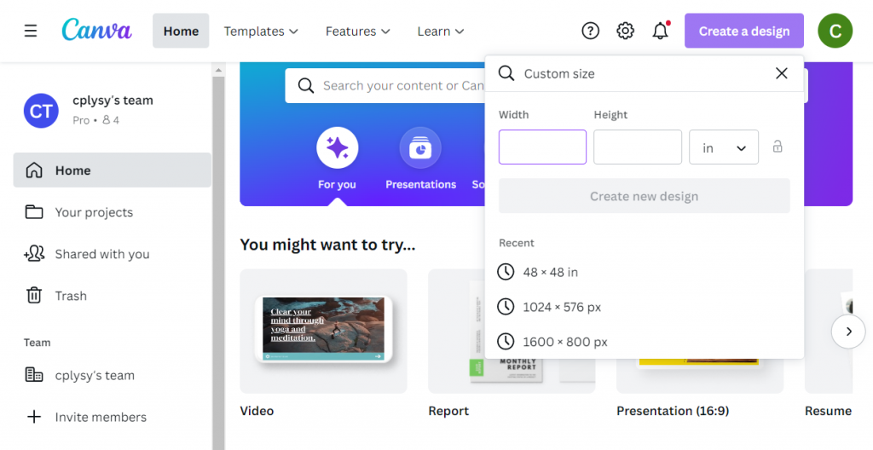
New Design
library.umbc.edu

Slide 26
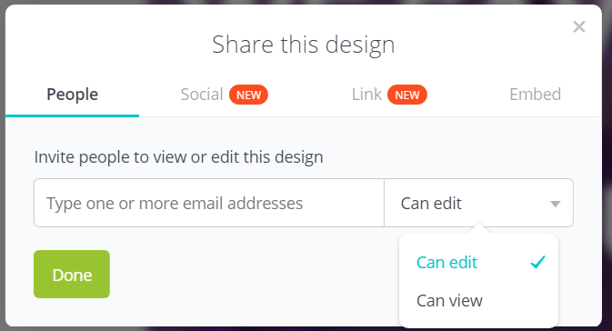
Sharing
Sharing your Template:
People
Link
Social Media
Embed
library.umbc.edu

Slide 27
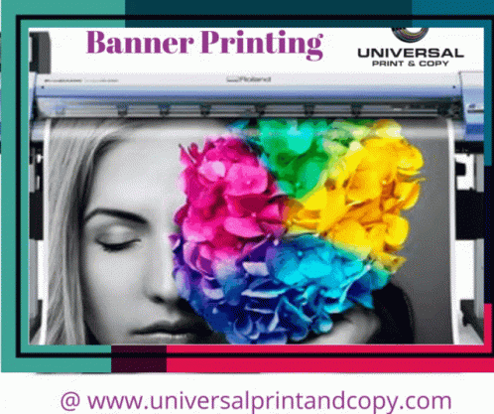
Printing
Campus Printing Service
Fedex Kinkos /Target/Staples/etc.

Slide 28
Canva Poster Examples
library.umbc.edu
Notes:
JS takes over!

Slide 29
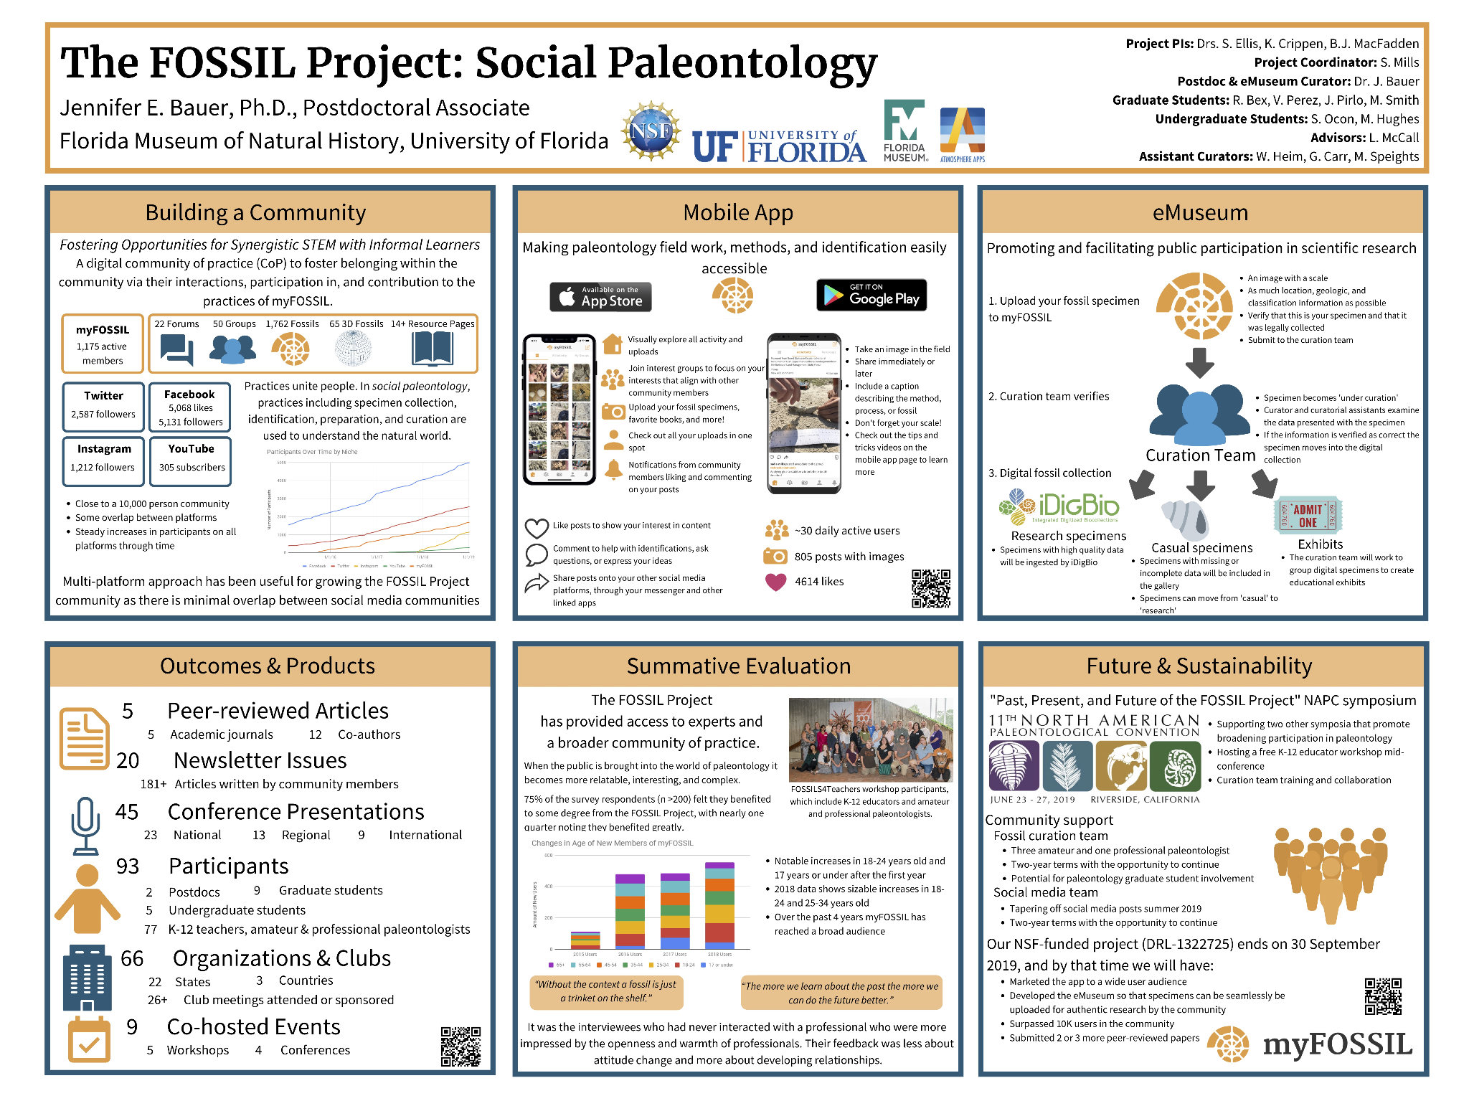
Template: Academic Research Poster
library.umbc.edu
Notes:
Made in Canva

Slide 30
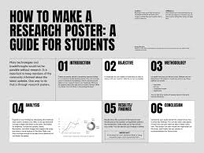
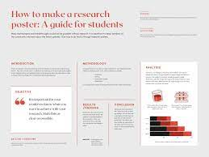
library.umbc.edu
Notes:
Made in Canva

Slide 31
Let’s Get Started
https://www.canva.com/
library.umbc.edu
Notes:
Made in Canva

Slide 32
Steps to Canva Poster
Step 1: Content
Step 2: Layout
Step 3: Color/font
library.umbc.edu
Notes:
Step 1: Give handouts! (link in chat)

Slide 33
Steps to Canva Poster
www.canva.com
https://tinyurl.com/canvadrive
library.umbc.edu
Notes:
If the box link above doesn’t work/load, give this link: https://tinyurl.com/canvabox

