Slide 1
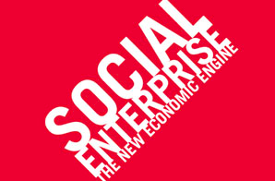
Doing well while doing good:
The shifting social contract for business

Slide 2
What is a Social Enterprise?
People
Planet
Profit
Social Enterprise

Slide 3
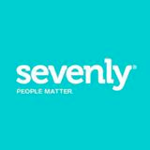
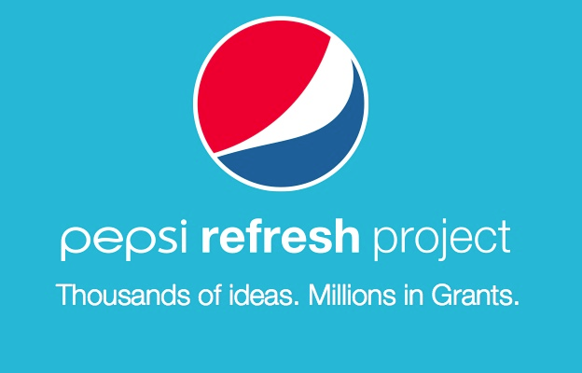
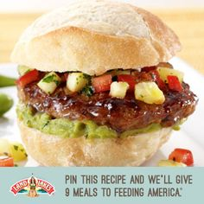
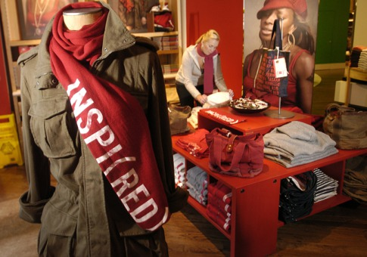
What does #SocEnt look like in the real world?
Do good
Nonprofits
Mission-based companies
Companies that share profits or directly benefit the planet
CSR - Companies that give back as a corporate citizen
Do well

Slide 4
Millennials are changing the game.
In under a decade, they have caused collisions in the do well/do good ethos that previously divided the workforce.

Slide 5
What matters to you?

