Slide 1

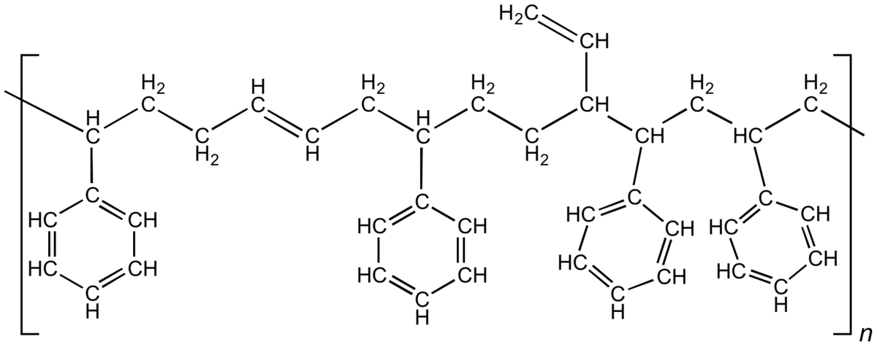





TreadSetters
Sarah Douglas
Alexandra Karalekas
Luke Kessler
Kris Scarborough
Morris Spekterman
Rafay Ashar
Devorah Cahn
Becca Glatt
Erick Gutierrez
Dyka Mulya
Hannah Aris
Rakan El-Mayta
Imen Ghadiri Noferest
Trevor Smith
Bethany Wolinski
Kojo Bonsu
Harley Edwards
Samantha Kim
Verity MacDougall
Naomi Mburu
Jessica Deng
Jeff Greene
Brian Marsden
Melissa Morales
Edfritz Tabi Orock
Andrew Beard
Thomas Gross
Jason Hughes
Alireza Maghsadi
Justin Thaggard
Adam Beard
Shayan Borhani
Brandon Folio
Kyle Goodman
Charles Portner

Slide 2


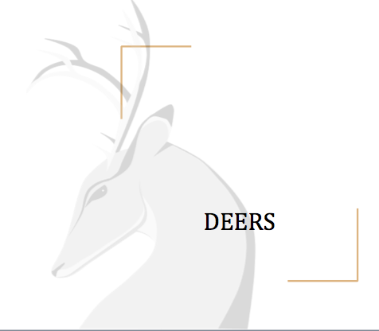
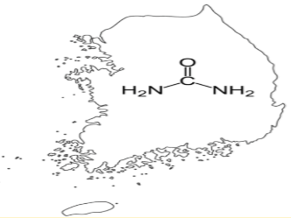



Band of Rubbers
Ryan Buckley
Anton Espiritu
John Fuchsluger
Mitch Martin
Donnel Thomas
Brittany Alms
Eli Brown
Quentin Murphy
Kayla Pope
Jessica Ramsey
Urea 51
Morgan Busch
Alex Lilly
Nick Simon
Joel Tyson
Sarah Wells
South Urea
Eric Ankers
Adrian Davey
Nicholas Dougherty
Damian Emerson
Adetokunbo Okunrinboye
Dorra Benmohamed
Erin Boyle
Ryan Brainard
Seth Friedman
Liz Sprow
LEMON
Tania Evans
Sayyid Ferouz
Boniface Liyayi
Theodora Martin
Colleen O’Donnell
Joshua Brown
Alexander Dolan
Emily Slaby
Mekha Thomas
Ying Zhang

