Slide 1

Workforce Recruitment Program
University of Maryland, Baltimore County

Slide 2
What is WRP?
The Workforce Recruitment Program (WRP) is a recruitment and referral program that connects federal and select private-sector employers nationwide with highly motivated college students and recent graduates with disabilities.
WRP is managed by the U.S. Department of Labor and the U.S. Department of Defense.

Slide 3
Goals of the Program
Bring students with disabilities into the employment process, both through their schools and contact with WRP employers.
Help college Career Centers and Disability Services Offices to engage with the issue of employment for their students with disabilities.
Function as a pipeline to bring new talent into the Federal Government and fill mission-critical jobs.
Break down attitudinal barriers in the workplace.

Slide 4
Important WRP Dates
Student registration opens: Monday, August 30
Student registration closes: Monday, October 11
Student applications close: Wednesday, October 13
Informational interview period: Monday, October 25 – Wednesday, November 17
Database released to employers: Mid-December

Slide 5
Who can participate?
Students and recent graduates with disabilities. All applicants must be:
eligible for the Schedule A Hiring Authority for persons with disabilities
a U.S. citizen
Current students must be a current, full-time, degree-seeking, postsecondary (undergraduate or graduate) student, unless they are taking a reduced course load due to a disability, the COVID-19 pandemic, or are in their last term/semester.
Recent graduates must have met the preceding requirements while enrolled, and have graduated with a degree on or after April 1, 2019.

Slide 6
What is Schedule A?
Schedule A is an hiring mechanism for people with disabilities that allows them to be quickly hired into the federal workplace.
  Improves the Federal Government’s ability to hire.
  Helps the Federal Government be a model employer.
Candidates who are eligible for Schedule A are individuals with an intellectual disability, psychiatric disability, or severe physical disability.
To be hired, candidates with disabilities must be qualified for the position and provide a Schedule A letter to HR.

Slide 7
Who can provide a Schedule A Letter?
A Schedule A letter is documentation that you are Schedule A eligible. This letter must be on letterhead and signed by:
A licensed medical professional;
A licensed rehabilitation professional; or
Any federal or state agency that issues or provides disability benefits.
This letter does NOT need to detail your specific disability, medical history, or need for accommodation. Follow the sample Schedule A letter language.

Slide 8
WRP and Schedule A
WRP candidates must certify that they are eligible for the Schedule A Hiring Authority when they register on the WRP website.
WRP Employers will use this hiring authority to bring candidates into internships and jobs at their agencies.
Candidates must provide a Schedule A letter to the federal agency’s human resources when accepting an opportunity through WRP.
You should not upload your letter to the website, but should have it in your files by January 2022 so you can provide it quickly to human resources. Otherwise, you could delay or lose job opportunities and frustrate your potential employer.

Slide 9
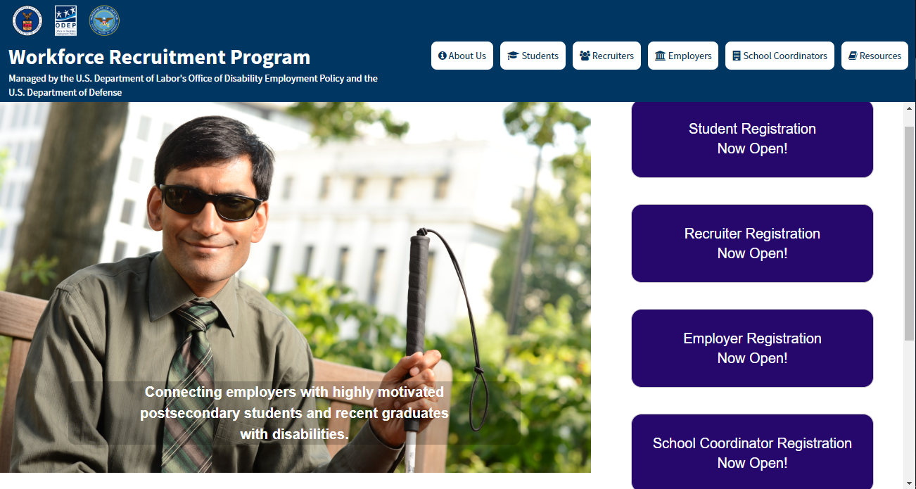
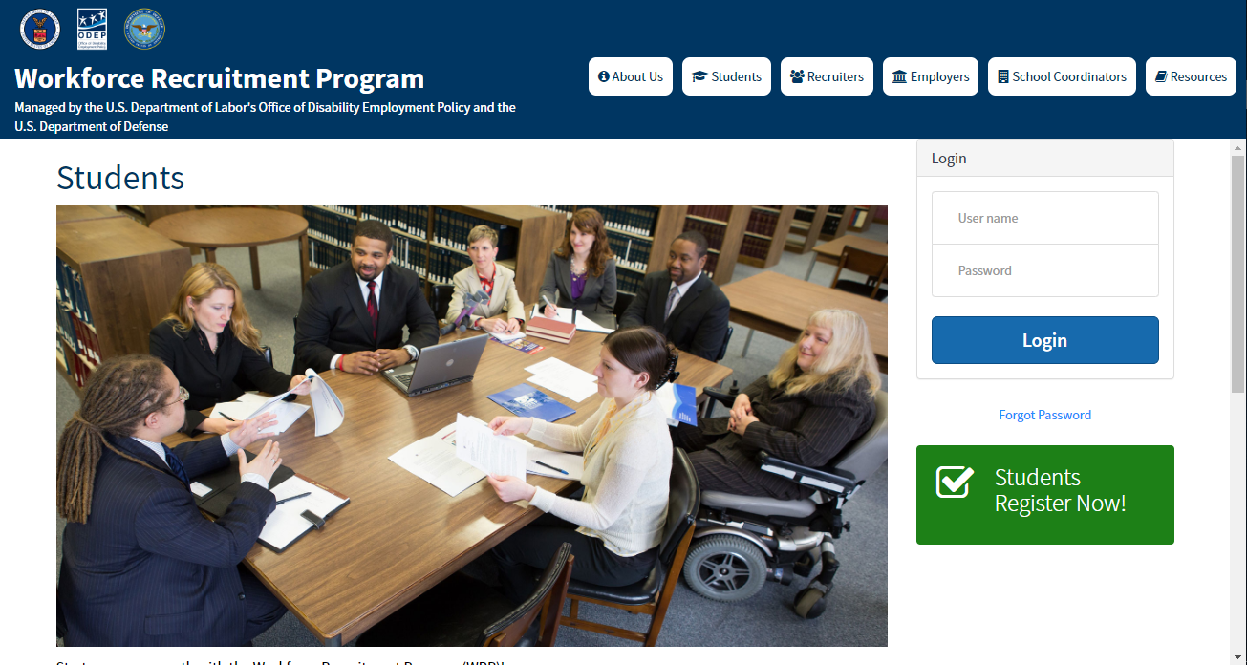
Register at WRP.gov
To register for the WRP, students will need to visit WRP.gov.
WRP.gov works best using a computer (not a mobile device) on Chrome or Firefox.
Once students arrive on the website they should select the first purple box that says “Students Registration Now Open!” Then, click the green “Students Register Now!” button.

Slide 10
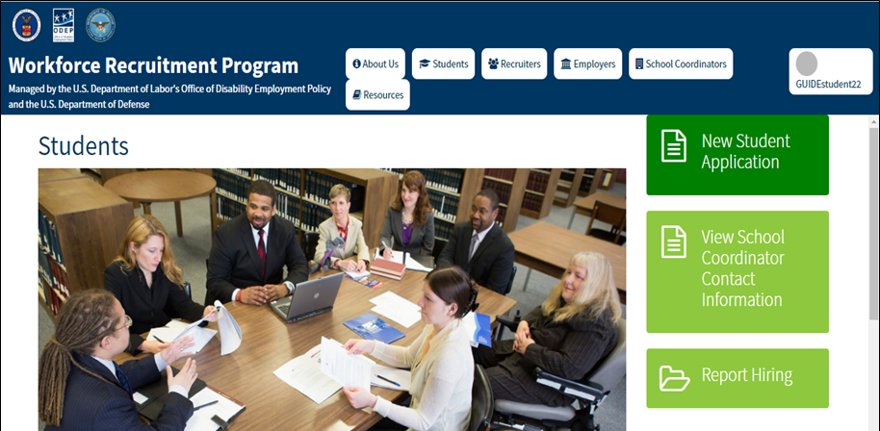
Steps to the Student Registration Process
After you click the registration button, complete the Rules of Behavior, Agreement, and Registration forms.
Once your School Coordinator has approved your registration, you will receive an email with information about how to create or sign into your Login.gov account, which you will use to log into WRP.
After you set up your login for the first time, you will be directed to your student homepage.
Click New Student Application to get started!

Slide 11
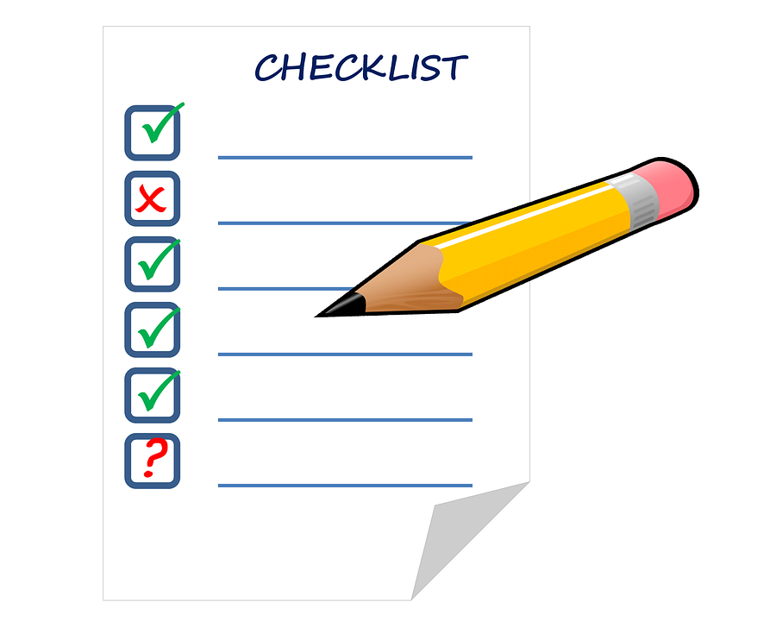
Required information for the WRP Application
The WRP student application consists of:
Identification and contact information
Resume
Transcript (official or unofficial)
Academic information including major, degree, GPA, etc.
Job and location preferences
Disability category (for statistical purposes only, not shown to employers)
Optional: Cover letter, letter of recommendation, writing sample, etc.
Do not upload information that contains your social security number, date of birth, or other sensitive personally identifiable or health information.

Slide 12
Informational Interviews
WRP applicants can receive an elective informational interview with a WRP Recruiter, who is a Federal Government employee.
You will have a conversation where you ask for career advice and learn about federal service.
You will discuss your resume and application, and the Recruiter will provide feedback and general suggestions.
This is your chance to learn and seek advice from someone in a federal career about how to succeed in your future career path.

Slide 13
How to Prepare for Your Interview
Create a list of general questions to ask your Recruiter about federal service and career advice, and practice with your Coordinator or a peer.
Review your resume with Career Services before uploading it to WRP. Be ready to receive feedback during your interview.
Be prepared to answer questions related to your academic, professional, and extracurricular experiences.
Give highlights of your successes and discuss how you solve problems.
Research federal careers and agencies. Be aware that your Recruiter may be in a different career field, so be flexible in your questions.

Slide 14
After the Interview
WRP database is published to federal employers in December 2021.
Keep your WRP application and contact info up to date all year for employers! You can edit your application and documents even after submitting.
Please note: WRP is not a guarantee of employment and we encourage you to pursue other avenues in addition to WRP.

Slide 15
How Employers will Contact You
Employers will contact candidates directly by email or phone. Neither your recruiter nor the WRP office will be tracking your application.
Employers may contact candidates about jobs as early as January, and will continue through June for summer jobs, and up to one year for permanent jobs.
If you are contacted with a job or interview offer, get the person’s contact information. Ask about the location of the position, the job title, and job duties.

Slide 16
Questions?
Contact Caroline Bodnar, carolc@umbc.edu

