Slide 1


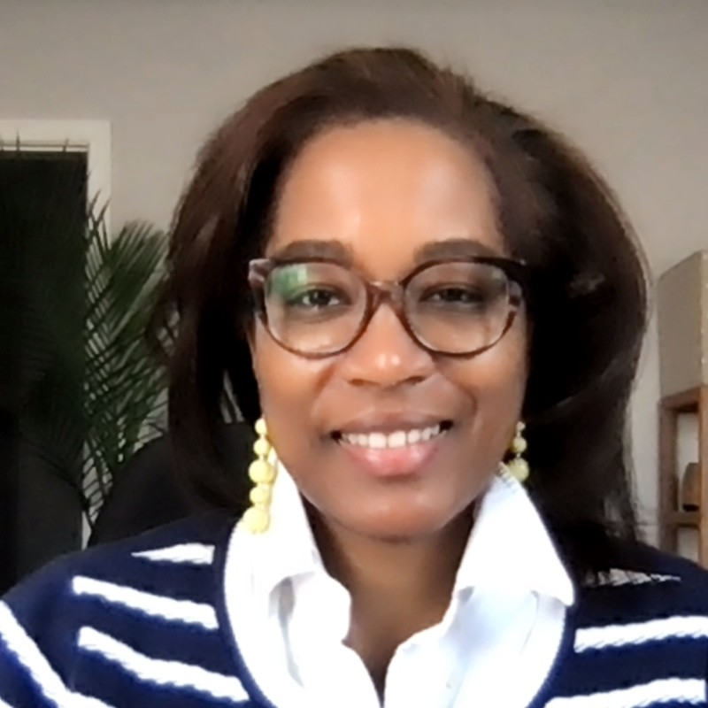


_{UMBC}
Department of Biological Sciences
_{Seminar}
Nykia D. Walker, PhD
UMBC
“Serendipitous Discovery of Tumor-Derived Extracellular Vesicle-Induced
Stromal Remodeling”
Wednesday, September 3, 2025
12pm - 1pm
BS 004
Visitors Welcome!
For information call: 410.455.2261
Email: Biology@UMBC.edu
Webpage: https://Biology.UMBC.edu

