Slide 1

Biology Council of Majors GBM
11/4/19

Slide 2
BioEthics Debate: Antibiotic Resistance Nov. 12, 7-9pm in Skylight Room in Commons
Dr. Jennifer Johnson is a Professor at the University of Maryland School of Medicine, Departments of Pathology, Epidemiology and Public Health as well as Microbiology and Immunology. She is also the Director of the Clinical Microbiology and Virology Laboratories at the University of Maryland Medical Center. She is a Diplomate of the American Board of Medical Microbiology and has expertise in the diagnosis of infectious disease. Her research focuses on the detection, transmission, and control of antimicrobial resistant organisms.
Dr. Ana Rule is a Professor at the Johns Hopkins Bloomberg School of Public Health, Department of Environmental Health and Engineering. She is also affiliated with the Johns Hopkins Education and Research Center for Occupational Safety and Health and the Particulate Matter Research Center. Her research focuses on the effects of exposure to biological aerosols and its relationship to antibiotic resistance development.
Pizza will be provided!

Slide 3
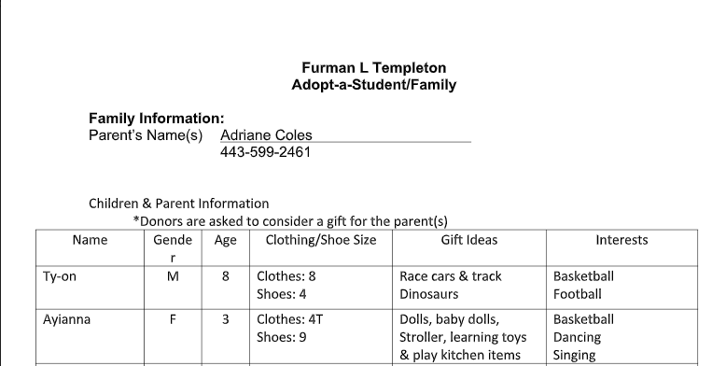
Christmas Families
Please consider donating an item (clothes, shoes, toys) for our Christmas family this year.
A sign up will be sent out later this week.
If you are interested in collaborating/paying for a gift with someone else, let us know.

Slide 4
Possible Lab Event for Next Semester
Dr. Wagner is willing to host an open lab next semester for BioCOM so you can learn valuable lab skills before you go into a lab or lab class.
Probably will be a Monday afternoon in early March.
Will send out an interest form when everyone has finished signing up for classes for next semester.

Slide 5


Now for our speakers!

