Slide 1
UMBC Chapter
ASME
Spring 2013

Slide 2
Why Are You Here Today?
2
ASME
Find Research
Resume Booster
ENES Report
1
3

Slide 3
The FIRST Thing You Should Know
1
About US

Slide 4
Who Belongs to ASME?
Mechanical Engineers
ASME
Chemical Eng.
+
Computer Eng.
+
Computer Sci.
+
Biomedical Eng.
+
Graphic Designers
+
Business Majors
We Are
INTERDISCIPLINARY

Slide 5
The SECOND Thing You Should Know
2
About US

Slide 6
Our Mission
Be one of those clubs that requires . . .
NOT
All members to attend every meeting to retain “active membership status”
Prospective members to attend X number of team-building exercise events to qualify for membership
Dozens of volunteer hours toward pointless tasks to qualify for membership
NOT
NOT

Slide 7
We Are Here . . .
YOU
To Help
Updating you on advancements in the field of Mechanical Engineering
Supply information that will guide your career/course focus
Relay relevant internship, REU, and on-campus employment opportunities
Serve as a conduit of human resources for your independent projects
Provide research opportunities in which you are the project investigator
That allow you to solidify your “big picture” seeing skills
Test-drive ideas that could become your senior design project
Maintain an online academic research portfolio, a tangible record of
your accomplishments for graduate schools and your own reference
during your career

Slide 8
The THIRD Thing You Should Know
3
About US

Slide 9
Engineers aren’t boring people. We just get really excited about boring things.
We Think
Dynamics
Mechanics
Statics

Slide 10
Test Yourself
So are you REALLY an engineer at heart?
See if you can sit through the next
without being mildly intrigued . . .
Mechanical Engineering
HIGHLIGHT

Slide 11
What Do These Have In Common?
Milk Bottles
Mission Impossible
Vogue
?

Slide 12
5 seconds

Slide 13
4 seconds

Slide 14
3 seconds

Slide 15
2 seconds

Slide 16
1 second

Slide 17
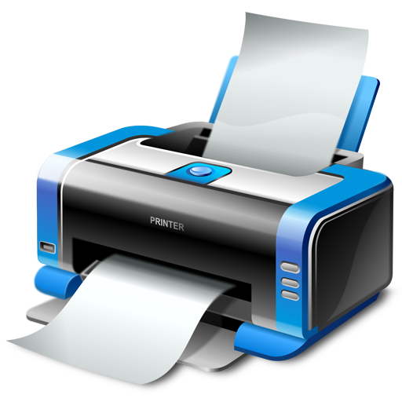
Give Up?
Here’s a Hint . . .
3D

Slide 18
CAD Meets Manufacturing
For those of you in ENES taking notes for a meeting report, you may have started learning something called:
→Computer Aided Design (CAD)
You could draw something in CAD
Use the same method utilized in ink jet printers to . . .
Deposit plastic in layers to match your design on the computer!
What IF

Slide 19
Mission Accepted
Use a 3D Scanner to input real life object into CAD
Use a 3D Printer to output CAD object into model

Slide 20
3D Printing is Exploding
The concept of 3D printing has been around for decades
The new thing?
Printers are becoming increasingly affordable
→ In fact, one of the ASME board members just bought one this year for personal use
What if everyone had one in their homes?

Slide 21
Infrastructure Change
What if you could customize, buy, download, and print out designs for physical objects online?
Toys
Furniture
Car parts
Clothes
Medical devices

Slide 22
Intricate Model Details

Slide 23
Precise Enough to Print Nanobots

Slide 24
Increasingly Fast Printing Speed

Slide 25
Readily Available Materials
Melted milk bottles

Slide 26
Water-tight Seals

Slide 27
Pre-Existing Community That Shares CAD Files

Slide 28
Easily Customizable

Slide 29
Personal Solutions with Professional Collaboration

Slide 30
Little to No Assembly Required

Slide 31
Make Unique Products

Slide 32
Endless Practical (and Impractical)Possibilities

Slide 33
Plastic is Now the Most Common Medium
Air Wolf Printer
Editable LabVIEW Drivers
Medium/Good Precision
$1700

Slide 34
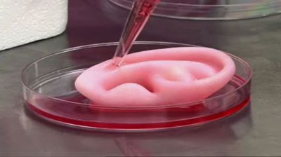
Experimental BioPrinting

Slide 35
In the Future
Cancerous Organs
Print New Ones
Face Lifts
Face Prints
So why stick with the same face? Mission Impossible face masks anyone . . .

Slide 36
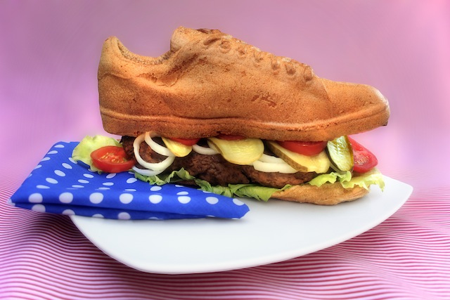
Edible Concoctions: Shoeburgers?

Slide 37
ASME
American Society of Mechanical Engineers
We want to help you
Achieve Your
Engineering Dreams

Slide 38
How to Join ASME
Go to www.asme.org
Click “Membership” at the top of the page
Click “Join Today” on the left hand side
Membership is free for freshmen!

Slide 39
Keep Track of UMBC ASME
Go to myUMBC
Click “Groups”
Click “Browse Groups”
Search for “ASME” and join
Meeting dates/location will be announced via Spotlights on this page

Slide 40
So What Are
We Doing NOW?

Slide 41
Mini-Bike
We will meet briefly after this GBM to exchange phone numbers and emails to keep everyone in the loop
Email Anthony Santini asantin1@umbc.edu
New game plan to be discussed in the next meeting

Slide 42
Dunk Tank
Building a dunk tank to rent out to fraternities/sororities
We will meet briefly after this GBM to exchange phone numbers and emails to keep everyone in the loop
Email Andrew Brow abrow1@umbc.edu
Next meeting: Thursday 2/21/13 at 4pm
Meet at commons front desk, then proceed to access the room

Slide 43
Hannah’s Ramps
Building two ramps for a 12 year old girl with brittle bone disease, so she’ll have privacy and independence
We will meet briefly after this GBM to exchange phone numbers and emails to keep everyone in the loop
Sponsored by V-LINC, Dr. Andy Conn
Email Mischa Bowen-Kreiner mischa1@umbc.edu
Next meeting: Friday 2/22/13 at 12pm
Meet at mechanical engineering conference room
Call for artists!

Slide 44
Let’s Go Boys and Girls
$300 stipend available for each position per semester with free transportation
Tuesdays 2:45-5:00PM
Club delivers hands-on STEM activities for students at Callaway ES in Baltimore
Email Joe DeAngelis joseph24@umbc.edu

Slide 45
ASME Relay for Life Team
Event Date: April 26-27, 6:00-7:00PM
Search www.relayforlife.org/umbcmd
Team Name: UMBC ASME
$10 Registration Fee (can be paid online or at event, then fundraise as much as possible
We can have team fundraising events)
Funds go to American Cancer Society, devoted to fighting cancer and helping those affected by it
Contact Jacob Alvarez alv3@umbc.edu

Slide 46
Join Us!
UMBC IEEE Student Branch Discussion Panel
Topic: Promoting Engineering at UMBC
When: This Wednesday 2/20/13 at 4:00-5:00PM
Where: ITE 201B
ASME and other engineering clubs will be represented; ask us your questions

Slide 47
Upcoming
Visit to General Electric Facility
Follow-up Panel with GE representatives in the Skylight Lounge in the Commons
Date: To be determined
Email: Morgan McClure morganm2@umbc.edu

Slide 48
Goals for the Semester
Institutionalize an “ASME Honor Society”, validating graduating ME’s with regalia during the graduation ceremony and an extra title to add to their resumes
Organize a system of online academic research portfolios that will solidify on-campus engineering community, provide an internet paper trail of accomplishments for graduate schools, and give students the chance to explore potential senior design project topics

Slide 49
Introducing Our New Team
Spring 2013

Slide 50
Dr. Anne Spence
Faculty Sponsor

Slide 51
Dr. Neil Rothman
Faculty Sponsor

Slide 52
Jason Dunthorn
Faculty Advisor

Slide 53
Emily Schultheis
President

Slide 54
Morgan McClure
Vice President

Slide 55
Anthony Santini
Secretary

Slide 56
John Graziano
Treasurer

Slide 57
Joe DeAngelis
Senior Board Member

Slide 58
Tom Carman
Senior Board Member

Slide 59
Jacob Alvarez
Inter-Club Coordinator

Slide 60
Andrew Brow
Student Project Manager

Slide 61
Andrew Ims
Student Project Manager

Slide 62
Nicole Racine
Leadership Board Member

Slide 63
Jason Ledesma
Leadership Board Member

Slide 64
Meet with Groups!

